Slide 1
Diagnosis of Diabetes Mellitus & Laboratory Investigations for Diabetes
Prof. Dato’ Dr. Mafauzy Mohamed
Professor of Medicine /
Senior Consultant Endocrinologist
Health Campus, Universiti Sains Malaysia

Slide 2
Screening & Diagnosis
Objective
To detect pre-diabetes and diabetes in the general as well as high-risk populations, whilst ensuring timely and appropriate interventions.
Strategy
Screening the general population for at risk individuals.
Screening of specific high-risk populations.

Slide 3
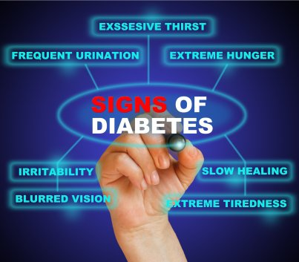
Who should be screened?
People with Symptoms & Signs
Polyuria
Polydypsia
Weight loss
Lethargy
Tiredness
Blurred Vision
Boils/abscesses
Pruritus Vulvae
DKA
Retinopathy
Nephropathy
Neuropathy
Foot ulcers/gangrene
Angina/MI/CVA

Slide 4
Who should be screened?
Asymptomatic
Adults who are overweight or obese (by BMI or waist circumference), and have one or more of the following additional risk factors:
First degree relative with diabetes
History of CVD
Hypertension
IGT or IFG
Abnormal HDL or TG
Other clinical conditions associated with insulin resistance
Women who delivered a baby weighing ≥4 kg, or had GDM
Women with PCOS
Physical inactivity
Special populations (e.g. those on ARV therapy or atypical antipsychotic drugs
Note: In those without these risk factors, testing should begin at the age of 30 years. If normal, repeat annually.

Slide 5
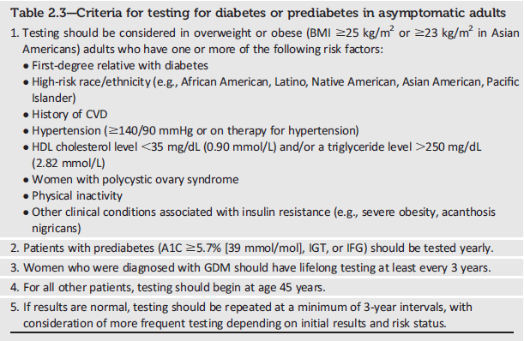
Testing for Diabetes or Prediabetes in Asymptomatic Adults
Classification and Diagnosis of Diabetes:
Standards of Medical Care in Diabetes - 2018. Diabetes Care 2018; 41 (Suppl. 1): S13-S27
Notes:
Because Table 2.3 was called out in the recommendation highlighted in the previous slide, lets take a quick look at the criteria for testing for diabetes or prediabetes in asymptomatic adults. As shown here, the criteria are as follows:
1. Testing should be considered in overweight or obese (BMI ≥25 kg/m2 or ≥23 kg/m2 in Asian Americans) adults who have one or more of the following risk factors:
First-degree relative with diabetes
High-risk race/ethnicity (e.g., African American, Latino, Native American, Asian American, Pacific Islander)
History of CVD
Hypertension (≥140/90 mmHg or on therapy for hypertension)
HDL cholesterol level <35 mg/dL (0.90 mmol/L) and/or a triglyceride level >250 mg/dL (2.82 mmol/L)
Women with polycystic ovary syndrome
Physical inactivity
Other clinical conditions associated with insulin resistance (e.g., severe obesity, acanthosis nigricans)
2. Patients with prediabetes (A1C ≥5.7% [39 mmol/mol], IGT, or IFG) should be tested yearly.
3. Women who were diagnosed with GDM should have lifelong testing at least every 3 years.
4. For all other patients, testing should begin at age 45 years.
5. If results are normal, testing should be repeated at a minimum of 3-year intervals, with consideration of more frequent testing depending on initial results and risk status.
[SLIDE]
5
Reference
American Diabetes Association. Standards of medical care in diabetes—2014. Diabetes Care 2014;37(suppl 1):S15; Table 2

Slide 6
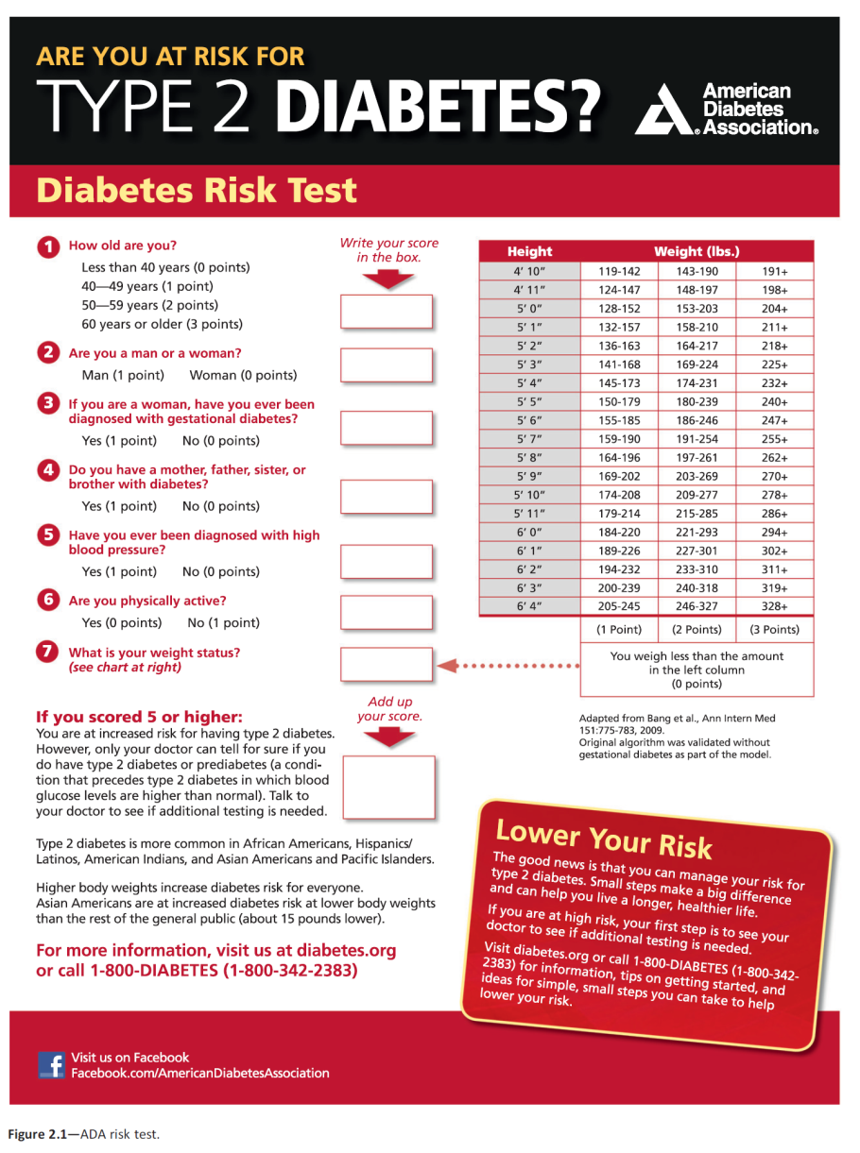
Notes:
An additional option for screening is provided in the ADA Diabetes Risk Test, which can be accessed online at diabetes dot org backslash soc risk test (diabetes.org/socrisktest)
[SLIDE]

Slide 7
Screening Test
Screening can be done by measuring either venous or capillary blood using glucometer.
Tests that can be performed are HbA1c, OGTT, FPG or RPG.

Slide 8
Prediabetes: Recommendations (2)
If tests are normal, repeat testing carried out at a minimum of 3-year intervals is reasonable. C
To test for prediabetes, fasting plasma glucose, 2-h plasma glucose during 75-g oral glucose tolerance test, and A1C are equally appropriate. B
In patients with prediabetes, identify and, if appropriate, treat other cardiovascular disease risk factors. B
Classification and Diagnosis of Diabetes:
Standards of Medical Care in Diabetes - 2018. Diabetes Care 2018; 41 (Suppl. 1): S13-S27
Notes:
Returning to the recommendations in section 2 that relate to prediabetes, the following are additional recommendations are provided:
If tests are normal, repeat testing carried out at a minimum of 3-year intervals is reasonable. . [CLICK]
To test for prediabetes, fasting plasma glucose, 2-h plasma glucose during 75-g oral glucose tolerance test, and A1C are equally appropriate. [CLICK]
In patients with prediabetes, identify and, if appropriate, treat other cardiovascular disease risk factors.
[SLIDE]
8

Slide 9
Prediabetes: Recommendations (3)
Testing for prediabetes should be considered in children and adolescents who are overweight or obese (BMI >85th percentile for age and sex, weight for height >85th percentile, or weight >120% of ideal for height) and who have additional risk factors for diabetes (Table 2.5). E
Classification and Diagnosis of Diabetes:
Standards of Medical Care in Diabetes - 2018. Diabetes Care 2018; 41 (Suppl. 1): S13-S27
Notes:
And lastly:
Testing for prediabetes should be considered in children and adolescents who are overweight or obese (BMI >85th percentile for age and sex, weight for height >85th percentile, or weight >120% of ideal for height) and who have additional risk factors for diabetes (Table 2.5).
Let’s now take a look at Table 2.5.
[SLIDE]
9

Slide 10
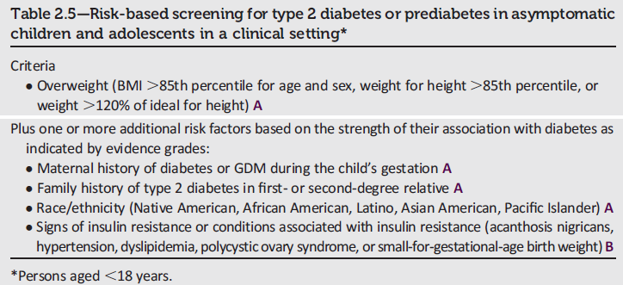
Risk-Based Screening in Asymptomatic Children and Adolescents
Classification and Diagnosis of Diabetes:
Standards of Medical Care in Diabetes - 2018. Diabetes Care 2018; 41 (Suppl. 1): S13-S27
Notes:
Table 2.5 provides information for risk-based screening for type 2 diabetes or prediabetes in asymptomatic children and adolescents, defined as persons under the age of 18 years. The criteria are as follows:
Criteria:
Overweight (BMI >85th percentile for age and sex, weight for height >85th percentile, or weight >120% of ideal for height) A
Plus one or more additional risk factors based on the strength of their association with diabetes as indicated by evidence grades:
Maternal history of diabetes or GDM during the child’s gestation A
Family history of type 2 diabetes in first- or second-degree relative A
Race/ethnicity (Native American, African American, Latino, Asian American, Pacific Islander) A
Signs of insulin resistance or conditions associated with insulin resistance (acanthosis nigricans, hypertension, dyslipidemia, polycystic ovary syndrome, or small-for-gestational-age birth weight) B
[SLIDE]
10

Slide 11
Algorithm 1: Screening for T2D in Symptomatic Individuals
WITH SYMPTOMS
Venous Plasma Glucose
Fasting
Random
<7.0
≥7.0
≥11.1
<11.1
OGTT
OGTT
Type 2 Diabetes Mellitus

Slide 12
Algorithm 2: Screening for T2DM in Asymptomatic Individuals
ASYMPTOMATIC WITH RISK
Capillary Random Blood Glucose
<5.6
≥5.6
Venous RPG
Venous FPG
<7.8
7.8–11.0
NORMAL
NORMAL
OGTT
≥11.1
<6.1
6.1–6.9
≥7.0
Second FPG
Second RPG
NORMAL
<7.0
≥7.0
≥11.1
OGTT
DM
DM
FPG
2-hour PPG
<6.1
6.1–6.9
≥7.0
<7.8
7.8–11.0
≥11.1
NORMAL
IFG
DM
NORMAL
IGT
DM

Slide 13
DM Diagnostic Criteria
Criteria For Diabetes Diagnosis
1. A1C ≥ 6.3%. The test should be performed in a laboratory using a method that is NGSP certified and standardized to the DCCT assay.
2. FPG ≥ 7.0 mmol/l. Fasting is defined as no caloric intake for at least 8 hr.
3. 2-hr plasma glucose ≥ 11.1 mmol/l during an OGTT. The test should be performed as described by the World Health Organization, using a glucose load containing the equivalent of 75 g of anhydrous glucose dissolved in water.
In a patient with classic symptoms of hyperglycemia or hyperglycemic crisis, a random plasma glucose ≥ 11.1 mmol/l.
5. Any of 4 but 1-3 should be confirmed by repeat testing. Diabetes Care January 2010 vol. 33 no. Supplement 1 S62-S69

Slide 14
Diagnosis: Diabetes Mellitus
Symptoms of diabetes (polydipsia, polyuria, unexplained weight loss) PLUS a random plasma glucose > 11.1 mmol/L
        or
Fasting plasma glucose > 7.0 mmol/L after overnight (at least 8 hours) fast
        or
Two-hour plasma glucose > 11.1 mmol/L during a standard 75g oral glucose tolerance test
        or
A1c Level of ≥ 6.3 % (CPG T2DM 2015).
The A1c test should be performed in a laboratory using a method that is NGSP certified and standardised to the DCCT assay.
Any of these criteria establishes the diagnosis however FPG & OGTT needs to be confirmed on a later day if asymptomatic

Slide 15
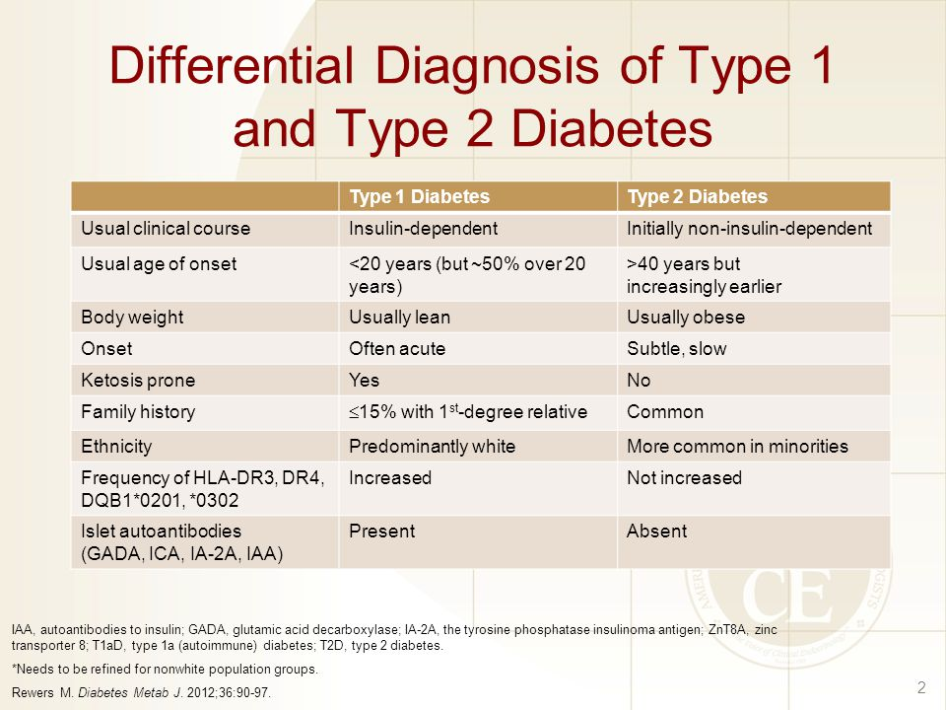

Slide 16
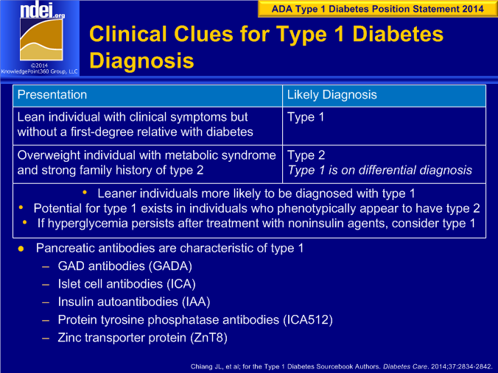

Slide 17
Pancreatic islet autoantibodies
Of all T1D patients,
~ 90% ICA positive
50%–80% GADA-positive
30%–70% IA-2A-positive
50%–70% ZnT8-positive
50%–90% IAA-positive

Slide 19
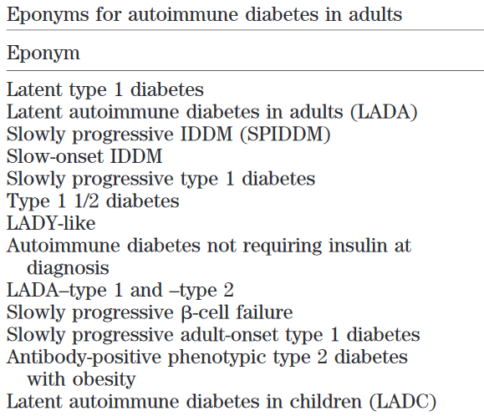
Latent Autoimmune Diabetes in Adults (LADA)

Slide 20
despite the presence of islet antibodies at diagnosis of diabetes, the progression of autoimmune β-cell failure is slow
not insulin requiring, at least during the first 6 months after diagnosis of diabetes

Slide 21
C-Peptide
Part of proinsulin which is cleaved prior to co-secretion with insulin
Produced in equimolar amounts to endogenous insulin
Widely used as measure of insulin secretion
Degradation rate slower than that of insulin → stable test window of beta cell response
Negligible hepatic clearance
No cross-reaction of assay with exogenous insulin

Slide 22
C-Peptide
Correlates with type of disease, duration of diabetes & age of diagnosis
Level is most appropriate outcome measure for preservation of beta cell function
Measurement recommended when there is doubt over the diagnosis T1 or T2DM

Slide 23
Urinalysis
Glucose
Protein
Albumin to Creatinine Ratio (UACR) - correct for variations in urinary concentration due to hydration as well as provide more convenience than timed urine collections
Ketones

Slide 24
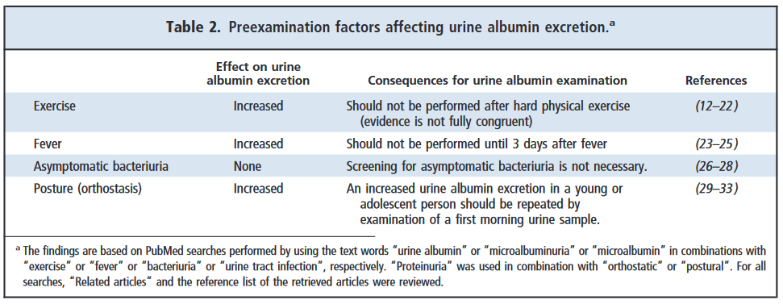

Slide 25
Diagnostic values – A1c
 | Normal | Pre-diabetes | Diabetes
A1c | <5.6% (<38 mmol/mol) | 5.6 – 6.2% (38 – 44 mmol/mol) | ≥6.3% (≥45 mmol/mol)
These values are based on currently available data for Malaysia.
For a precise classification of pre-diabetes, an OGTT is recommended.
A repeat A1c should be done 4 weeks after the first positive test for asymptomatic patients.
For symptomatic patients, a single positive test is sufficient.

Slide 26
Recognize pitfalls of A1C: conditions that can affect value
Factors affecting A1C | Increased A1C | Decreased A1C | Variable Change in A1C
Erythropoiesis | B12/Fe deficiency Decreased erythropoiesis | Use of EPO, Fe, or B12 Reticulocytosis Chronic liver Dx
Altered hemoglobin |  |  | Fetal hemoglobin Hemoglobinopathies Methemoglobin
Altered glycation | Chronic renal failure ↓↓erythrocyte pH | ASA, vitamin C/E Hemoglobinopathies ↑ erythrocyte pH
Erythrocyte destruction | Splenectomy | Hemoglobinopathies Chronic renal failure Splenomegaly Rheumatoid arthritis HAART meds, Ribavirin Dapsone
Assays | Hyperbilirubinemia Carbamylated Hb ETOH Chronic opiates | Hypertriglyceridemia
Notes:
Script:
While HbA1c is an excellent measure for diagnosis, it is essential to know conditions where the value may not adequate reflect true glycemic control and other measures such as fasting blood sugar or OGTT may be more helpful.
Important conditions where the rate of red blood cell turnover is significantly shortened or extended, or the structure of hemoglobin is altered, A1C may not accurately reflect glycemic status
This includes common conditions such as B12 and Fe deficiency that can falsely increase hbA1c and also increased red cell turn over states and factors that increase erthropoeisis such as use of EPO, Fe, B12 deficiency – which can falsely lower hbA1c.
So While HbA1c is convenient for patients understanding the factors that affect the accuracy of it’s ability to diagnose diabetes.
TT: point of slide is to teach practionners to recognize common pitfalls and conditions where HbA1c might not be an accurate measure to use for diagnosis.

Slide 27
Pros and Cons of Diagnostic Tests
Test | Advantages | Disadvantages
FPG | Established standard Fast and easy Single Sample | Sample not stable Day-to-day variability Inconvenient to fast Glucose homeostasis in single time point
2hPG in 75 g OGTT | Established standard | Sample not stable Day-to-day variability Inconvenient, Unpalatable Cost
A1C | Convenient Single sample Low day-to-day variability Reflects long term [glucose] | Cost Affected by haemoglobinopathies Standardised, validated assay required Not used for age <18, pregnant women or suspected T1DM
Notes:
Script:
While all 3 approaches predict microvascular disease and can be used for diagnosis, A1c may be a better predictor of macrovascular disease. The decision of which test to use for diabetes diagnosis is left to clinical judgment. Each diagnostic test has advantages and disadvantages
TT: Slide compares the advantages and disadvantages of the different tests.

Slide 28
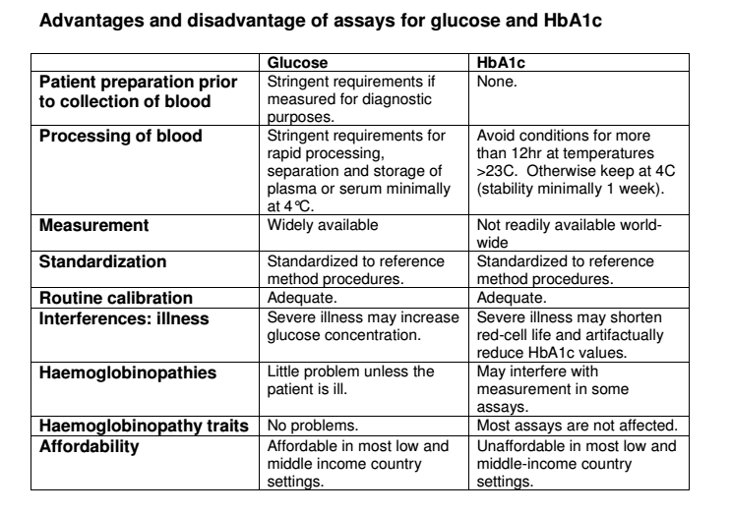
Use of Glycated Haemoglobin (HbA1c) in the Diagnosis of Diabetes Mellitus
Abbreviated Report of a WHO Consultation 2011.

Slide 29
Diagnosis of GDM
GDM is diagnosed in the presence of any one of these results:
FPG ≥ 5.1 mmol/L
2-hour post-prandial (2-HPP) ≥ 7.8 mmol/L

Slide 30
Gestational Diabetes Mellitus (GDM): Recommendations
Test for undiagnosed diabetes at the 1st prenatal visit in those with risk factors, using standard diagnostic criteria. B
Test for GDM at 24–28 weeks of gestation in pregnant women not previously known to have diabetes. A
Test women with GDM for persistent diabetes at 4–12 weeks postpartum, using the OGTT and clinically appropriate nonpregnancy diagnostic criteria. E
Classification and Diagnosis of Diabetes:
Standards of Medical Care in Diabetes - 2018. Diabetes Care 2018; 41 (Suppl. 1): S13-S27
Notes:
Recommendations for the detection and diagnosis of gestational diabetes mellitus (GDM) are summarized on two slides;
First, because of the number of pregnant women with undiagnosed type 2 diabetes, it is reasonable to test women with risk factors for type 2 at the first prenatal visit, using standard diagnostic criteria. B [CLICK]
Test for GDM at 24–28 weeks of gestation in pregnant women not previously known to have diabetes. A [CLICK]
Test women with GDM for persistent diabetes at 4–12 weeks postpartum, using the OGTT and clinically appropriate nonpregnancy diagnostic criteria. E
[SLIDE]
30
References
Lawrence JM, Contreras R, Chen W, Sacks DA. Trends in the prevalence of preexisting diabetes and gestational diabetes mellitus among a racially/ethnically diverse population of pregnant women, 1999-2005. Diabetes Care 2008;31:899–904
American Diabetes Association. Standards of medical care in diabetes—2014. Diabetes Care 2014;37(suppl 1):S18

Slide 31
Gestational Diabetes Mellitus (GDM): Recommendations (2)
Women with a history of GDM should have lifelong screening for the development of diabetes or prediabetes at least every 3 years. B
Women with a history of GDM found to have prediabetes should receive intensive lifestyle interventions or metformin to prevent diabetes. A
Classification and Diagnosis of Diabetes:
Standards of Medical Care in Diabetes - 2018. Diabetes Care 2018; 41 (Suppl. 1): S13-S27
Notes:
And finally,
Women with a history of GDM should have lifelong screening for the development of diabetes or prediabetes at least every 3 years. [CLICK]
Women with a history of GDM found to have prediabetes should receive intensive lifestyle interventions or metformin to prevent diabetes.
[SLIDE]
31
References
Lawrence JM, Contreras R, Chen W, Sacks DA. Trends in the prevalence of preexisting diabetes and gestational diabetes mellitus among a racially/ethnically diverse population of pregnant women, 1999–2005. Diabetes Care 2008;31:899–904
American Diabetes Association. Standards of medical care in diabetes—2014. Diabetes Care 2014;37(suppl 1):S15–S16

Slide 32
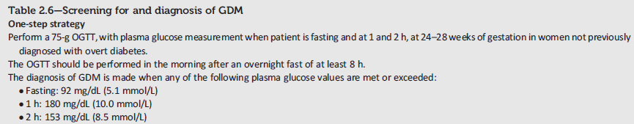
Screening and Diagnosis of GDM: One-Step Strategy
Classification and Diagnosis of Diabetes:
Standards of Medical Care in Diabetes - 2018. Diabetes Care 2018; 41 (Suppl. 1): S13-S27
Notes:
A diagnosis of gestational diabetes can be accomplished with either of two strategies, which we’ll walk through now.
First, the one-step strategy, which consists of a 75g OGTT:
In women between 24 and 28 weeks gestation not previously diagnosed with overt diabetes, perform a 75-g OGTT in the morning after an overnight fast of at least 8 hours.
Measure plasma glucose measurement fasting and at 1 and 2 hours.
Gestational diabetes is diagnosed if the fasting glucose is higher than 92 mg per dL, if the 1 hour glucose is higher than 180, or if the 2 hour is over 153.
[SLIDE]
32
References
American Diabetes Association. Standards of medical care in diabetes—2014. Diabetes Care 2014;37(suppl 1):S19; Table 6
Metzger BE, Lowe LP, Dyer AR, et al, for the HAPO Study Cooperative Research Group. Hyperglycemia and adverse pregnancy outcomes. N Engl J Med 2008;358:1991–2002
Metzger BE, Gabbe SG, Persson B, et al, for the International Association of Diabetes and Pregnancy Study Groups Consensus Panel. International Association of Diabetes and Pregnancy Study Groups recommendations on the diagnosis and classification of hyperglycemia in pregnancy. Diabetes Care 2010;33:676–682

Slide 33
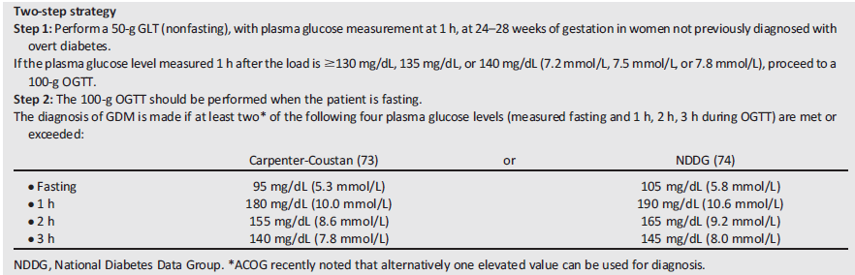
Screening and Diagnosis of GDM: Two-Step Strategy
Classification and Diagnosis of Diabetes:
Standards of Medical Care in Diabetes - 2018. Diabetes Care 2018; 41 (Suppl. 1): S13-S27
Notes:
And here’s the 2-step strategy recommended by NIH.
Step 1:
First, perform a 50-g GLT (nonfasting), with plasma glucose measurement at 1 h, at 24–28 weeks of gestation in women not previously diagnosed with overt diabetes
If the plasma glucose level measured 1 h after the load is ≥140 mg/dL, proceed to Step 2, the 100-g OGTT
Step 2:
If the non-fasted 1-hour glucose is 140 or above, then perform the 100-g OGTT. This one is fasting, and GDM is diagnosed if at least two of the four plasma glucose criteria (measured fasting and 1h, 2h, 3h during OGTT) are met or exceeded, as illustrated in the table within this slide.
[SLIDE]
33
References
American Diabetes Association. Standards of medical care in diabetes—2014. Diabetes Care 2014;37(suppl 1):S19; Table 6
Vandorsten JP, Dodson WC, Espeland MA, et al. NIH consensus development conference: diagnosing gestational diabetes mellitus. NIH Consens State Sci Statements 2013;29:1–31

Slide 34
Guideline Criteria for the Diagnosis of Prediabetes
Criteria | ADA 2018¹ | CPG T2DM 2015² | AACE 2015³ | WHO 2016⁴
Prediabetes diagnosis criteria | FPG: 100 mg/dL (5.6 mmol/L) to 125 mg/dL (6.9 mmol/L; IFG) OR 2-h PG during 75-g OGTT: 140 mg/dL (7.8 mmol/L) to 199 mg/dL (11.0 mmol/L; IGT) OR A_{1c}: 5.7%–6.4% (39–47 mmol/mol) | Patients with IFG and/or IGT and/or A_{1c} 5.6%–6.2% are considered prediabetic | IFG FPG: ≥100–125 mg/dL IGT 2-h PG ≥140–199 mg/dL A_{1c} 5.5%–6.4% | IFG FPG: ≥110–125 mg/dL IGT 2-h PG: ≥140-200 mg/dL
ADA: American Diabetic Association; CPG T2DM: Clinical Practice Guidelines Type 2 Diabetes Mellitus; AACE: American Association of Clinical Endocrinologists; WHO: World Health Organization; FPG: Fasting plasma glucose; A_{1c}: Glycated hemoglobin; IFG: Impaired fasting glucose; PG: Postprandial glucose; OGTT: Oral glucose tolerance test; IGT: Impaired glucose tolerance.
1. American Diabetes Association. Diabetes Care. 2018;41(1):S51-554. 2. Malaysian T2DM guidelines clinical practice guideline. 2015. 3. Handelsman Y, et al. End Pract. 2015;21(1):1-87. 4. World Health Organization. Global report on diabetes, 2016.
Notes:
Prediabetes, typically defined as blood glucose levels above normal but below diabetes thresholds, denotes a risk state that defines a high chance of developing diabetes. According to the World Health Organization (WHO), a high risk of developing diabetes is related to two distinct factors, impaired fasting glucose (IFG) and impaired glucose tolerance (IGT); in addition, the American Diabetes Association (ADA) has introduced hemoglobin A_{1c} levels as a new category of high diabetes risk, apart from IFG and IGT. The above slide shows prediabetes thresholds defined by the WHO, ADA, Clinical Practice Guidelines Type 2 Diabetes (CPG T2DM) 2015, Malaysia, and American Association of Clinical Endocrinologists.^{1–4}
References
American Diabetes Association. Prevention or delay of type 2 diabetes: Standards of medical care in diabetes. Diabetes Care. 2018;41(1):S51-S54.
Malaysian T2DM guidelines clinical practice guideline. March 2016, 5th edn. MOH/P/PAK/303.15(GU). Available at: http://www.moh.gov.my/penerbitan/CPG/CPG%20T2DM%202015.pdf. Accessed on: 31 Aug 2018.
Handelsman Y, Bloomgarden ZT, Grunberger G, et al. American Association of Clinical Endocrinologists and American College of Endocrinology–clinical practice guidelines for developing a diabetes mellitus comprehensive care plan–2015. End Pract. 2015;21(1):1-87.
World Health Organization. Global report on diabetes. World Health Organization; 2016. Available at: http://apps.who.int/iris/bitstream/handle/10665/204871/9789241565257_eng.pdf;jsessionid=1D69407D222692F642248EA473DD1D30?sequence=1. Accessed on: 31 Aug 2018.

Slide 35
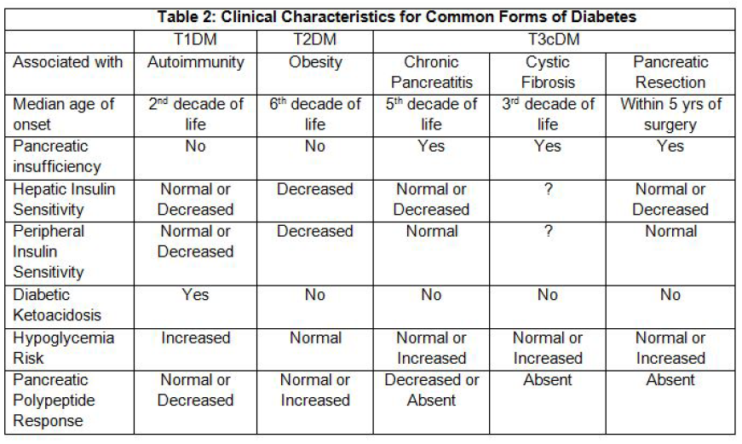
Gudipaty & Rickels Pancreapedia Sep 1, 2015 [DOI: 10.3998/panc.2015.35]

Slide 36
