Slide 1
Epidemiology & Types of Diabetes
Prof. Dato’ Dr. Mafauzy Mohamed
Professor of Medicine /
Senior Consultant Endocrinologist
Health Campus, Universiti Sains Malaysia

Slide 2
What Is Diabetes Mellitus?
Diabetes is a chronic, metabolic disease characterized by elevated levels of blood glucose, which leads over time to serious damage to the heart, blood vessels, eyes, kidneys and nerves
World Health Organization

Slide 3
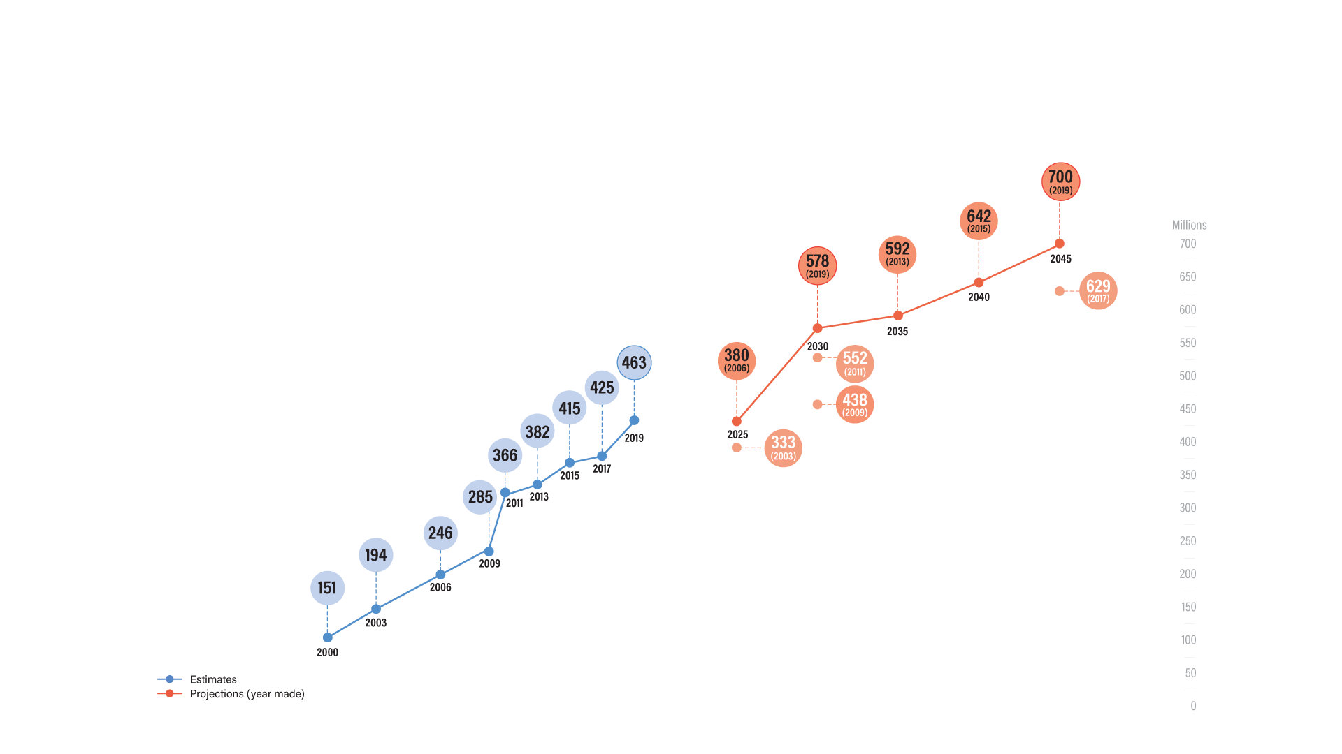
Diabetes around the world
Estimates and projections of the global prevalence of
diabetes in the 20–79 year age group (millions)

Slide 4
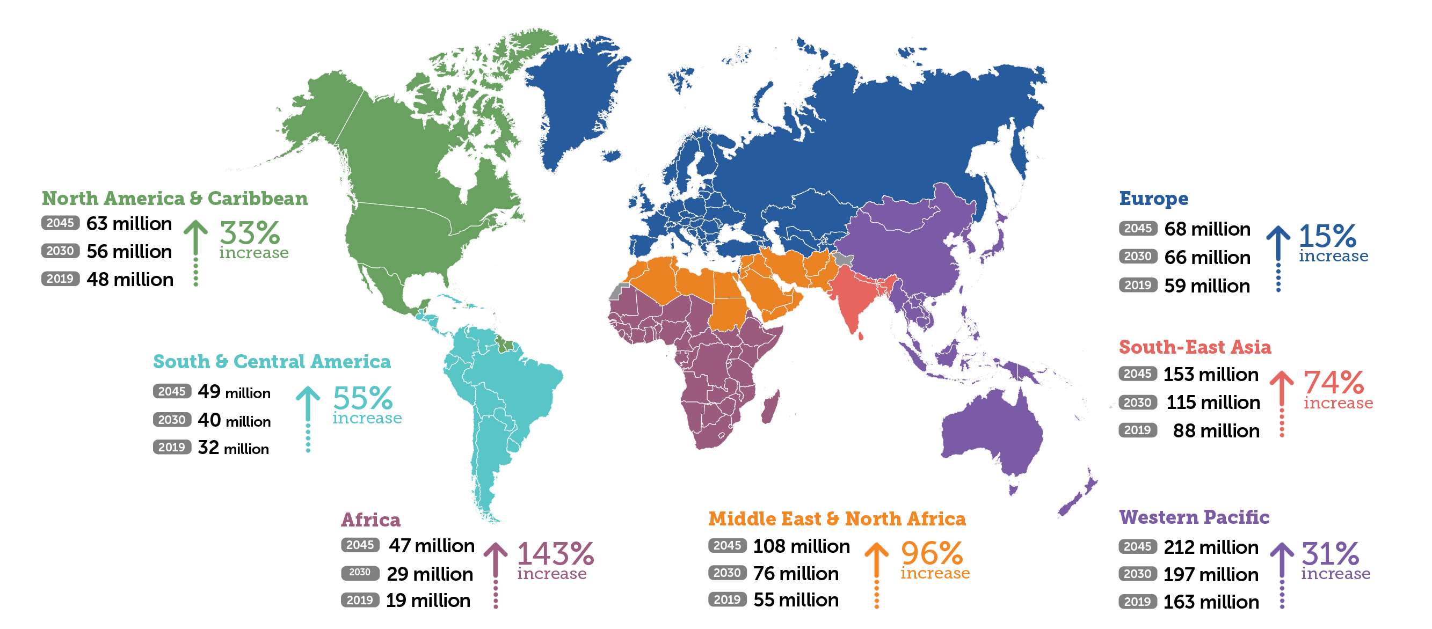
Diabetes around the world
Number of people (20-79 years) with diabetes globally and by IDF Region

Slide 5
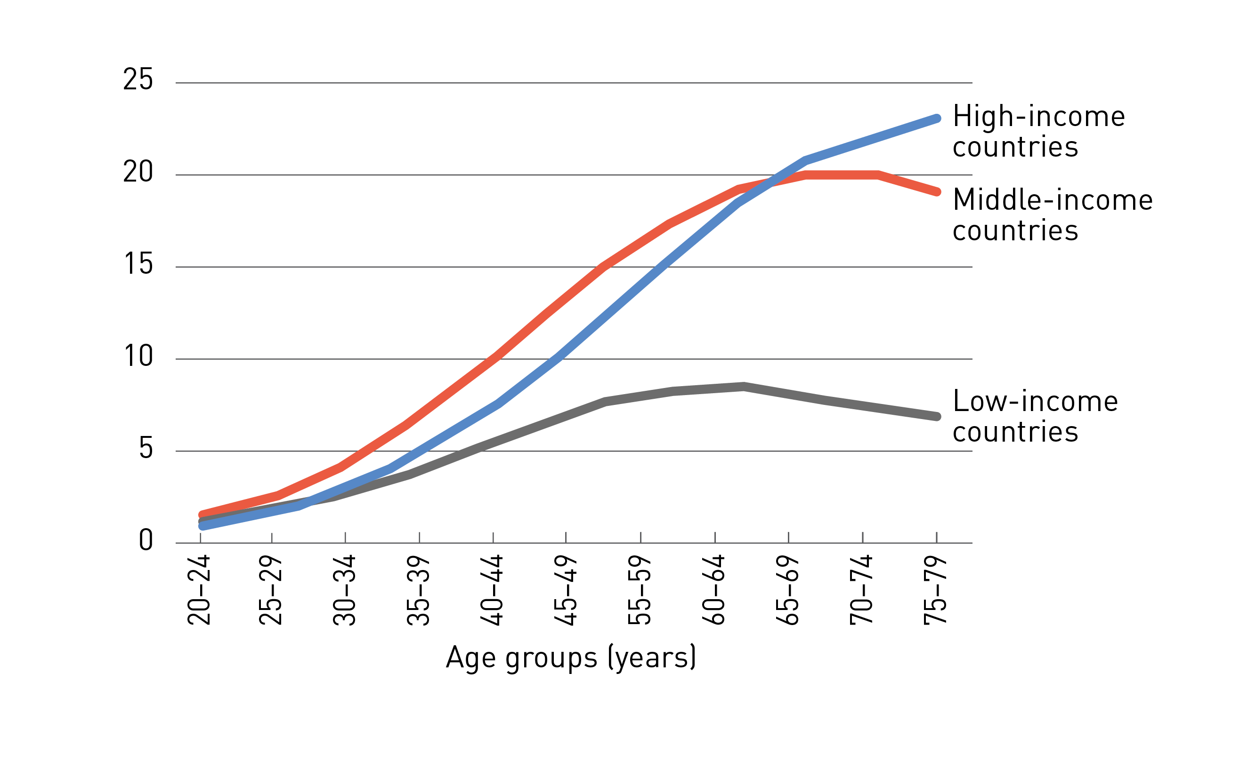
Prevalence of people with diabetes by age and income group (%), 2019

Slide 6
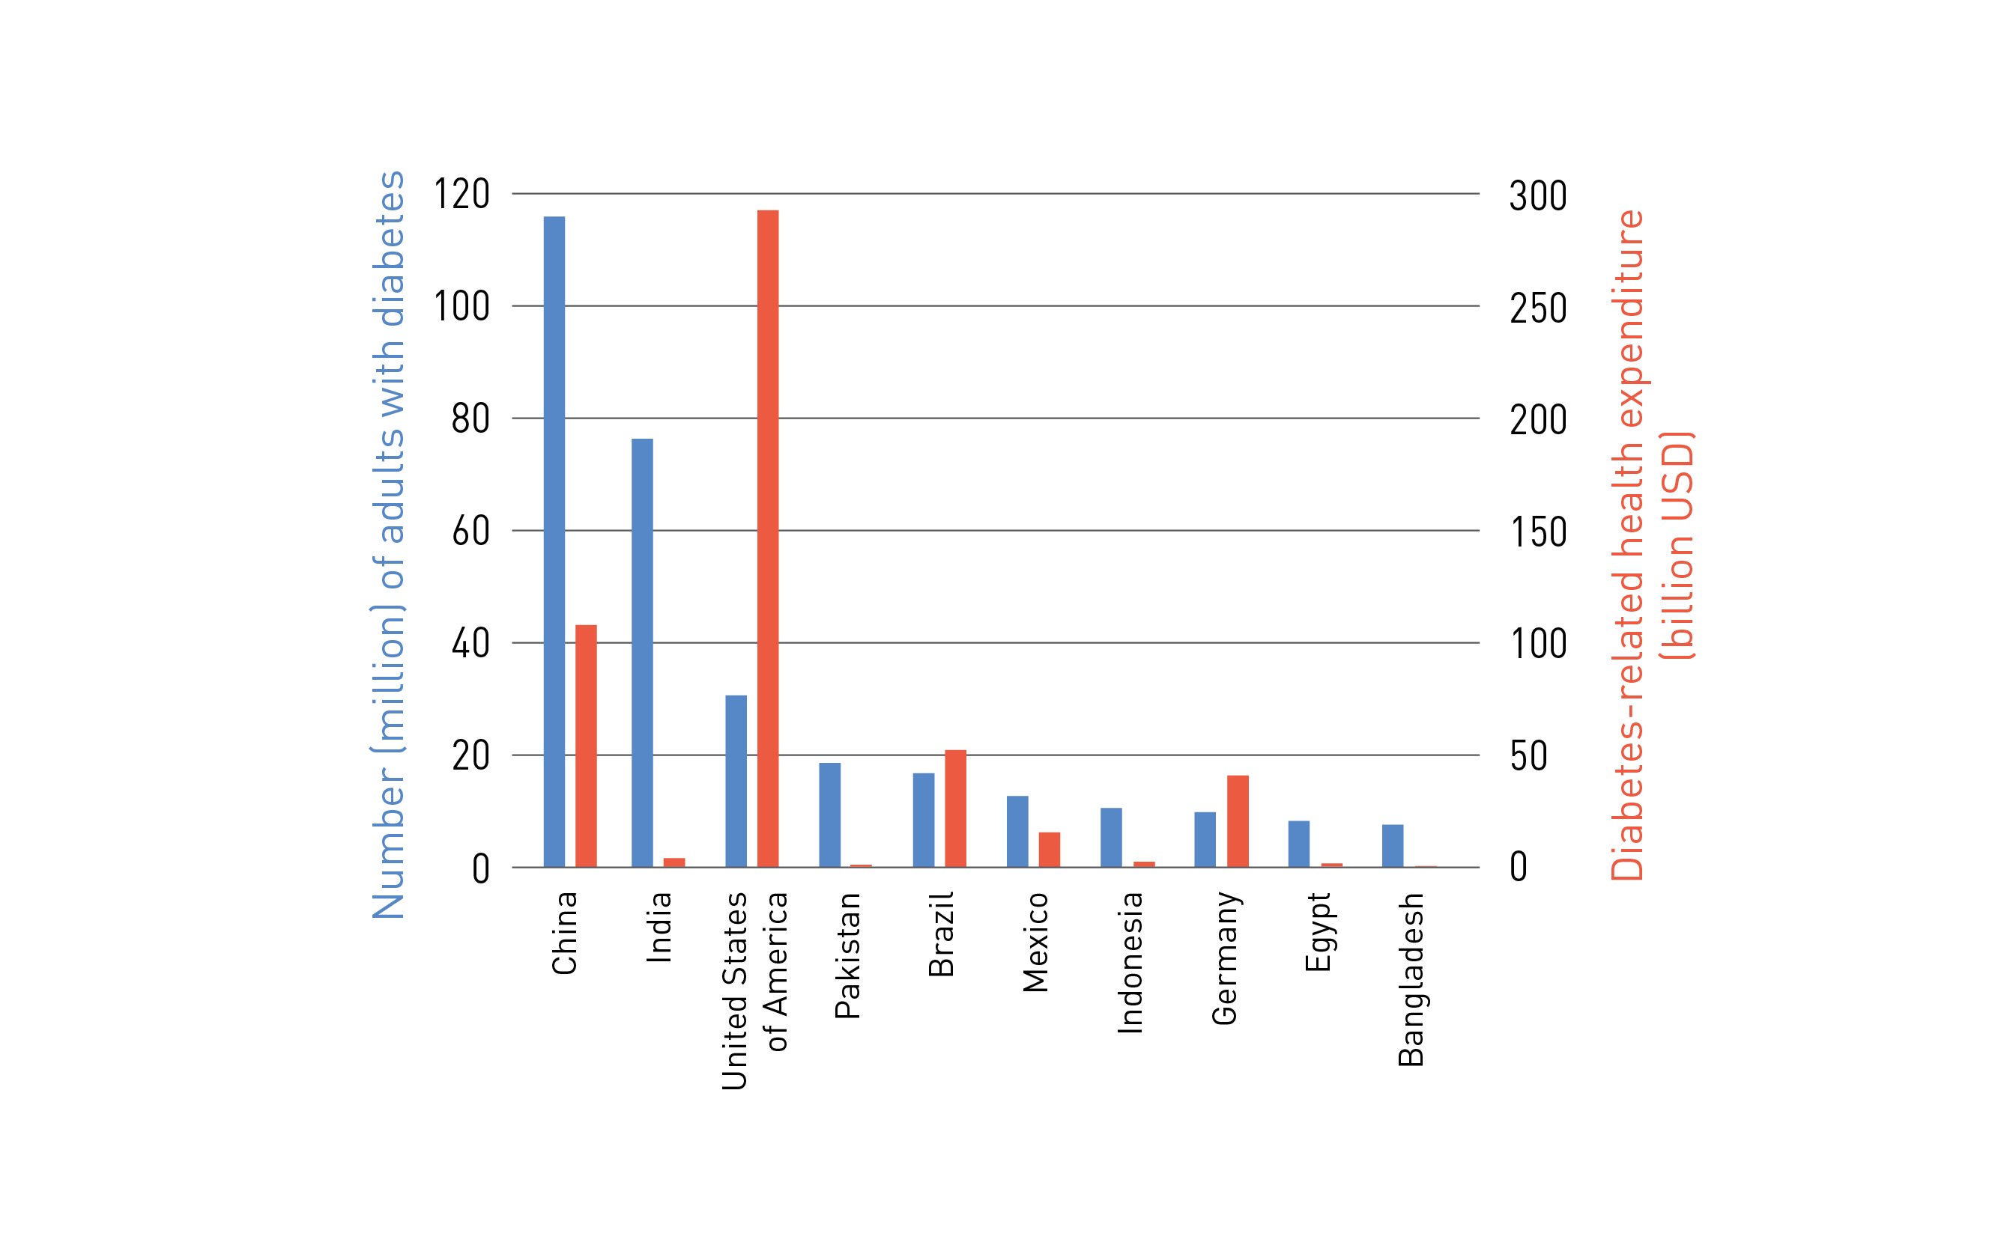
Top 10 countries with diabetes (20-79 years) and their health expenditure, 2019

Slide 7

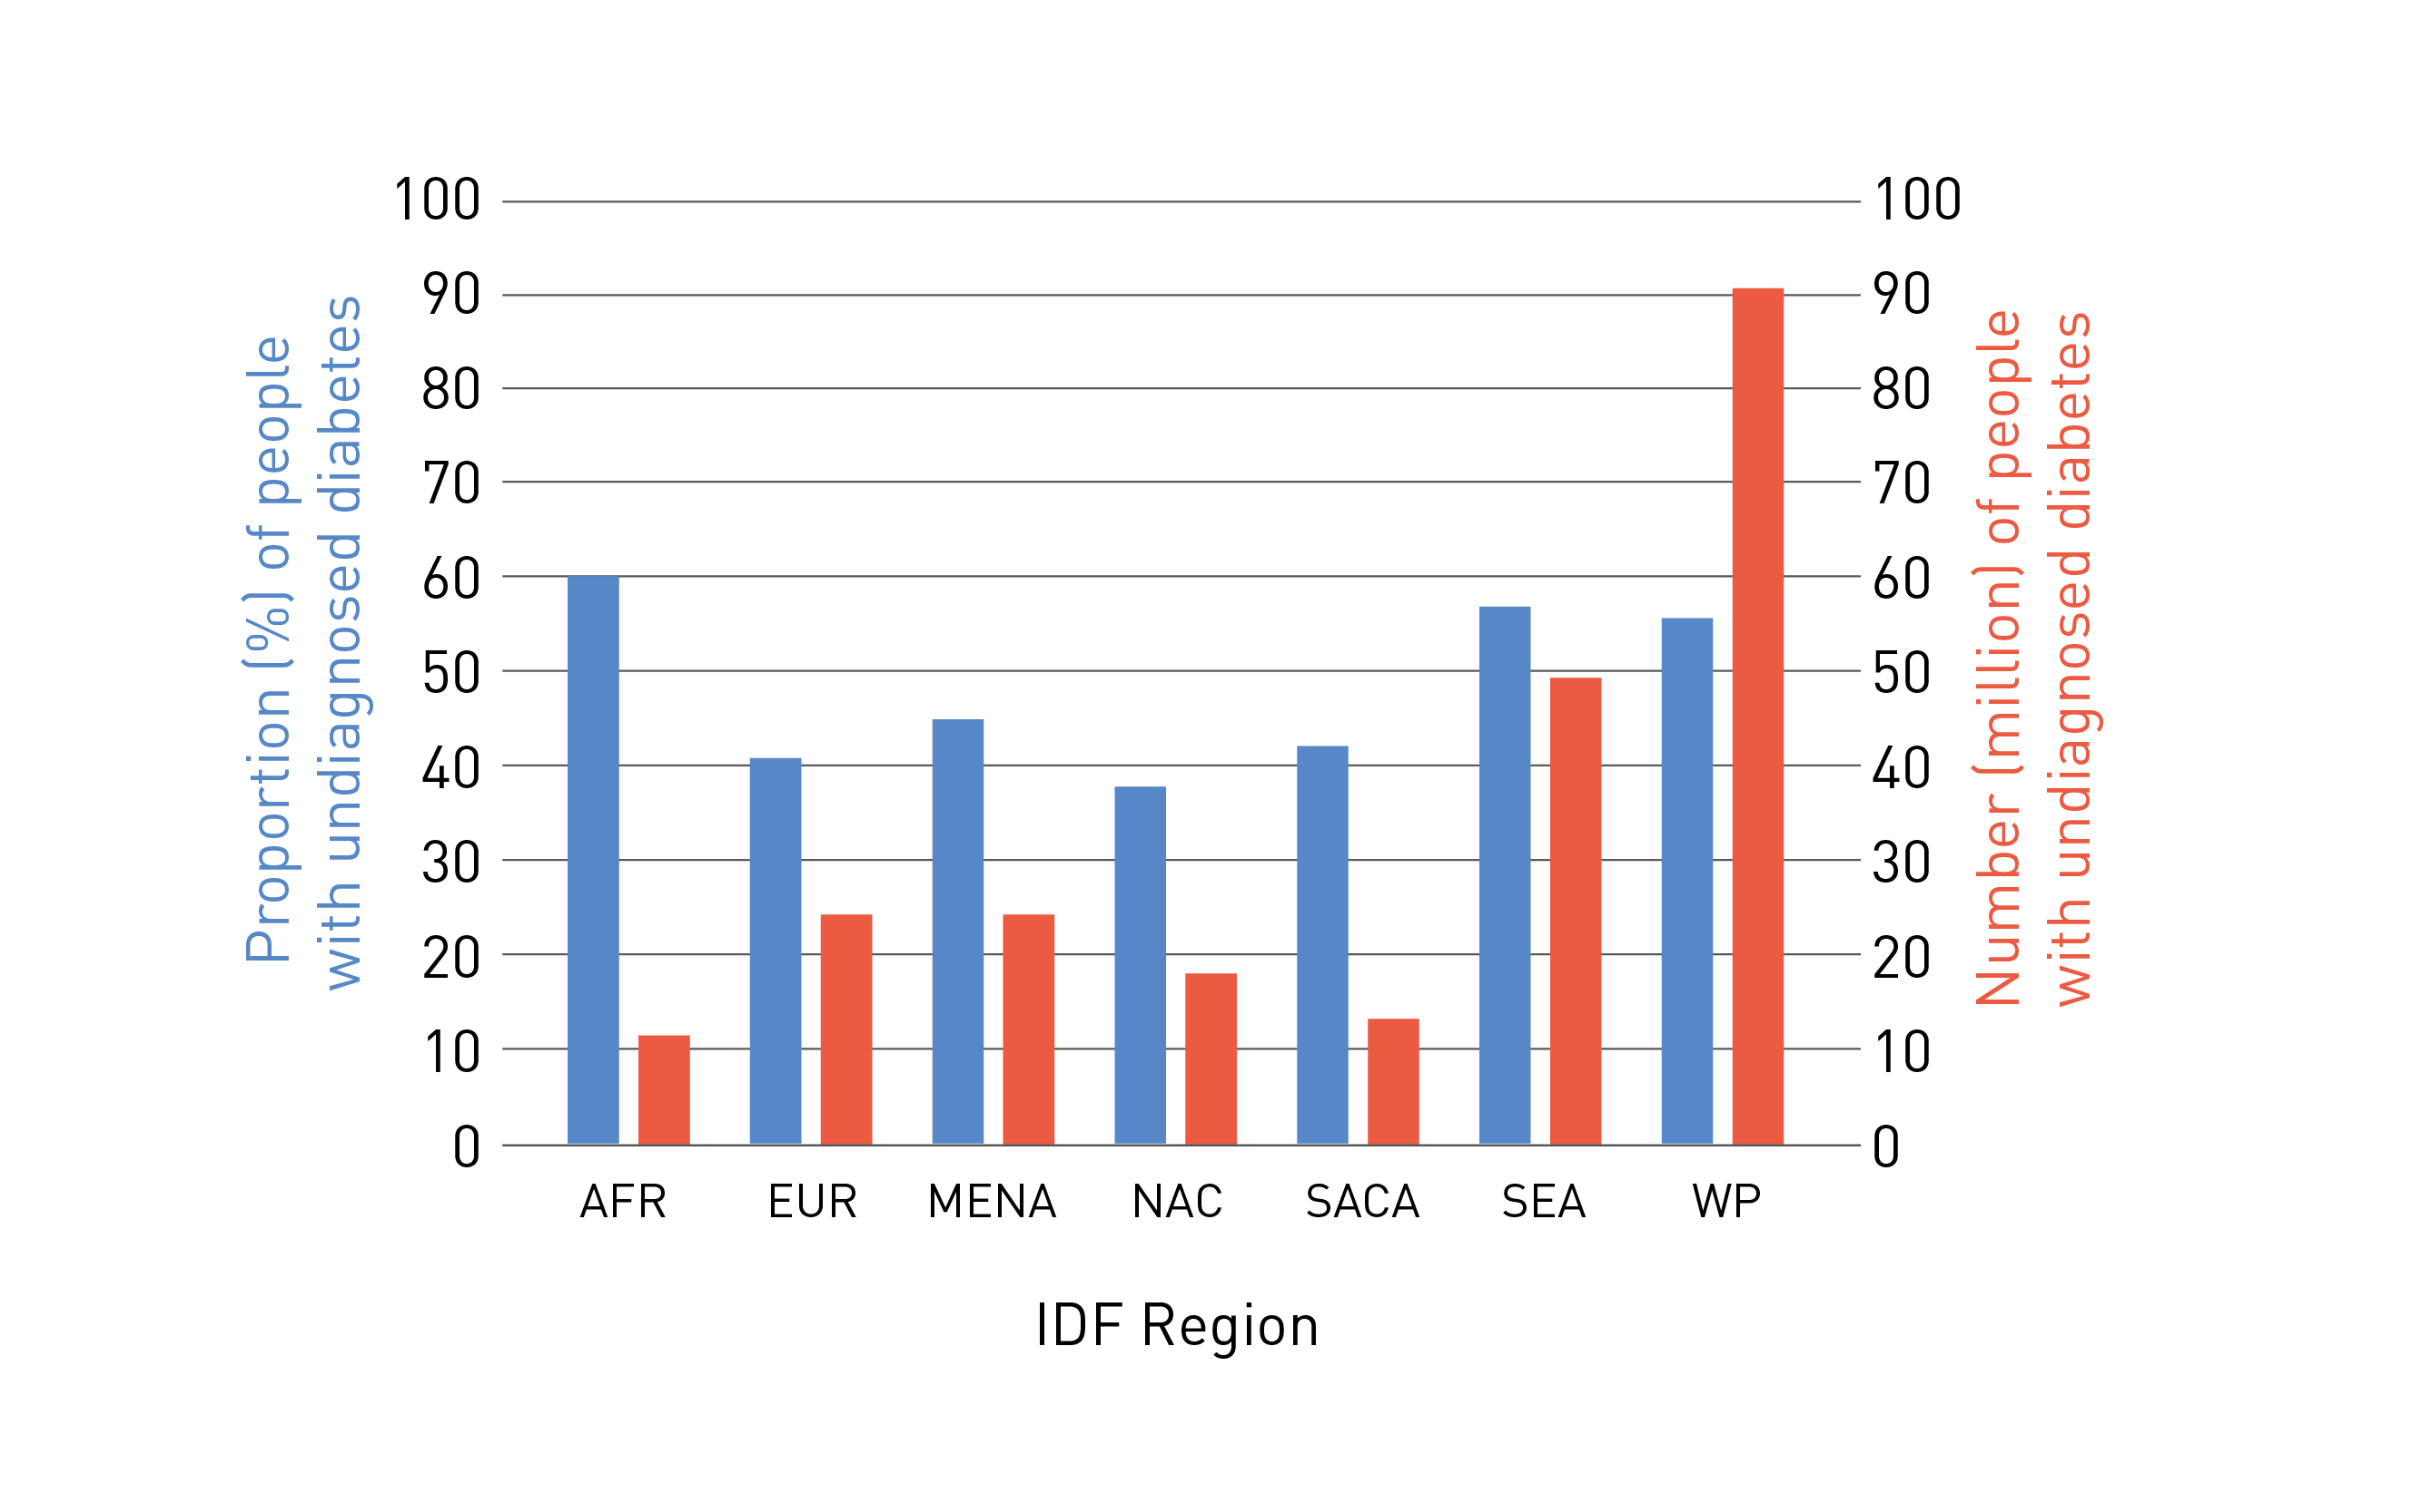
UNDIAGNOSED DIABETES
Number and proportion of adults (20-79 years) with undiagnosed diabetes per region, 2019
UNDIAGNOSED

Slide 8
Status of Diabetes Mellitus in Malaysia in the past 30 years (NHMS)
 | 1986 | 1996 | 2006 | 2011
Remarks | 35 years old & above | 30 years old & above | 18 years old & above | 30 years old & above
Prevalence | 6.3% | 8.3% | 11.6% | 20.8%
Known diabetes | 4.5% | 6.5% | 7.0% | 10.7%
Newly diagnosed | 1.8% | 1.8% | 4.5% | 10.2%
Impaired Glucose Tolerance (IGT) / Fasting Glucose (IFG) | 4.8% * | 4.3% * | 4.2%** | 5.3% #
2015
18 years old & above
17.5%
8.3%
9.2%
4.7% #
**based on IGT; # based on IFG

Slide 9
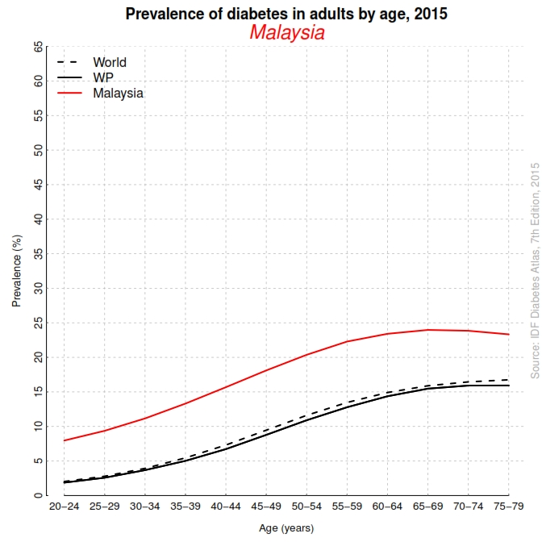

Slide 10
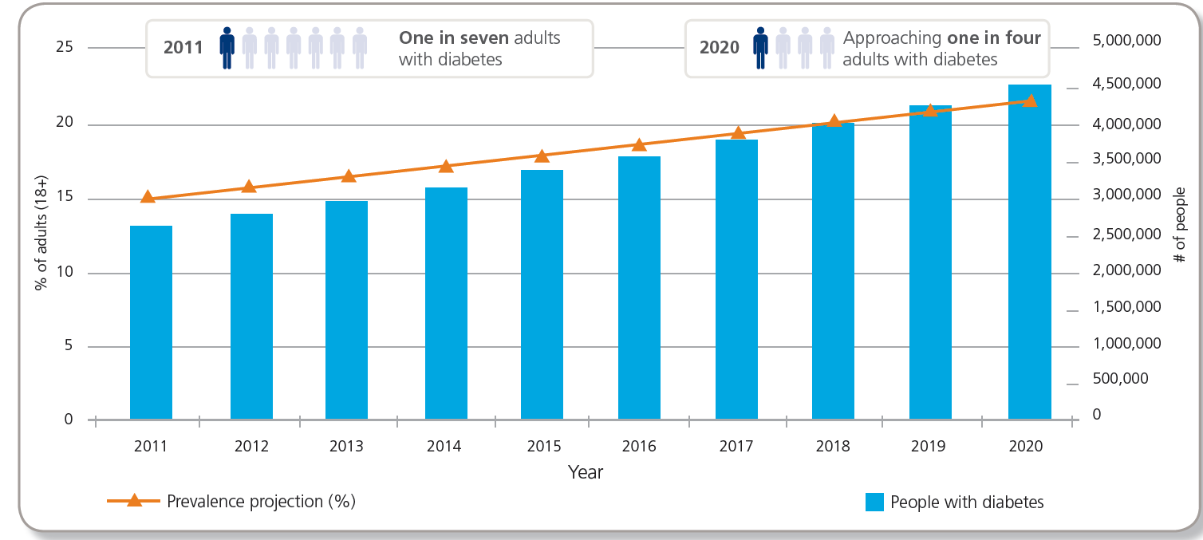
Malaysia diabetes challenge
Prevalence of diabetes in adults aged ≥18 years¹
Diabetes prevalence and forecast up to 2020^{2,3}
8.3
7.0
Source:
1. The Third National Health and Morbidity Survey 2006 (NHMS III)
2. Institute for Public Health (IPH). National Health and Morbidity Survey 2015, Nutritional Status. Ministry of Health, Malaysia; 2016
3. Rahman H. Keynote address and presentation: The Future of Diabetes in Malaysia. Malaysian Diabetes Educators Society Seminar 2012. Available at: www.moh.gov.my/attachments/716

Slide 11
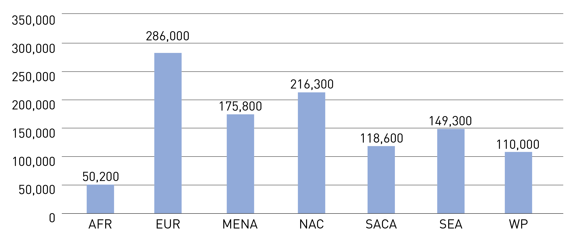
Diabetes in Children and Adolescents
Estimated number of children and adolescents (<20years) with type 1 diabetes by IDF region, 2017

Slide 12

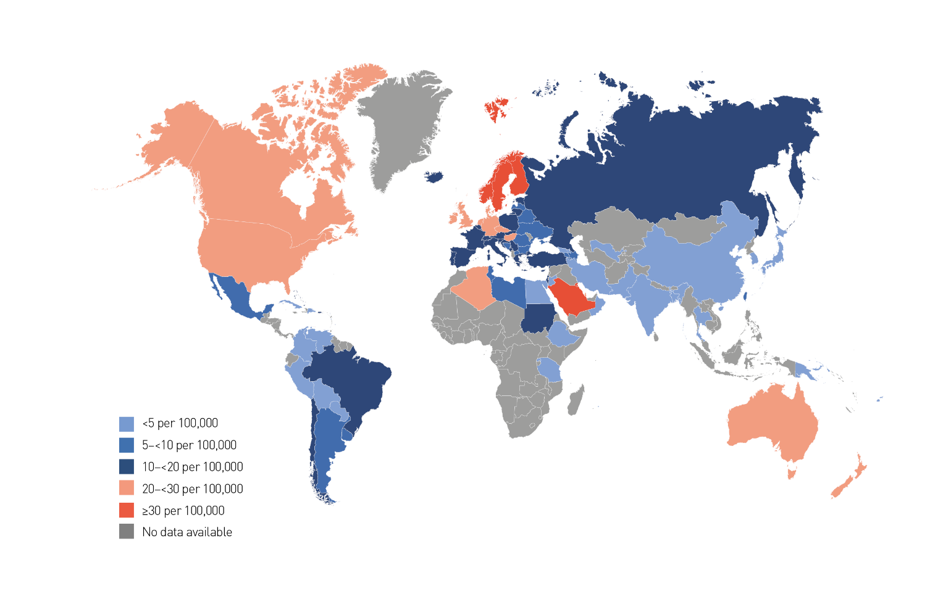
Total diabetes-related health expenditure for adults (20–79 years) with diabetes
CHILDREN AND ADOLESCENTS
Age-sex standardised incidence rates (per 100,000 population per annum)
of type 1 diabetes in children and adolescents aged 0–14 years, 2019

Slide 13
Type 2 Diabetes
T2DM in youth has increased over the past 20 years
  ~5,000 new cases per year in the U.S.
T2DM in youth is different from both T1DM in youth and T2DM in adults
Disproportionally impacts youth of ethnic and racial minorities
Additional risk factors include:
  Adiposity, family history of diabetes, female sex, and low socioeconomic status
Children and Adolescents:
Standards of Medical Care in Diabetes - 2018. Diabetes Care 2018; 41 (Suppl. 1): S126-S136
Notes:
We covered information on screening and testing for type 2 diabetes in children & adolescents earlier, so now we’ll focus on treatment.
Type 2 diabetes in youth has increased over the past 20 years, and recent estimates suggest an incidence of ~5,000 new cases per year in the U.S.
Evidence suggests that type 2 diabetes in youth is different not only from type 1 diabetes but also from type 2 diabetes in adults and has unique features, such as a more rapidly progressive decline in β-cell function and accelerated development of diabetes complications.
Type 2 diabetes disproportionately impacts youth of ethnic and racial minorities and can occur in complex psychosocial and cultural environments, which may make it difficult to sustain healthy lifestyle changes and self-management behaviors.
Additional risk factors associated with type 2 diabetes in youth include adiposity, family history of diabetes, female sex, and low socioeconomic status.
[SLIDE]
13

Slide 14
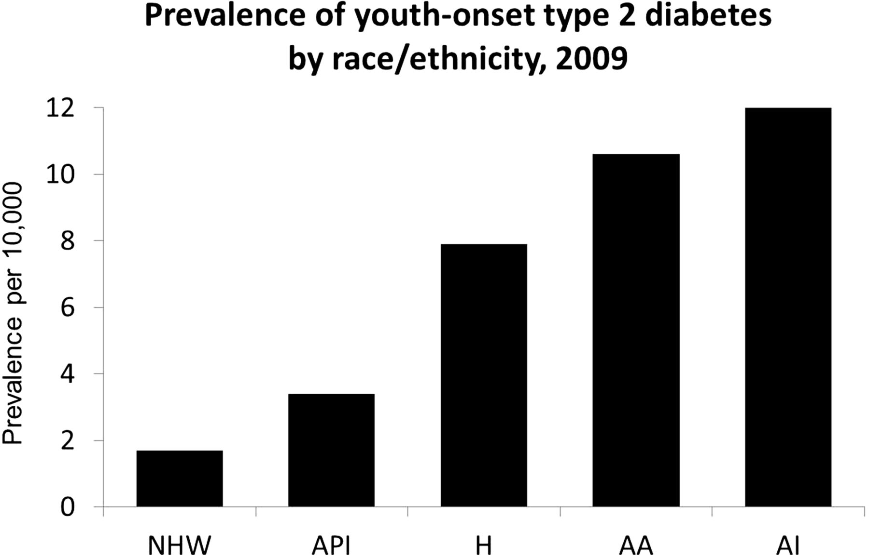

Prevalence of youth-onset type 2 diabetes by race/ethnicity. 2009 prevalence of type 2 diabetes among youth, as published by the SEARCH for Diabetes in Youth study (4).
*AA, African American; AI, American Indian; API, Asian Pacific Islander; H, Hispanic; NHW, non-Hispanic white.
Kristen J. Nadeau et al. Dia Care 2016;39:1635-1642
©2016 by American Diabetes Association
Notes:
Prevalence of youth-onset type 2 diabetes by race/ethnicity. 2009 prevalence of type 2 diabetes among youth, as published by the SEARCH for Diabetes in Youth study (4). Prevalence is reported per 10,000 population at risk for type 2 diabetes (ages 10–19 years). AA, African American; AI, American Indian; API, Asian Pacific Islander; H, Hispanic; NHW, non-Hispanic white.

Slide 15
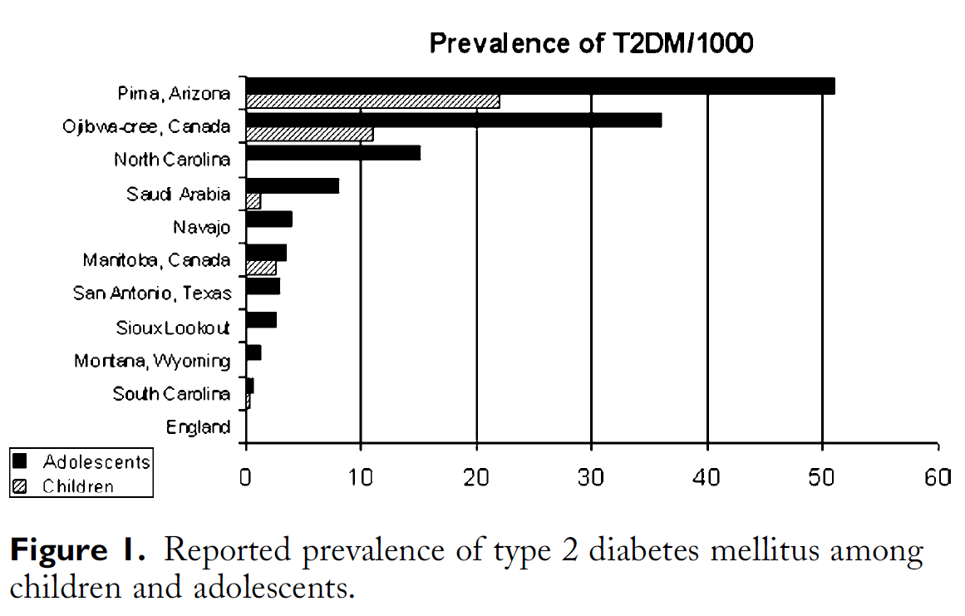
Pinhas-Hamiel & Zeitler J Pediatr 2005;146:693-700

Slide 16
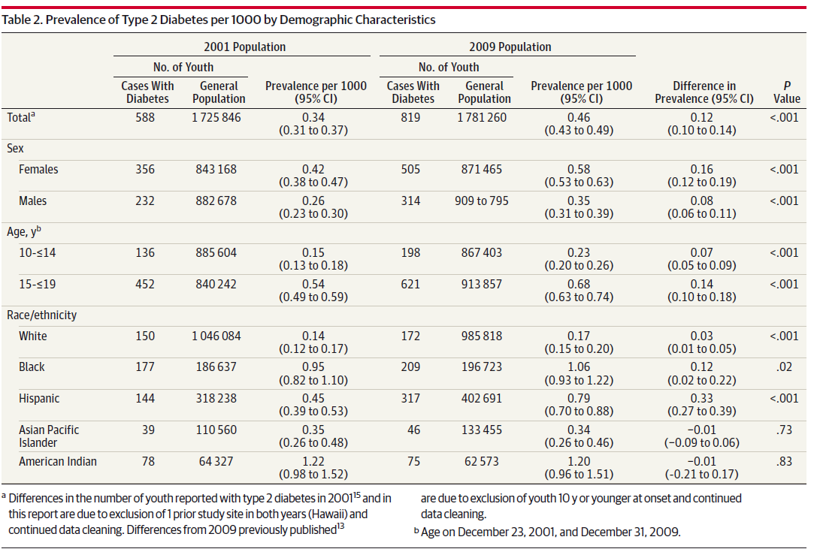
Prevalence of type 2 diabetes in youth across US race and ethnic groups
Dabelea et al JAMA. 2014;311(17):1778-1786. doi:10.1001/jama.2014.3201

Slide 17
Classification of Diabetes
Type 1 diabetes
  β-cell destruction
Type 2 diabetes
  Progressive insulin secretory defect
Gestational Diabetes Mellitus (GDM)
Other specific types of diabetes due to other causes:
  Monogenic diabetes syndromes
  Diseases of the exocrine pancreas, e.g., cystic fibrosis
  Drug- or chemical-induced diabetes
Classification and Diagnosis of Diabetes:
Standards of Medical Care in Diabetes - 2018. Diabetes Care 2018; 41 (Suppl. 1): S13-S27
Notes:
The 2018 Standards of Care classifies diabetes into four general clinical categories:
Type 1 diabetes, due to β-cell destruction, usually leading to absolute insulin deficiency; [CLICK]
Type 2 diabetes, due to a progressive insulin secretory defect frequently on the background of insulin resistance; [CLICK]
Gestational diabetes mellitus, which is diabetes diagnosed in the second or third trimester pregnancy that is not clearly overt diabetes existing prior to gestation [CLICK]
And other specific types of diabetes due to other causes, such as monogenic diabetes syndromes, diseases of the exocrine pancreas (such as cystic fibrosis and pancreatitis), and drug- or chemical-induced diabetes (such as diabetes resulting from glucocorticoid use, treatment of HIV/AIDS, or medications used after organ transplantation)
[SLIDE]
17
Reference
American Diabetes Association. Standards of medical care in diabetes—2014. Diabetes Care 2014;37(suppl 1):S14

Slide 18
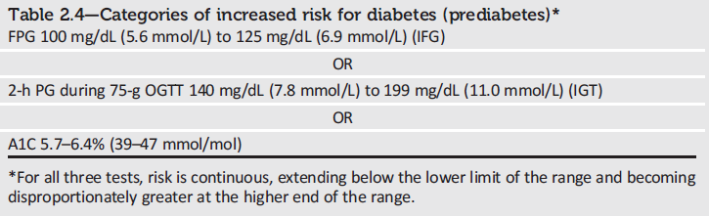
Categories of Increased Risk for Diabetes (Prediabetes)
Classification and Diagnosis of Diabetes:
Standards of Medical Care in Diabetes - 2018. Diabetes Care 2018; 41 (Suppl. 1): S13-S27
Notes:
The 2018 Standards of Care additionally provide definitions for prediabetes.
An increased risk for diabetes/prediabetes is defined as:
Fasting plasma glucose (FPG) of 100-125 mg/dL
OR
2-hour plasma glucose of 140-199 mg/dL during an OGTT
OR
A1C between 5.7-6.4%
For all three tests, risk is continuous, extending below the lower limit of the range and becoming disproportionately greater at the higher end of the range.
[SLIDE]
18
Reference
American Diabetes Association. Standards of medical care in diabetes—2014. Diabetes Care 2014;37(suppl 1):S15; Table 2

Slide 19









What is Prediabetes?
Fasting Plasma
Glucose
2-hour Plasma Glucose On OGTT
Hemoglobin A1C
Diabetes Mellitus
Diabetes Mellitus
Diabetes Mellitus
Prediabetes
Impaired Fasting
Glucose
126 mg/dL
Prediabetes
Impaired Glucose
Tolerance
200 mg/dL
Prediabetes
6.5%
100 mg/dL
140 mg/dL
5.7%
Normal
Normal
Normal
Any abnormality must be repeated and confirmed on a separate day
The diagnosis of diabetes can also be made based on unequivocal symptoms and a random glucose >200 mg/dL
Adapted from:
American Diabetes Association. Diabetes Care. 2014;37 Suppl 1:S81-90.
Notes:
19
WHAT IS PREDIABETES?
ANIMATION SLIDE
Prediabetes is when an individual’s plasma glucose level is higher than normal, but not yet high enough to be diagnostic of having diabetes. This is based upon an impaired fasting glucose, impaired glucose tolerance, and/or an elevated hemoglobin A1C (A1C).
Individuals with IFG, IGT and/or and elevated A1C have been referred to as having prediabetes, indicating the relatively high risk for the future development of diabetes.
CLICK … By definition, IFG is a condition in which FPG levels range between 100 mg/dL (5.6 mmol/L) and 125 mg/dL (6.9 mmol/L) after an 8 to 12 hour fast.
CLICK … IGT is defined as having 2-hour plasma glucose values from an OGTT of 140 mg/dL (7.8 mmol/L) to 199 mg/dL (11.0 mmol/L). Levels above this, or if a 2-hour blood glucose rises to 200 mg/dl or above, a person has diabetes.
CLICK … The American Diabetes Association’s Standards of Care also state that it is reasonable to consider an A1C range of 5.7–6.4% as having prediabetes.
CLICK … Any abnormality must be repeated and confirmed on a different day than the original test. Although the above results can be used to diagnose diabetes, diagnosis can also be made based on unequivocal symptoms and a random glucose >200 mg/dL.
Recommended Reference(s):
Bullard KM, Saydah SH, Imperatore G, et al. Secular changes in U.S. Prediabetes prevalence defined by hemoglobin A1c and fasting plasma glucose: National Health and Nutrition Examination Surveys, 1999-2010. Diabetes Care. 2013;36:2286-2293.
American Diabetes Association. Diagnosis and classification of diabetes mellitus. Diabetes Care. 2014;37 Suppl 1:S81-90.
American Diabetes Association. Standards of Medical Care in Diabetes—2014 Diabetes Care. 2014;37:S14-S80.

Slide 20
Monogenic diabetes
Inheritance of mutation in single gene
Dominant ,recessive or denovo
Most are due to mutations in genes which regulate βcell function
Rare cases due to insulin resistance
Can mimic type 1 or type 2 diabetes

Slide 21
Pathophysiologic classification
ASSOCIATED WITH INSULIN RESISTANCE
Mutations in the insulin receptor gene
  • Type A insulin resistance
  • Leprechaunism
  • Rabson-Mendenhall syndrome
Lipoatrophic diabetes
Mutations in the PPARγ gene

Slide 22
ASSOCIATED WITH DEFECTIVE INSULIN SECRETION
Mutations in the insulin or proinsulin genes
Mitochondrial gene mutations
Maturity-onset Diabetes of the Young (MODY)
  HNF-4α (MODY 1)
  Glucokinase (MODY 2)
  HNF-1α (MODY 3)
  IPF-1 (MODY 4)
  HNF-1β (MODY 5)
  NeuroD1/Beta2 (MODY 6)

Slide 23
Diseases of the exocrine pancreas
1. Pancreatitis
2. Trauma/pancreatectomy
3. Neoplasia
4. Cystic fibrosis
5. Hemochromatosis
6. Fibrocalculous pancreatopathy

Slide 24
DM secondary to pancreatic diseases
Classified as type 3c DM (T3cDM)
5-10% of Western diabetic population
Most common cause is chronic pancreatitis (CP), found in 78.5% of T3cDM
BMI <25 kg/ m2 or absence of family history of diabetes might raise suspicion of T3cDM
Clinical features, such as “brittle diabetes” due to problems with hypoglycaemia and serologic markers (e.g., postprandial pancreatic polypeptide deficiency)
Absence of pancreatic polypeptide response to mix nutrition ingestion seems to be specific diagnostic criteria of type 3cDM
CP and DM - both are risk factors for the development of pancreatic cancer - combined presence increases the risk for the disease by 33-fold
Vujasinovic et al JOP. J Pancreas 2016 May 09; 17(3):263-268

Slide 25
Diabetes Mellitus & Pancreatic Exocrine Insufficiency (PEI)
Prevalence in both type I (25–74%) and type II (28–54%) diabetes
Risk factors - long disease duration, high insulin requirement and poor glycemic control
Chronic pancreatitis patients may suffer from type III diabetes characterized by destruction of islet cells by inflammatory and fibrotic injury
Type III diabetes differs from type I diabetes as damage of pancreatic islets not limited to insulin secreting beta cells but more diffused as also affects glucagon and pancreatic polypeptide secreting alpha and PP cells.
Type I diabetes patients, prevalence of both severe (10–30%) and moderate (22–56%) PEI seems higher than in children, possibly suggesting that exocrine pancreatic function decreases in parallel with the duration of disease and increase in insulin requirement
Piciucchi et al Int J Endocrinol 2015 Mar 29. doi: 10.1155/2015/595649

Slide 26
Symptoms of EPI
Symptoms of EPI related to maldigestion and malabsorption
(a) Diarrhoea
(b) Loss of appetite
(c) Weight loss
(d) Steatorrhea
(e) Flatulence
(f) Abdominal pain

Slide 27
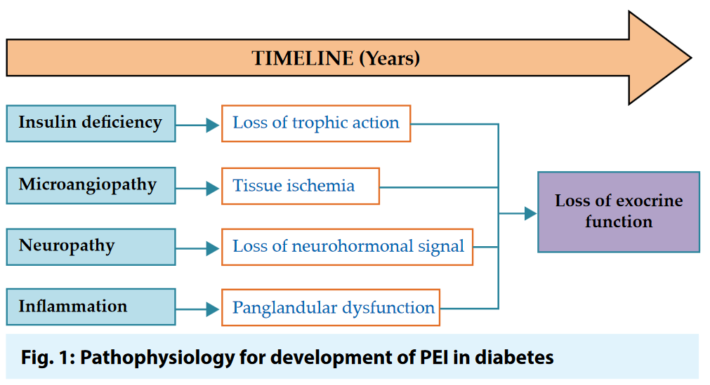
Talukdar & Reddy Journal of The Association of Physicians of India Vol. 65 Sept 2017

Slide 28
Drug or chemical induced diabetes
1. Vacor
2. Pentamidine
3. Nicotinic acid
4. Glucocorticoids
5. Thyroid hormone
6. Diazoxide
7.b-Adrenergic agonists
8. Thiazides
9. Dilantin
10. Ɣ-Interferon

Slide 29
Gestational Diabetes Mellitus (GDM)
Gestational diabetes mellitus (GDM) is any degree of glucose intolerance which is first recognised during pregnancy, whether or not the condition persisted after pregnancy.

Slide 30
Maternal complications in diabetic pregnancy
Hypoglycemia, ketoacidosis
Pregnancy-induced hypertension
Pyelonephritis, other infections
Polyhydramnios
Preterm labor
Worsening of chronic complications
  Retinopathy
  Nephropathy
  Neuropathy
  Cardiac disease

Slide 31
Complications for infants of mothers with DM
Congenital malformations
Macrosomia
Birth injury
Asphyxia
Respiratory Distress Syndrome
Perinatal mortality
Metabolic abnormalities
  Hypoglycaemia
  Hypokalemia
  Hypocalcemia
  Hyperbilirubinemia
  Erythrosis

Slide 32
Screening - risk factors
BMI >27 kg/m²
Previous macrosomic baby weighing ≥4 kg
Previous gestational diabetes mellitus
First-degree relative with diabetes
History of unexplained intrauterine death
History of congenital anomalies
Glycosuria at the first or any prenatal visit
Current obstetric problems (essential hypertension, pregnancy-induced hypertension, polyhydramnios and current use of steroids)
Notes:
Basically the screening criteria is the same . However this time , the age of more than 25 years old were not included. As there is not
Enough strong evidence to screen this group

Slide 33
Gestational Diabetes Mellitus (GDM): Recommendations
Test for undiagnosed diabetes at the 1st prenatal visit in those with risk factors, using standard diagnostic criteria. B
Test for GDM at 24–28 weeks of gestation in pregnant women not previously known to have diabetes. A
Test women with GDM for persistent diabetes at 4–12 weeks postpartum, using the OGTT and clinically appropriate non-pregnancy diagnostic criteria. E
Classification and Diagnosis of Diabetes:
Standards of Medical Care in Diabetes - 2018. Diabetes Care 2018; 41 (Suppl. 1): S13-S27
Notes:
Recommendations for the detection and diagnosis of gestational diabetes mellitus (GDM) are summarized on two slides;
First, because of the number of pregnant women with undiagnosed type 2 diabetes, it is reasonable to test women with risk factors for type 2 at the first prenatal visit, using standard diagnostic criteria. B [CLICK]
Test for GDM at 24–28 weeks of gestation in pregnant women not previously known to have diabetes. A [CLICK]
Test women with GDM for persistent diabetes at 4–12 weeks postpartum, using the OGTT and clinically appropriate nonpregnancy diagnostic criteria. E
[SLIDE]
33
References
Lawrence JM, Contreras R, Chen W, Sacks DA. Trends in the prevalence of preexisting diabetes and gestational diabetes mellitus among a racially/ethnically diverse population of pregnant women, 1999-2005. Diabetes Care 2008;31:899–904
American Diabetes Association. Standards of medical care in diabetes—2014. Diabetes Care 2014;37(suppl 1):S18

Slide 34
Type 1 Diabetes Mellitus
Characterized by absolute insulin deficiency
Pathophysiology and etiology
  Result of pancreatic beta cell destruction
    Prone to ketosis
  Total deficit of circulating insulin
  Autoimmune
  Idiopathic

Slide 35
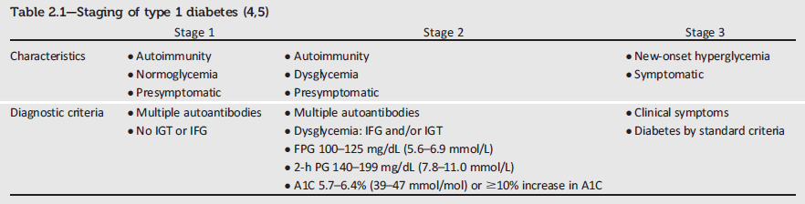
Staging of Type 1 Diabetes
Classification and Diagnosis of Diabetes:
Standards of Medical Care in Diabetes - 2018. Diabetes Care 2018; 41 (Suppl. 1): S13-S27
Notes:
Characterization of the underlying pathophysiology of diabetes is much more developed in type 1 diabetes than in type 2 diabetes. Three distinct stages of type 1 diabetes can be identified and serve as a framework for future research and regulatory decision making. The rate of progression is dependent on the age at first detection of antibody, number of antibodies, antibody specificity, and antibody titer. Glucose and A1C levels rise well before the clinical onset of diabetes, making diagnosis feasible well before the onset of DKA.
[SLIDE]
35
Reference
American Diabetes Association. Standards of medical care in diabetes—2014. Diabetes Care 2014;37(suppl 1):S14

Slide 36
Type 1 Diabetes
Inflammation
Beta cell destruction
  Usually leading to absolute
  insulin deficiency
Immune mediated
Idiopathic
FasL
TNFα
IFNγ
T cell
Autoimmune Reaction
Macrophage
TNFα
Class I
MHC
Class II
MHC
IL-1
Beta cell
NO
CD8⁺ T cell
Dendritic cell
Beta cell Destruction
Maahs DM, et al. Endocrinol Metab Clin North Am. 2010;39:481-497.

Slide 37
Pathophysiology of T1DM
Chronic autoimmune disorder occurring in genetically susceptible individuals
  May be precipitated by environmental factors
Immune system is triggered to develop an autoimmune response against
  Altered pancreatic beta cell antigens
  Molecules in beta cells that resemble a viral protein
~ 85% of T1DM patients have circulating islet cell antibodies
  Majority also have detectable anti-insulin antibodies
Most islet cell antibodies are directed against glutamic acid decarboxylase (GAD) within pancreatic beta cells
Maahs DM, et al. Endocrinol Metab Clin North Am. 2010;39:481-497.

Slide 38
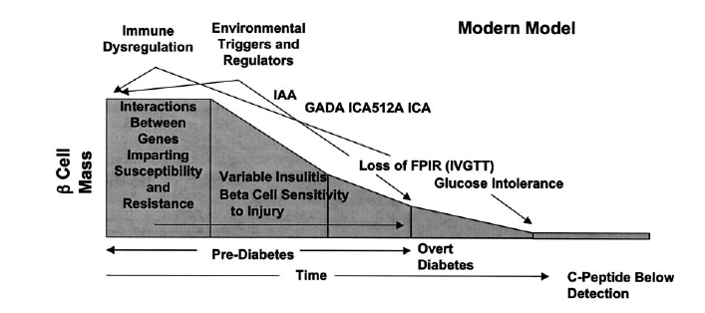
Autoimmune Basis for
Type 1 Diabetes
Atkinson MA. Diabetes. 2005;54:1253-1263.

Slide 39
Pathophysiology of
Type 2 Diabetes
Organ System | Defect
Major Role
Pancreatic beta cells | Decreased insulin secretion
Muscle | Inefficient glucose uptake
Liver | Increased endogenous glucose secretion
Contributing Role
Adipose tissue | Increased FFA production
Digestive tract | Decreased incretin effect
Pancreatic alpha cells | Increased glucagon secretion
Kidney | Increased glucose reabsorption
Nervous system | Neurotransmitter dysfunction
DeFronzo RA. Diabetes. 2009;58:773-795

Slide 40
Risk Factors for Prediabetes and Type 2 Diabetes
Age ≥45 years
Family history of T2D or cardiovascular disease
Overweight or obese
Sedentary lifestyle
Non-Caucasian ancestry
Previously identified IGT, IFG, and/or metabolic syndrome
PCOS, acanthosis nigricans, or NAFLD
Hypertension (BP >140/90 mmHg)
Dyslipidemia (HDL-C <35 mg/dL and/or triglycerides >250 mg/dL)
History of gestational diabetes
Delivery of baby weighing
>4 kg (>9 lb)
Antipsychotic therapy for schizophrenia or severe bipolar disease
Chronic glucocorticoid exposure
Sleep disorders
  Obstructive sleep apnea
  Chronic sleep deprivation
  Night shift work
BP, blood pressure; HCL-C, high density lipoprotein cholesterol; IFG, impaired fasting glucose; IGT, impaired glucose tolerance; NAFLD, nonalcoholic fatty liver disease; PCOS, polycystic ovary syndrome; T2D, type 2 diabetes.
Handelsman YH, et al. Endocr Pract. 2015;21(suppl 1):1-87.

Slide 41

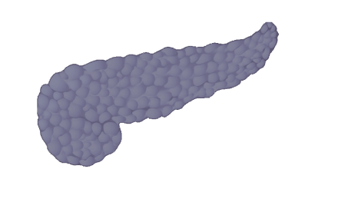
Insulin resistance and β-cell dysfunction are core defects of type 2 diabetes
Genetic susceptibility,
obesity, Western lifestyle
Insulin
resistance
IR
β
β-cell
dysfunction
Type 2 diabetes
Rhodes CJ & White MF. Eur J Clin Invest 2002; 32 (Suppl. 3):3–13.
Notes:
A number of factors, both genetic and environmental, influence the development of insulin resistance and β-cell dysfunction. In addition to the risk posed by inherited factors, a Western lifestyle (i.e. sedentary lifestyle, high-fat diet) can contribute to obesity, a strong risk factor for insulin resistance.
Insulin resistance at the tissue level contributes significantly to hyperglycemia and is due primarily to abnormalities in the way that the effects of insulin are carried from the receptor on the cell’s surface to intracellular proteins that regulate glucose transport. The consequences of insulin resistance include reduced glucose uptake into fat and muscle, and increased glucose production by the liver.¹
β-cell dysfunction is characterized by a reduced ability to respond to raised glucose levels leading to reduced insulin secretion, which in turn results in chronic hyperglycemia.
Together, these two factors often lead to the development of type 2 diabetes, and so are key targets for therapeutic intervention.
¹Rhodes CJ & White MF. Eur J Clin Invest 2002; 32 (Suppl. 3):3–13.

Slide 42

Insulin resistance
Major defect in individuals with type 2 diabetes¹
Reduced biological response to insulin^{1–3}
Strong predictor of type 2 diabetes⁴
Closely associated with obesity⁵
IR
¹American Diabetes Association. Diabetes Care 1998; 21:310–314.
²Beck-Nielsen H & Groop LC. J Clin Invest 1994; 94:1714–1721. ³Bloomgarden ZT. Clin Ther 1998; 20:216–231.
⁴Haffner SM, et al. Circulation 2000; 101:975–980. ⁵Boden G. Diabetes 1997; 46:3–10.
Notes:
Insulin resistance is the inability of the body to use its own insulin.
Insulin resistance is present to varying degrees in a high proportion of the general population.¹
Insulin resistance may lead to impaired glucose tolerance (IGT) and eventually to the development of type 2 diabetes.^{2,3}
> 80% of individuals with type 2 diabetes are insulin resistant.⁴
Insulin resistance is also a strong predictor for the development of type 2 diabetes.⁴
Many people with type 2 diabetes are obese – this can be up to ~85% in some populations,⁵ which may explain their insulin resistance.
¹American Diabetes Association. Diabetes Care 1998; 21:310–314.
²Beck-Nielsen H & Groop LC. J Clin Invest 1994; 94:1714–1721.
³Bloomgarden ZT. Clin Ther 1998; 20:216–231.
⁴Haffner SM, et al. Circulation 2000; 101:975–980.
⁵Boden G. Diabetes 1997; 46:3–10.

Slide 43






Insulin resistance – reduced response to circulating insulin
Insulin
resistance
IR
Liver
Muscle
Adipose
tissue
↑ Glucose output
↓ Glucose uptake
↓ Glucose uptake
Hyperglycemia
Notes:
The consequences of insulin resistance at the tissue level include reduced glucose uptake into peripheral sites, that is, fat and muscle.
Combined with excessive glucose output by the liver, this leads to hyperglycemia.

Slide 44
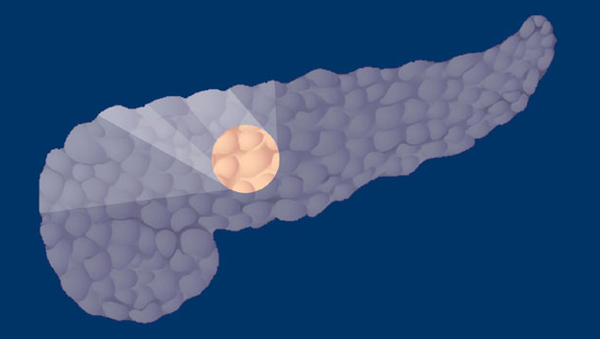
β-cell dysfunction
Major defect in individuals with type 2 diabetes
Reduced ability of β-cells to secrete insulin in response to hyperglycemia
β
β
β
β
DeFronzo RA, et al. Diabetes Care 1992; 15:318–354.
Notes:
Together with insulin resistance, β-cell dysfunction is one of the two major defects involved in development of type 2 diabetes¹ and is often inherited.
β-cell dysfunction may be a consequence of insulin resistance, but also occurs in insulin-sensitive individuals.²
In the insulin-resistant state, the pancreas is able to initially compensate for insulin resistance through increased production of insulin.¹ With time, however, the β-cells are unable to maintain increased insulin secretion leading to the development of impaired glucose tolerance and type 2 diabetes.¹
¹DeFronzo RA, et al. Diabetes Care 1992; 15:318–354.
²Haffner SM, et al. Circulation 2000; 101:975–980.

Slide 45
Etiology of β-cell Dysfunction
Genetic predisposition
Lean phenotype
Obese phenotype
IGT, IFG
Elevated FFA
Initial glucolipoadaptation (increased FFA usage)
Oxidative stress and glucotoxicity
Cellular lipid synthesis and glucolipotoxicity
Hyperglycemia
Glucolipotoxicity and glucotoxicity
Progressive β-cell failure and type 2 diabetes
Poitout V, Robertson RP. Endocrine Rev. 2008;29:351-366.

Slide 46
Natural History of Type 2 Diabetes
Years from
diagnosis
–10
–5
0
5
10
15
Onset
Diagnosis
β-Cell function
Insulin resistance
Insulin secretion
Postprandial glucose
Fasting glucose
Microvascular complications
Macrovascular complications
Prediabetes
Type 2 diabetes
Figure courtesy of CADRE.
Adapted from Holman RR. Diabetes Res Clin Pract. 1998;40(suppl):S21-S25;
Ramlo-Halsted BA, Edelman SV. Prim Care. 1999;26:771-789; Nathan DM. N Engl J Med. 2002;347:1342-1349; UKPDS Group. Diabetes. 1995;44:1249-1258

Slide 47
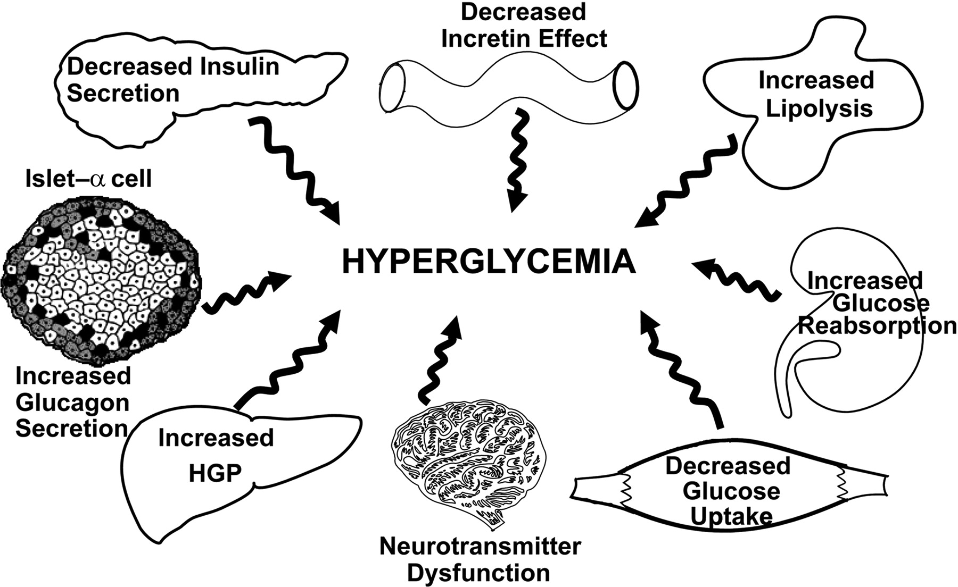
The Ominous Octet.
Ralph A. DeFronzo Diabetes 2009;58:773-795
©2009 by American Diabetes Association
Notes:
The ominous octet. See text for a more detailed explanation.

Slide 48
Common differences between type 1 and type 2 diabetes
Type 1 Diabetes | Type 2 Diabetes
Often diagnosed in childhood | Usually diagnosed in adults
Not associated with overweight / obesity | Often associated with overweight / obesity
Often associated with higher than normal ketone levels at diagnosis | Often associated with hypertension and/or dyslipidemia at diagnosis
Treated with insulin injections or insulin pump | Is usually treated initially lifestyle changes or with oral medication
Cannot be controlled without taking insulin | Sometimes possible to come off diabetes medication

Slide 49
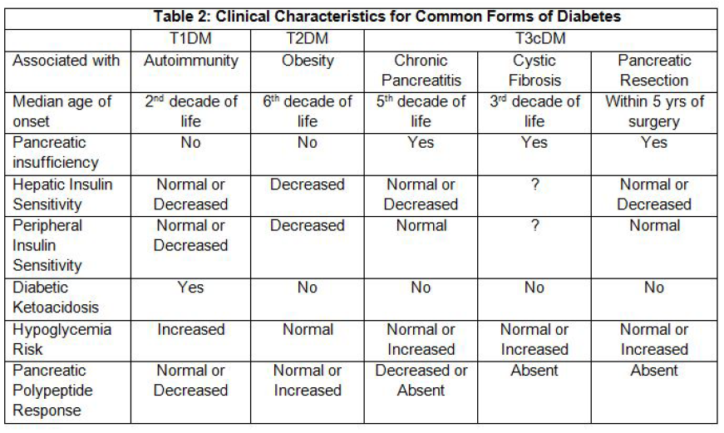
Gudipaty & Rickels Pancreapedia Sep 1, 2015 [DOI: 10.3998/panc.2015.35]

