Slide 1
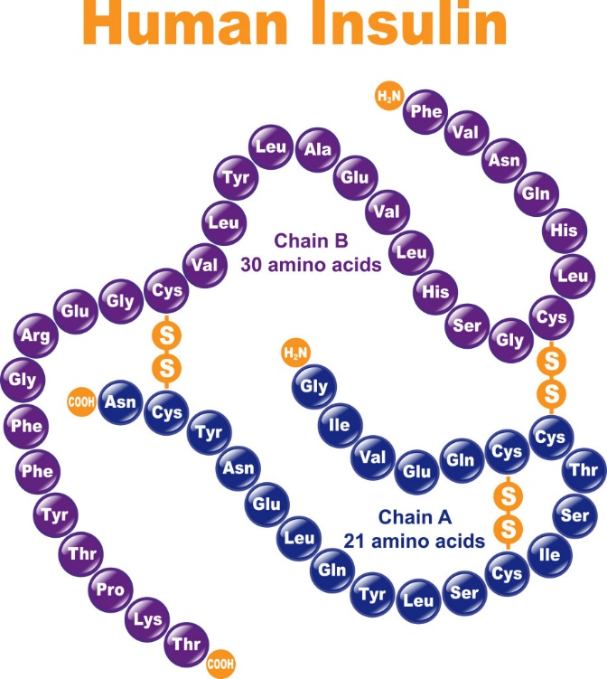
Normal physiology of glucose metabolism
By
Assoc Prof Dr Gnanajothy Ponnudurai

Slide 2
Lesson outcomes
At the end of the session, the student should be able to:
Discuss the structure and function of key organs, such as the pancreas, liver, muscle, adipose tissue, and kidney
Discuss the basic physiology of digestion, absorption and metabolism of glucose
Discuss the relationship between blood glucose and insulin in healthy people including gluconeogenesis, glycogenolysis, lipolysis and ketogenesis
Discuss normal insulin synthesis and secretion
Understand the hormonal, metabolic and neural control of insulin production and secretion
Discuss insulin action
Discuss the role of insulin receptors
Discuss the effect of insulin and counter-regulatory hormones on fuel homeostasis (carbohydrate, fat and protein)

Slide 3
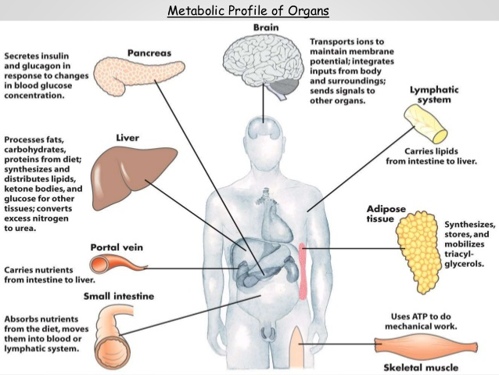
Notes:
Liver plays a central role in metabolism. After a meal, liver takes up carbohydrates, lipids and amino acids, processes them and routes to other tissues. Liver also synthesises and distributes glucose, ketone bodies and fatty acids.

Slide 4
Digestion and absorption of carbohydrates
Digestion of carbohydrates
Begins in mouth
Further digestion by pancreatic enzymes in small intestine
Final digestion by enzymes synthesised by intestinal mucosa cells.
Absorption of monosaccharides by intestinal mucosa cells
Galatose and glucose via sodium–dependent glucose cotransporter 1 (SGLT-1)
Fructose via GLUT-5
Notes:
Digestion of carbohydrates
Mouth: Salivary α-amylase hydrolyses dietary starch and glycogen resulting in a mixture of short oligosaccharides known as dextrin.
Stomach: Carbohydrate digestion does not happen in the stomach, because the high acidity inactivates salivary α-amylase.
Duodenum: When the acidic contents of the stomach reaches the duodenum, they are neutralised by bicarbonate secreted by pancreas. Pancreatic α-amylase continues the digestion of polysaccharides.
Intestinal mucosa cells: The final digestion occurs at the mucosal lining of the upper jejunum by disaccharidases (isomaltase, maltase, lactase, sucrase) to the monosaccharides.
Absorption of monosaccharides
Galactose and glucose are transported into mucosal cells by an active, energy-requiring process that requires a concurrent uptake of sodium ions. The transport protein is sodium–dependent glucose cotransporter 1 (SGLT-1).
Fructose uptake requires a sodium-independent transporter (GLUT-5) for its absorption.
All three monosaccharides are transported from intestinal mucosa cells into portal circulation via GLUT-2.

Slide 5
Carbohydrate metabolism
Pathways of carbohydrate metabolism:
Glycolysis
Krebs cycle
Gluconeogenesis
Glycogenesis
Glycogenolysis
Pentose phosphate pathway
Notes:
Blood glucose levels depend on a balance between intake, utilisation and production of glucose.
Glucose is utilised in cellular transport and phosphorylation, as well as in glycolysis and glycogen synthesis. (glycogenesis).
Glucose can be obtained form digestion of dietary carbohydrate, glycogen breakdown, gluconeogenesis.

Slide 6
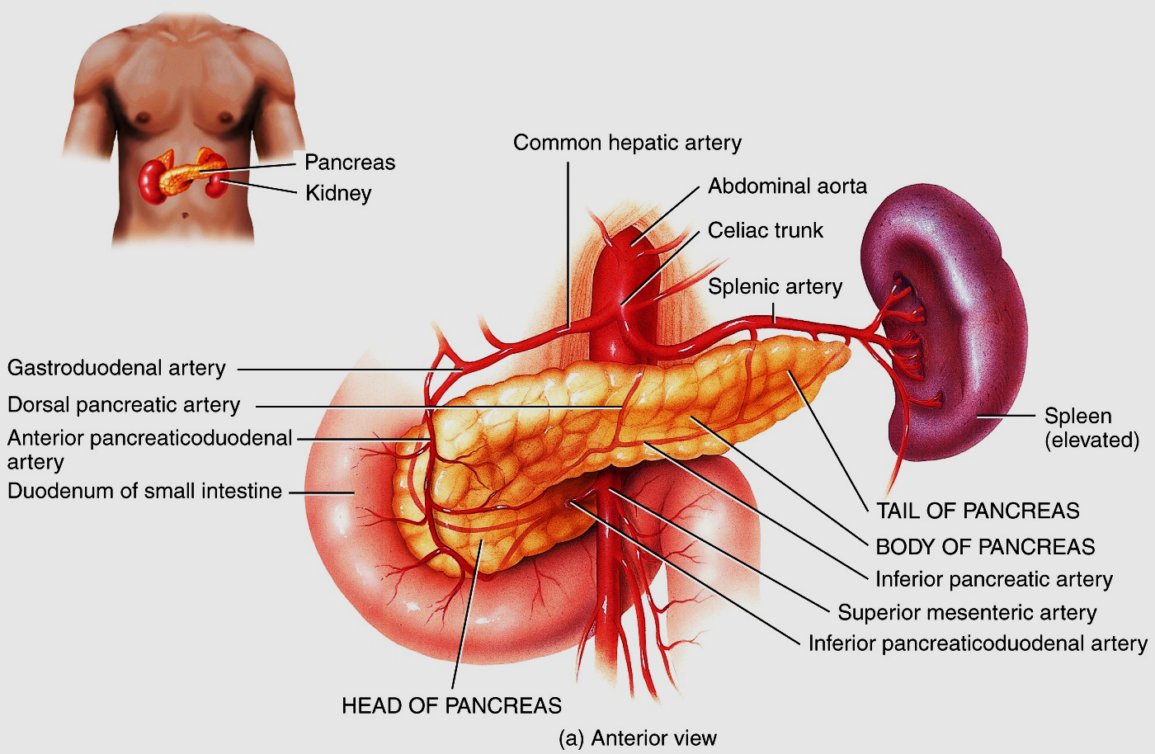
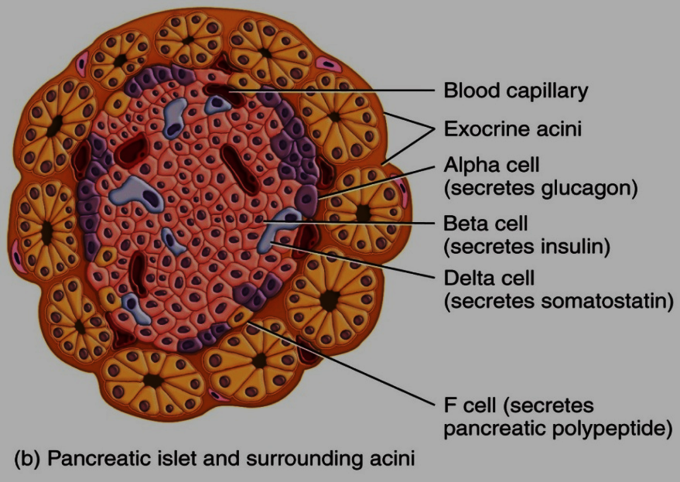
Anatomy of the Pancreas
Pancreas is an organ with both exocrine and endocrine functions
Pancreas is a flattened retroperitoneal
gland located posterior and inferior to
stomach and duodenum.
The exocrine cells of the pancreas are
arranged in small clusters, called acini.
The endocrine clusters are called islets of Langerhans

Slide 7
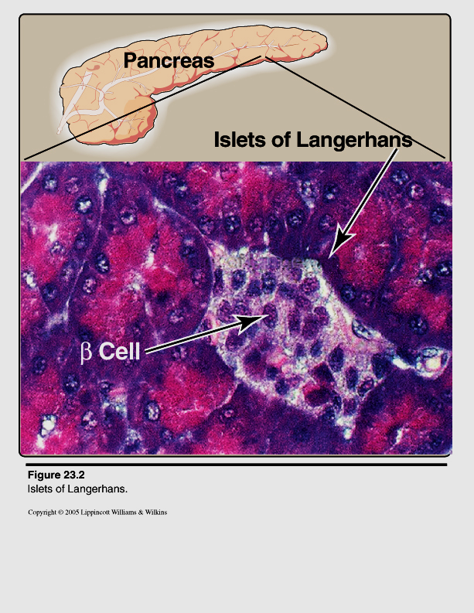
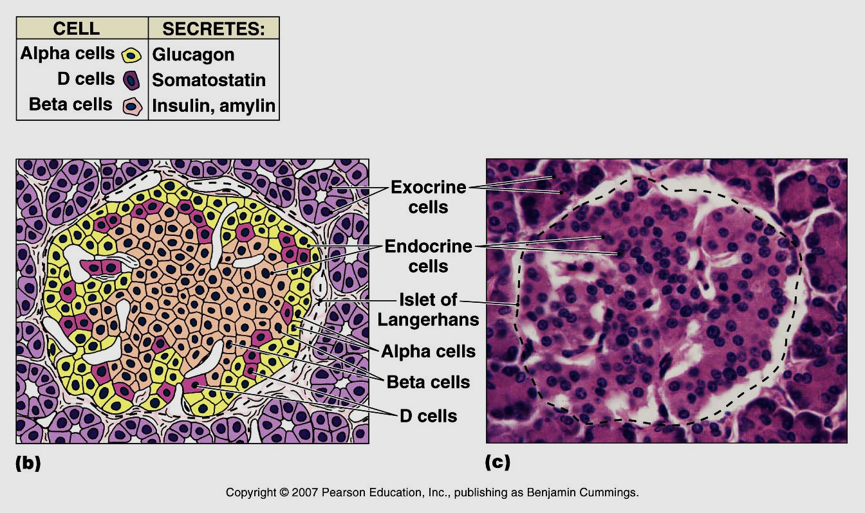
Islets of Langerhans (3000 – 5000 cells)
The islets are made up of endocrine cells
containing dense secretory granules.
Glucagon-secreting α - cells (20%)
Insulin-secreting β - cells (70%)
Somatostatin secreting δ - cells (8%)
Pancreatic polypeptide secreting F - cells
Insulin and glucagon help to
regulate blood glucose levels.
Somatostatin inhibits the release
of insulin and glucagon.
PP inhibits exocrine functions
of the pancreas.

Slide 8
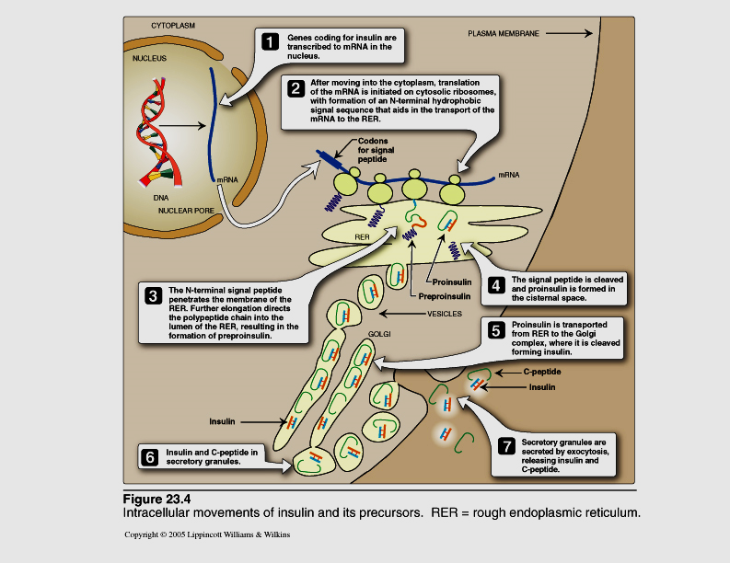
Insulin biosynthesis
Notes:
Insulin is synthesised as a single polypeptide pre-proinsulin on rough endoplasmic
reticulum (RER) of pancreatic B cells. Cleavage of signal sequence yields 86
amino acid peptide proinsulin. Proinsulin is transported from RER to Golgi apparatus.
Proinsulin is converted to insulin, with the excision of C peptide. Mature secretory
vesicles in beta cells of the pancreatic islets contain equimolar amounts of
insulin and C peptide. Upon proper stimulation, insulin and C-peptide are released by exocytosis of the secretory vesicles.

Slide 9
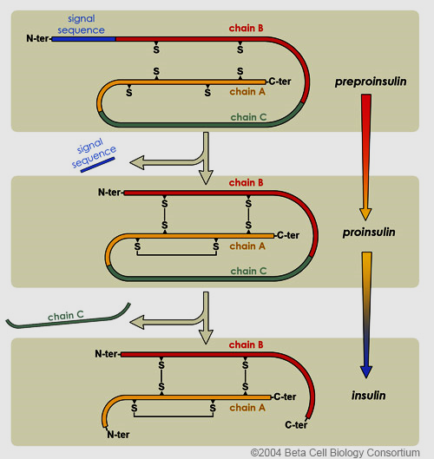
Insulin biosynthesis
Notes:
Insulin is synthesised as 2 inactive precursors, pre-proinsulin and proinsulin. The half life of C-peptide in plasma is longer than insulin, thus the C-peptide is a good indicator of insulin production and secretion. Insulin has a half life of approximately 6 minutes. This short duration allows rapid changes in circulating levels of insulin.

Slide 10
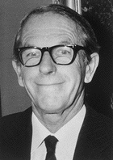
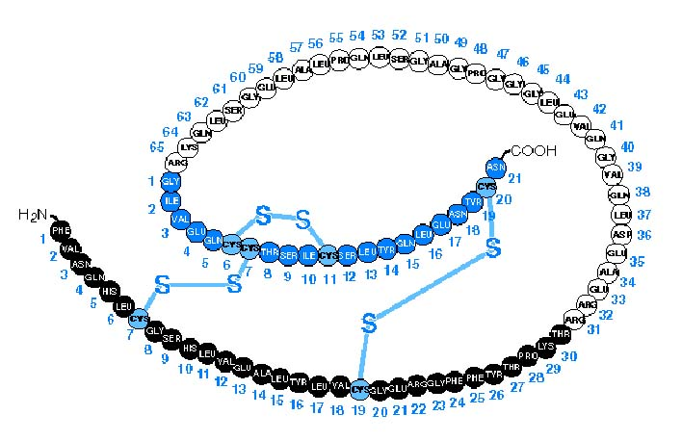
Structure of Pro-insulin and Insulin
Frederick Sanger
Proinsulin
C peptide
Insulin
Ca²⁺-dependent endopeptidases
MW 5808
PC2
(PC3)
A Chain
B Chain
PC3
Notes:
Insulin is a peptide hormone. It is composed of 51 amino acids, arranged in two polypeptide chains, A chain and B chain, linked by 2 disulphide bonds.
Insulin was the first peptide for which the primary structure was determined (by Frederick Sanger) and the first therapeutic molecule made by recombinant DNA technology.

Slide 11
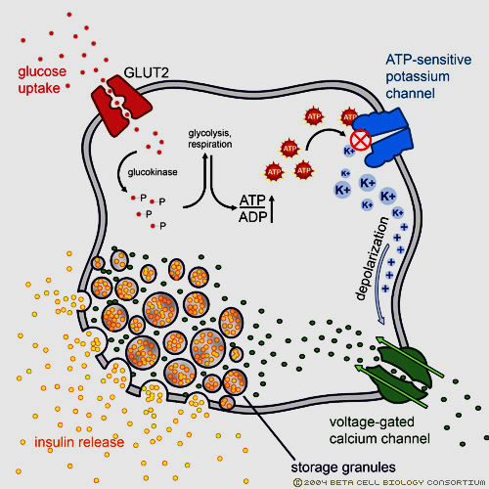
Insulin secretion
Notes:
When the plasma glucose concentration increases,
Glucose is transported into beta cells by facilitated diffusion through a glucose transporter, GLUT-2.
Results in increase in glucose concentration in beta cells
Glucose is phosphorylated and metabolized in beta cells
Increase in ATP production within the beta cell
ATP-sensitive potassium channels on membrane closes. This depolarises the plasma membrane.
Calcium channels on the membrane opens
There is influx of extracellular calcium ions into the cell
Calcium ions causes vesicles containing insulin to be exocytosed from beta cells

Slide 12
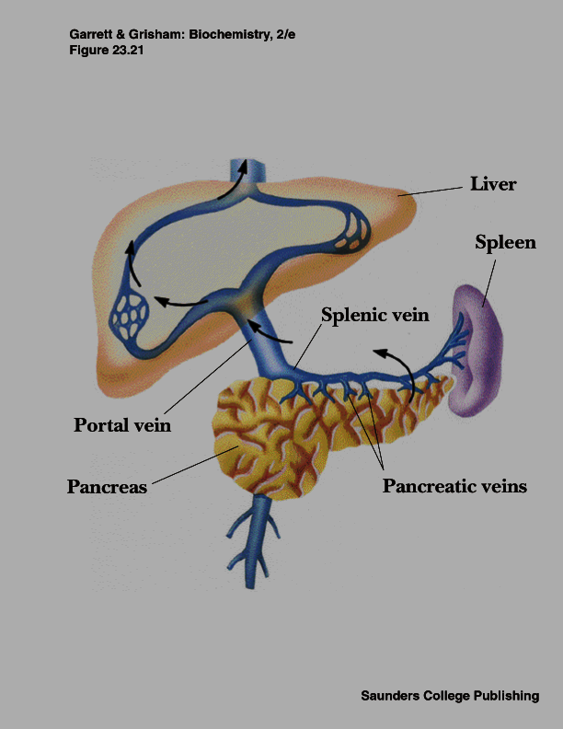
Insulin secreted into portal circulation

Slide 13
Regulation of Insulin secretion
Factors stimulating insulin secretion
Chemical
Glucose
Amino acids (arginine, alanine), fatty acids, ketone bodies also stimulates insulin release
Hormonal
GIT hormones: GLP-1, GIP, gastrin, secretin, released after food increases insulin secretion
Factors inhibiting insulin secretion
Epinephrine suppresses insulin secretion.
Notes:
Increase in blood glucose is most important stimulus for insulin secretion.
Gastrointestinal peptide hormones: The intestinal peptides glucagon-like protein-1 (GLP-1) and gastric inhibitory polypeptide which is also called glucose-dependent insulinotropicpeptide (GIP) increase sensitivity of beta cells to glucose.
Epinephrine inhibits insulin release. It has a direct effect of energy metabolism causing mobilisation of energy yielding compounds such as glucose from liver and fatty acids from adipose tissue.

Slide 14
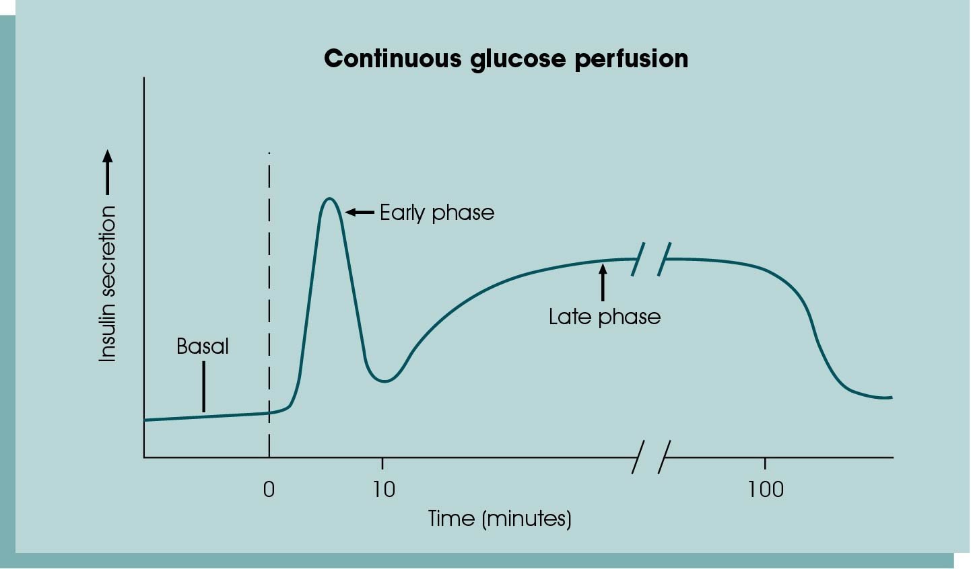
The biphasic insulin response
Notes:
Insulin secretion is biphasic.
The first phase of insulin secretion occurs within 10 mins of stimulation and is the release of preformed insulin.
The second phase which lasts up to 2 hours is the release of newly synthesised insulin.

Slide 15
Notes:
The intestinal peptides glucagon-like protein-1 (GLP-1) and gastric inhibitory polypeptide (GIP) are released from small intestine after ingestion of food, causing a rise in insulin level and are referred to as ‘incretins’.

Slide 16
I
Notes:
Insulin secretion is higher after oral glucose intake compared to intravenous administration and is known as incretin effect.
Incretin effect is reduced in diabetics.

Slide 17
Insulin metabolism
Secreted into portal circulation
50% of degradation in liver
50% of degradation in other target tissues and kidney
Enzymatic degradation follows receptor-mediated endocytosis
Plasma half-life: 3 - 5 min

Slide 18
Metabolic effects of Insulin
Promotes anabolic processes
Inhibits catabolic processes
Liver cells
Increases glycogenesis
Increases conversion of glucose to fatty acids
Inhibits gluconeogenesis
Inhibits glycogenolysis
Inhibits ketogenesis
Muscle cells
Increases uptake of glucose from blood into the cells
Increases glycogenesis
Increases amino acid uptake & protein synthesis
Increases K⁺ uptake
Inhibits protein degradation
Inhibits glycogenolysis
Adipose tissue
Increases uptake of glucose and conversion to glycerol
Increases triacylglycerol synthesis
Inhibits lipolysis
Notes:
Insulin activates lipoprotein lipase in blood capillaries, leading to hydrolysis of triacylglycerol in circulating lipoproteins

Slide 19
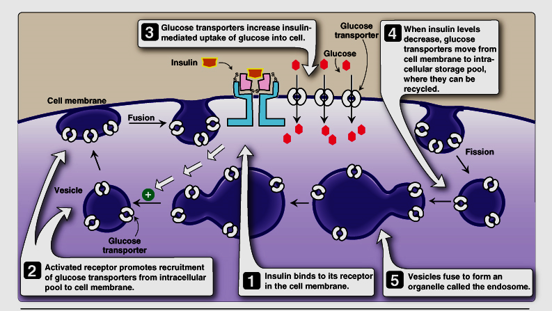
Insulin causes cells to recruit transporters
from intracellular stores
Notes:
Glucose is hydrophilic whereas cell membrane is hydrophobic.
Glucose cannot enter by simple diffusion.
Glucose enters cells by facilitated diffusion involving glucose transporter protein
Insulin facilitates glucose transport into muscle and adipose cells by increasing number of glucose transporters in cell membrane by causing glucose transporters (GluT4) to move from intracellular stores to cell membrane.

Slide 20
Homeostatic control

Slide 21
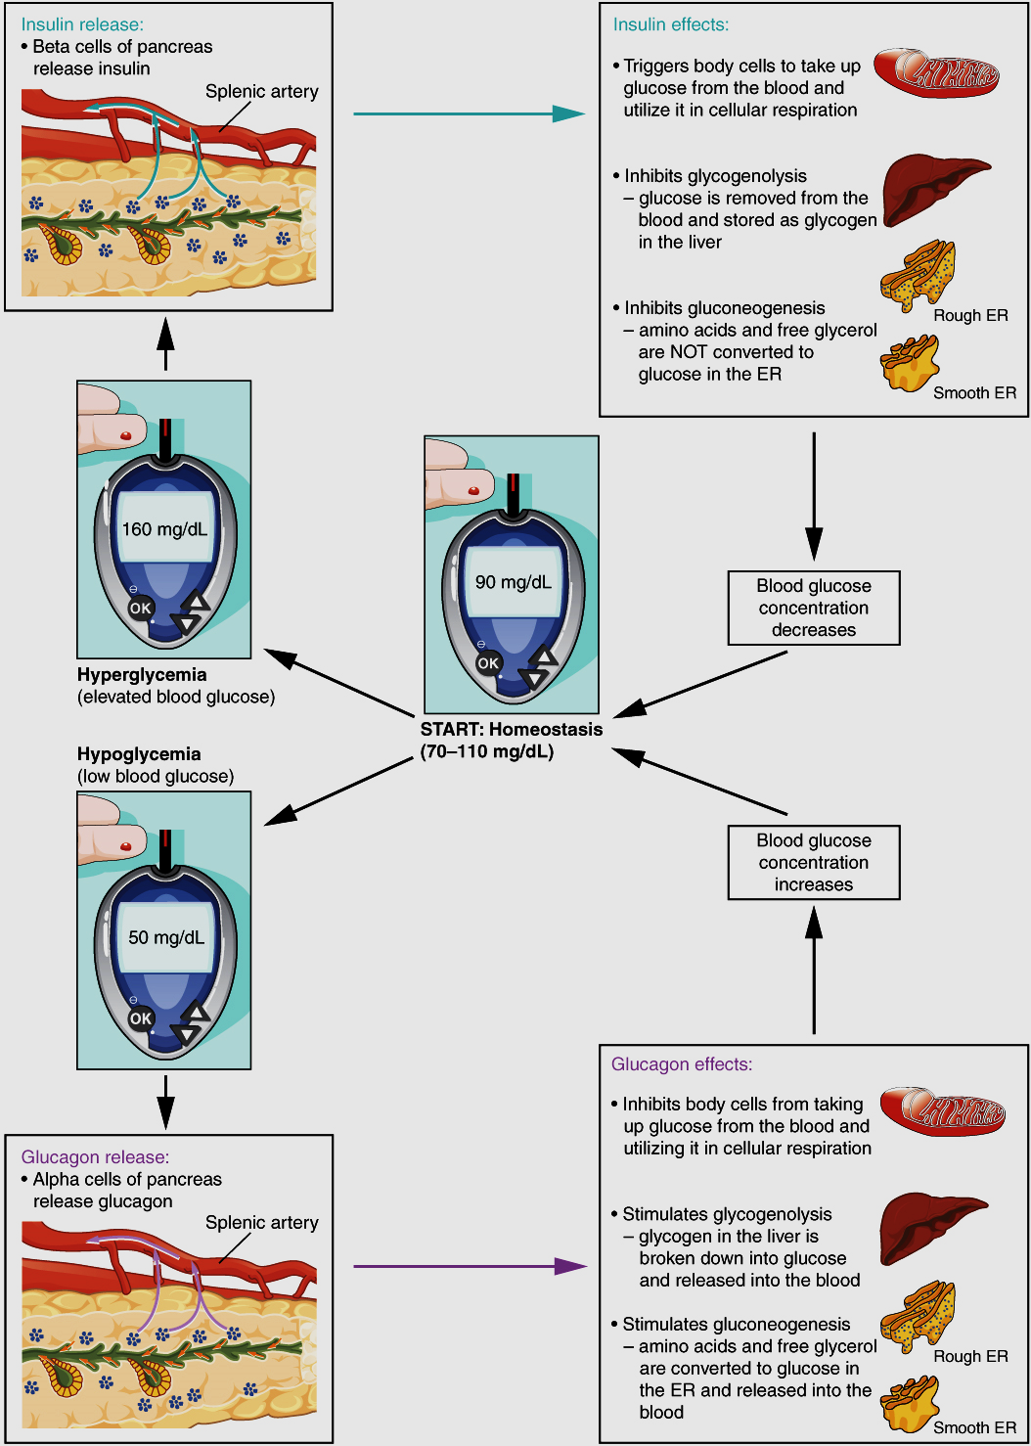
Glucose homeostasis by insulin and glucagon
Notes:
Increase in blood glucose levels will stimulate beta cells of pancreas to release insulin. Insulin stimulates adipose and muscle cells to take up glucose from the blood and utilised in cellular respiration and glycogenesis. Insulin also inhibits glycogenolysis and gluconeogenesis. Thus blood glucose concentration decreases.
Decrease in blood glucose level will stimulate alpha cells of the pancreas to release glucagon. Glucagon inhibits adipose and muscle cells from taking up glucose from the blood and utilising it. Glucagon stimulates glycogenolysis and gluconeogenesis. Thus blood glucose concentration increases.

Slide 22
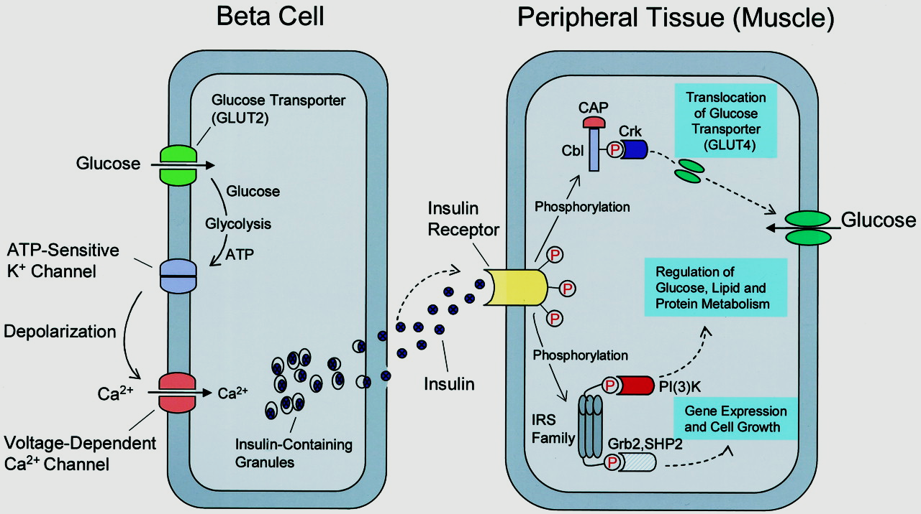
Insulin release and action

Slide 23
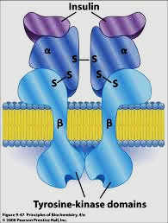
Structure of insulin receptor
Insulin receptor (glycoprotein) consists of
- α subunit that binds insulin and
- β subunit that has tyrosine kinase activity and can undergo autophosphorylation
Notes:
Insulin receptor
The extracellular alpha subunit contains the insulin binding site.
A hydrophobic domain in each beta subunit spans the plasma membrane. The cytosolic domain of the beta which is activated by insulin subunit, is a tyrosine kinase. Thus insulin receptor is a tyrosine kinase receptor.

Slide 24
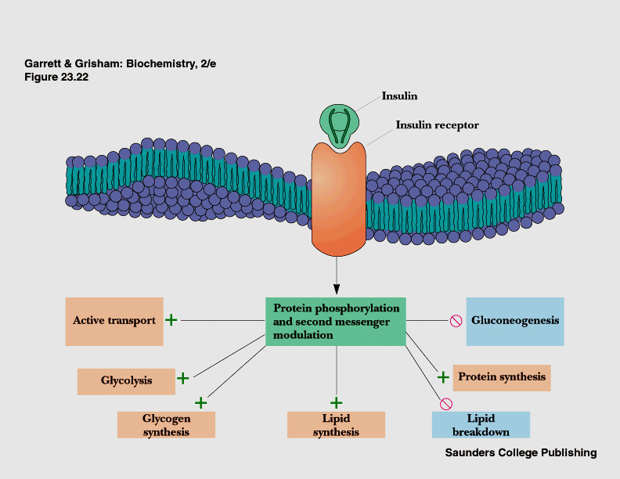
Mechanism of insulin action

Slide 25
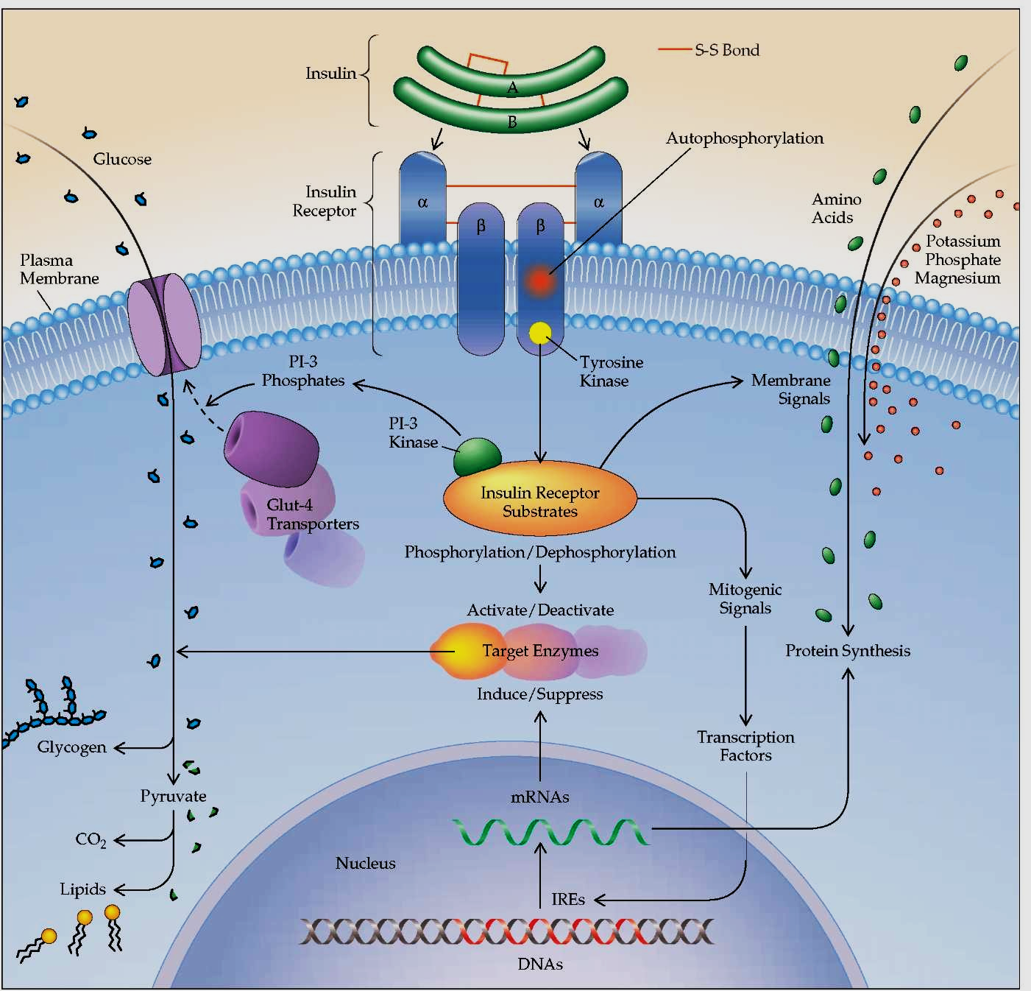
Mechanism of insulin action
Notes:
Insulin binds to α subunit of receptor
This activates tyrosine kinase in β subunits
Tyrosine residues on β subunits are autophosphorylated
Tyrosine kinase in insulin receptor phosphorylates intracellular proteins (eg. insulin receptor substrate {IRS})
Phosphorylated IRS interacts with other intracellular proteins involved in mediating different effects of insulin

Slide 26
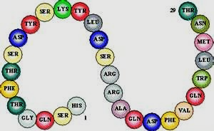
Structure of Glucagon
29 amino acids – single peptide

Slide 27
Metabolic effects of glucagon
Liver
Glucagon increases glycogenolysis
Glucagon increases gluconeogenesis
Adipose tissue
Glucagon stimulates breakdown of triacylglycerols

Slide 28
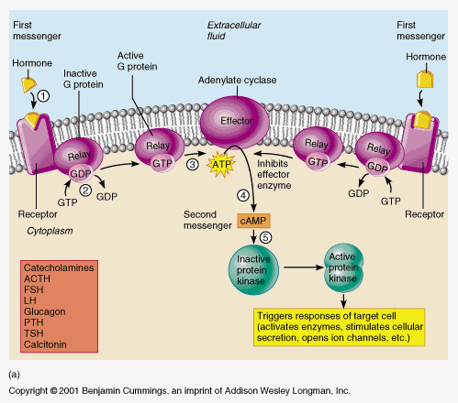
Mechanism of glucagon action
Glucagon binds to receptors cell membranes
Activates adenylate cyclase in plasma membrane
Increases level of cAMP
Activates cAMP-dependent protein kinase
Increases phosphorylation of specific enzymes/proteins leading to the biological effect

Slide 29
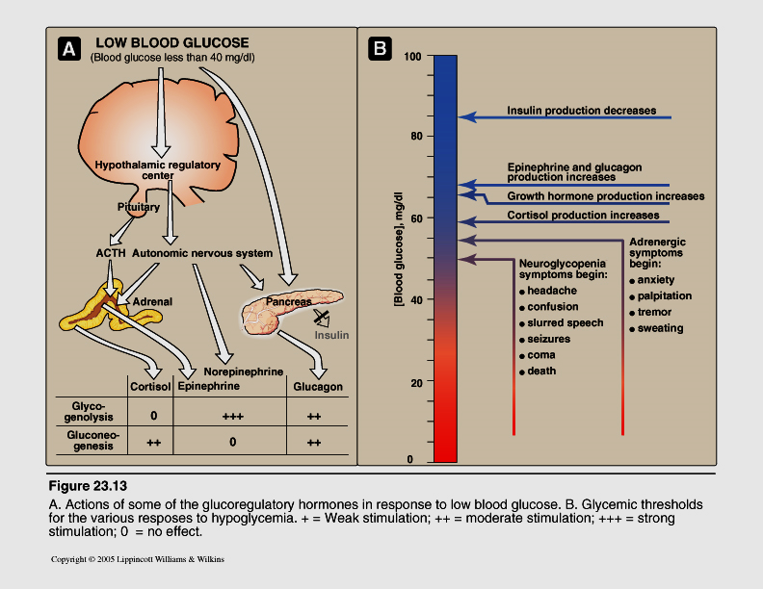
Actions of counter regulatory hormones
Notes:
Major insulin counter regulatory hormones. Low blood glucose level mediates the release of the insulin counter regulatory hormones through neuronal signals. Hypoglycemia stimulates the release of cortisol, epinephrine, and norepinephrine. Adrenocorticotropic hormone (ACTH) is released from the pituitary and stimulates the release of cortisol (a glucocorticoid) from the adrenal cortex. Neuronal signals stimulate the release of epinephrine from the adrenal medulla and norepinephrine from nerve endings. Neuronal signals also play a minor role in the release of glucagon. Although norepinephrine has counter regulatory actions, it is not a major counter regulatory hormone.

Slide 30
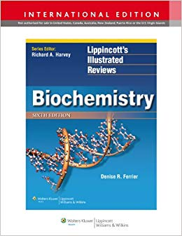
Reference
Lippincott’s Illustrated Reviews: Biochemistry by Denise R Ferrier

Slide 31
Formative questions
Which of the following cells demonstrate insulin-dependent uptake of glucose?
Kidney cells
Muscle cells
Liver cells
Red blood cells

