Slide 1
Functional Basis of Molecular Diseases
Dr Mayuren Candasamy

Slide 2
Learning outcomes
At the completion of this module, the students should be able
To evaluate the interaction between drugs and receptors.

Slide 3


Slide 4
Introduction
Most drugs exert their effects by interacting with receptors that is, specialized target macromolecules present on the cell surface or intracellularly.
A general property of all receptors is the ability to interact with their endogenous ligands (hormones and neurotransmitters) to alter cellular responsiveness without changing the chemical nature of the ligand.

Slide 5
Intro…..
In each case, the formation of the drug–receptor complex leads to a biologic response.
Cells may have tens of thousands of receptors for certain ligands (drugs).
Cells may also have different types of receptors, each of which is specific for a particular ligand.

Slide 7
Importance of receptors
It determines selective therapeutic and toxic effects of the drug.
Receptors largely determine the quantitative relation between dose of a drug and its effect.

Slide 8
Drug-receptor interaction
The two properties of a drug that determine the nature of its interaction with the receptor are it’s:
Affinity: The ability of the drug to get bound to the receptor is known as affinity.
Intrinsic activity/ Efficacy: The ability of the drug to produce a pharmacological action after combining with the receptor is known as intrinsic activity of the drug.

Slide 9
Efficacy [intrinsic activity]
This is the ability of a drug to illicit a physiologic response when it interacts with a receptor.
Efficacy is dependent on the number of drug–receptor complexes formed and the efficiency of the coupling of receptor activation to cellular responses.

Slide 10
Efficacy [intrinsic activity] contd..
Analogous to the maximal velocity for enzyme-catalyzed reactions, the maximal response (E_{max}) or efficacy is more important than drug potency.
A drug with greater efficacy is more therapeutically beneficial than one that is more potent.

Slide 11
Agonist
Agonist is a drug that interacts with a receptor and produces effects by activating a receptor.
Direct agonism
Indirect agonism
Partial agonist: A drug that displays efficacy that is intermediate between that of an agonist and an antagonist is called a partial agonist.

Slide 12
Antagonist
Antagonist are drugs that interact with receptors but do not initiate an effect.
The inhibitory effects of antagonists that act reversibly at the agonist binding site can be overcome by increasing the concentration of an agonist – Competitive antagonist.
An irreversible interaction between the receptor and the antagonist – Non-competitive antagonist.

Slide 13
Partial agonist
A drug that displays efficacy that is intermediate between that of an agonist and an antagonist is called a partial agonist.

Slide 14
Some characteristic of receptor
Spare receptor
  Example: Insulin receptor (99% of receptors are spare receptor).
  Beta-adrenergic receptor (5- 10% receptors are spare)
Desensitization of receptor
  Unresponsiveness of receptor
  Down regulation of receptor

Slide 15

Regulation of receptors
Receptors are in a dynamic state. The density or the affinity of the receptors to drugs is not fixed. It alters according to the situation.
Receptor down-regulation
Prolonged use of agonists
Receptor number expressed in membrane (internalization)and sensitivity of receptors
Drug effect
For example, chronic use of salbutamol downregulates the β2- adrenoceptors.
Receptor up-regulation
Prolonged use of antagonists
Receptor number and sensitivity of receptors
agonist effect
For example, when propranolol is stopped after prolonged use, some patients experience withdrawal syndrome such as nervousness, anxiety, palpitation, tachycardia, rise in BP, increased incidence of angina.

Slide 16
Dose response relationship
A pharmacological response is a function of the dose or concentration of a drug.
Dose response curves are graphical representation of the relationship between dose and response.
The magnitude of the drug effect depends on the drug concentration at the receptor site.
There are two types of responses: quantal or “all-or-none” and graded.

Slide 17
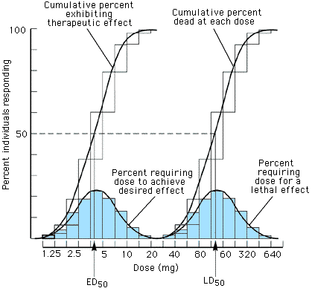
Quantal Dose-Response
The response is represented as cumulative percentage of subjects exhibiting a defined effect.
The median effective (ED50), median toxic (TD50) ,and median lethal doses (LD50) are extracted from experiments carried out in this manner.
Examples: Analgesia for headache

Slide 18
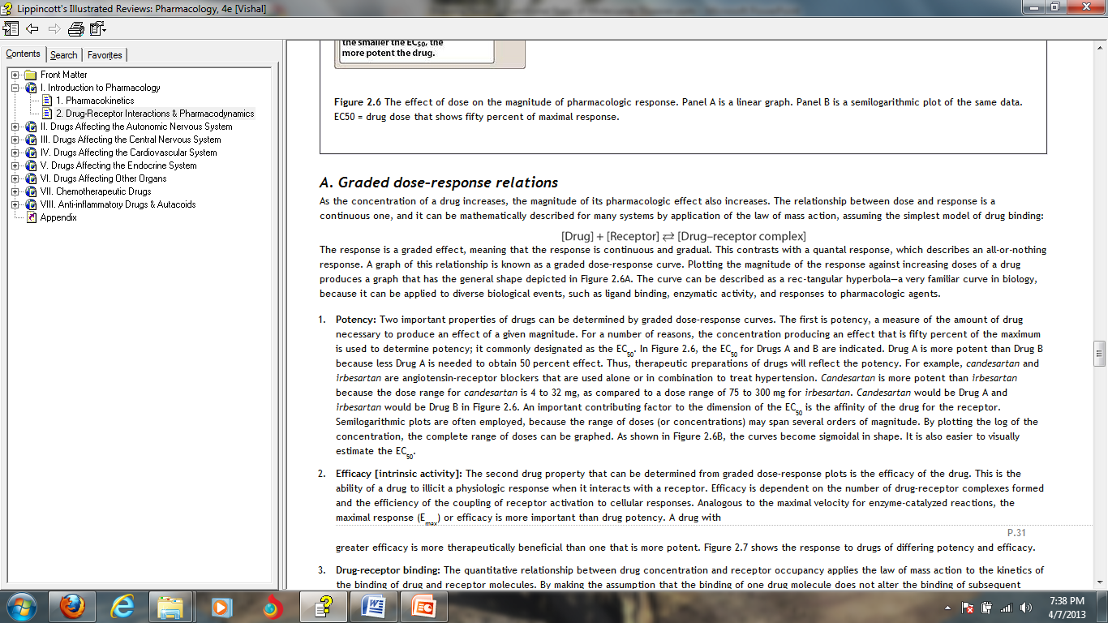
Graded dose-response relations
As the concentration of a drug increases, the magnitude of its pharmacologic effect also increases.
The relationship between dose and response can be mathematically described by application of the law of mass action, assuming the simplest model of drug binding:

Slide 19
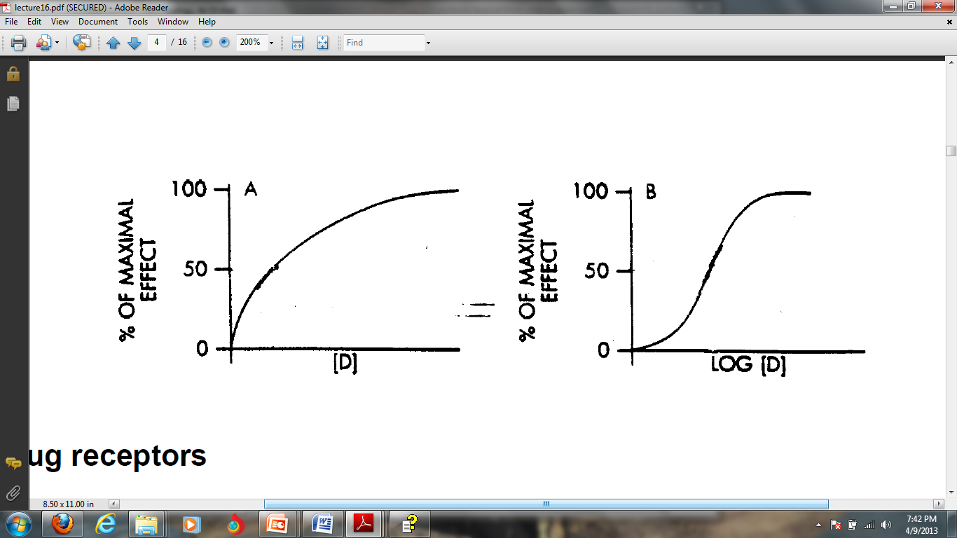
Graded response
Responses are often described as a percentage of maximal response.
A: A linear concentration scale yields the rectangular hyperbolic curve.
B: Plotting using logarithm of concentration yields a sigmoidal curve (most common)

Slide 20
Potency
A measure of the amount of drug necessary to produce an effect of a given magnitude.
For a number of reasons, the concentration producing an effect that is fifty percent of the maximum is used to determine potency; it commonly designated as the EC₅₀
Thus, therapeutic preparations of drugs will reflect the potency.
An important contributing factor to the dimension of the EC₅₀ is the affinity of the drug for the receptor.
Semilogarithmic plots are often employed, because the range of doses (or concentrations) may span several orders of magnitude.

Slide 21
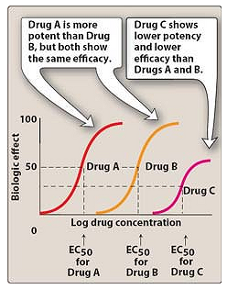
Typical dose-response curve for drugs showing differences in potency and efficacy.
(EC₅₀ = drug dose that shows fifty percent of maximal response.)

Slide 22
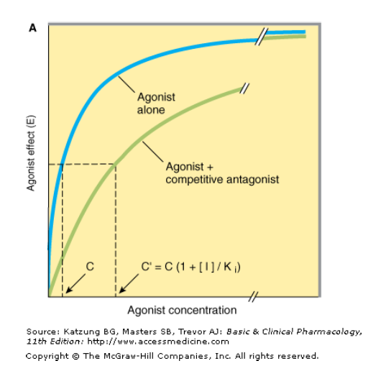
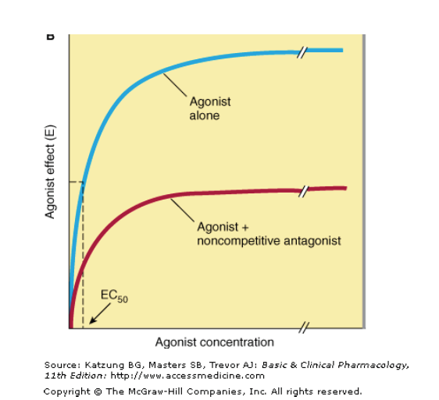
Antagonist

Slide 23
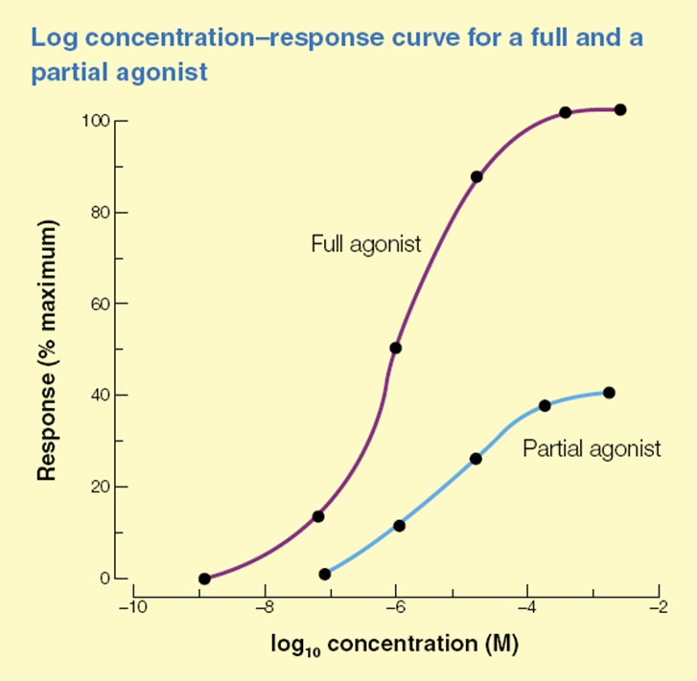
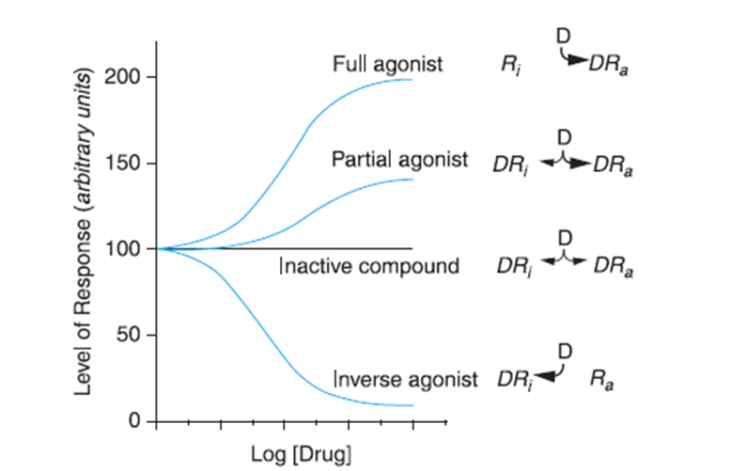
Agonists

Slide 24
Receptor theory
Receptor theory is the application of receptor models to explain drug behaviour.
The occupancy model was the first model put forward by Clark to explain the activity of drugs at receptors and quantified the relationship between drug concentration and observed effect.

Slide 25
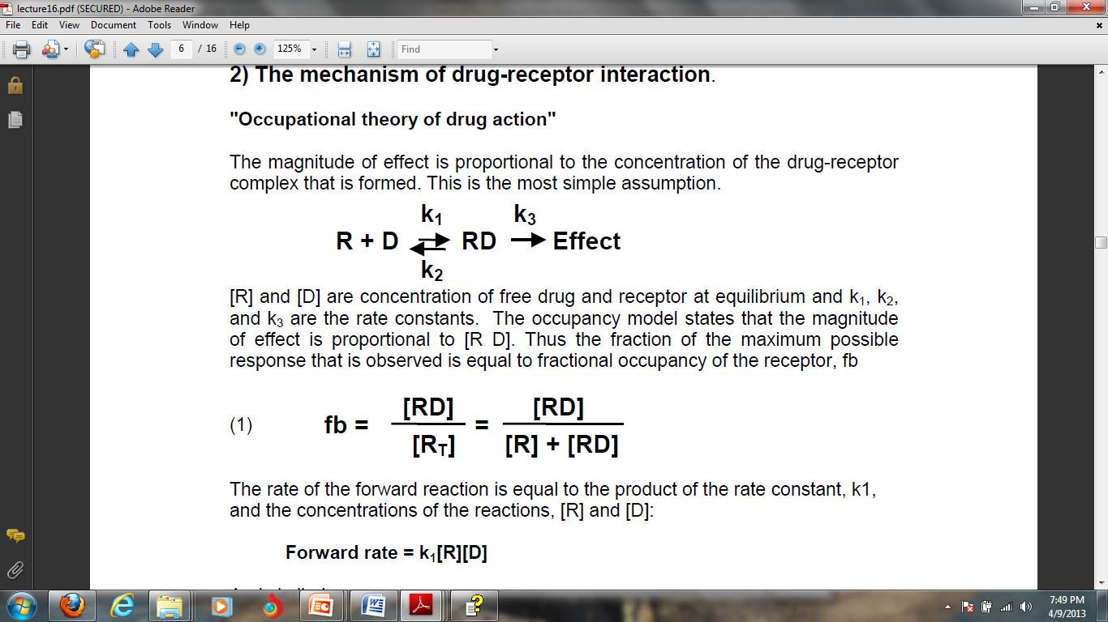
Drug-receptor binding

Slide 26
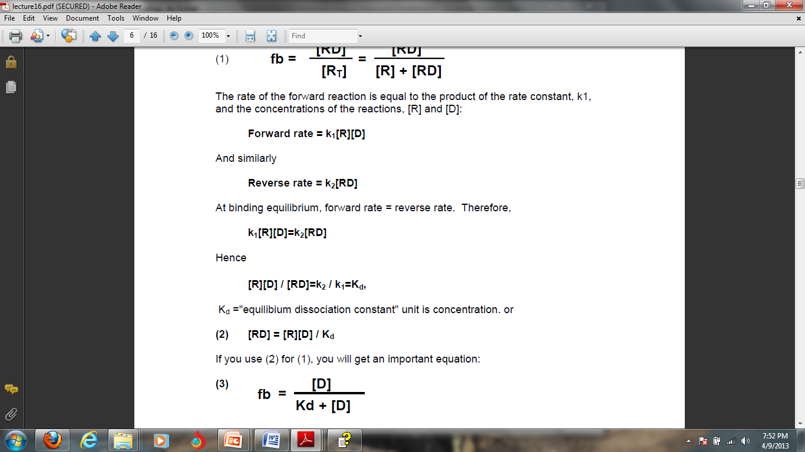

Slide 27
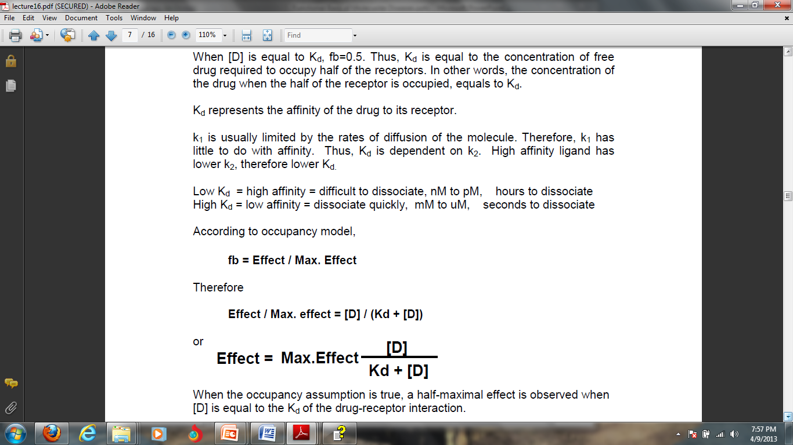

Slide 28
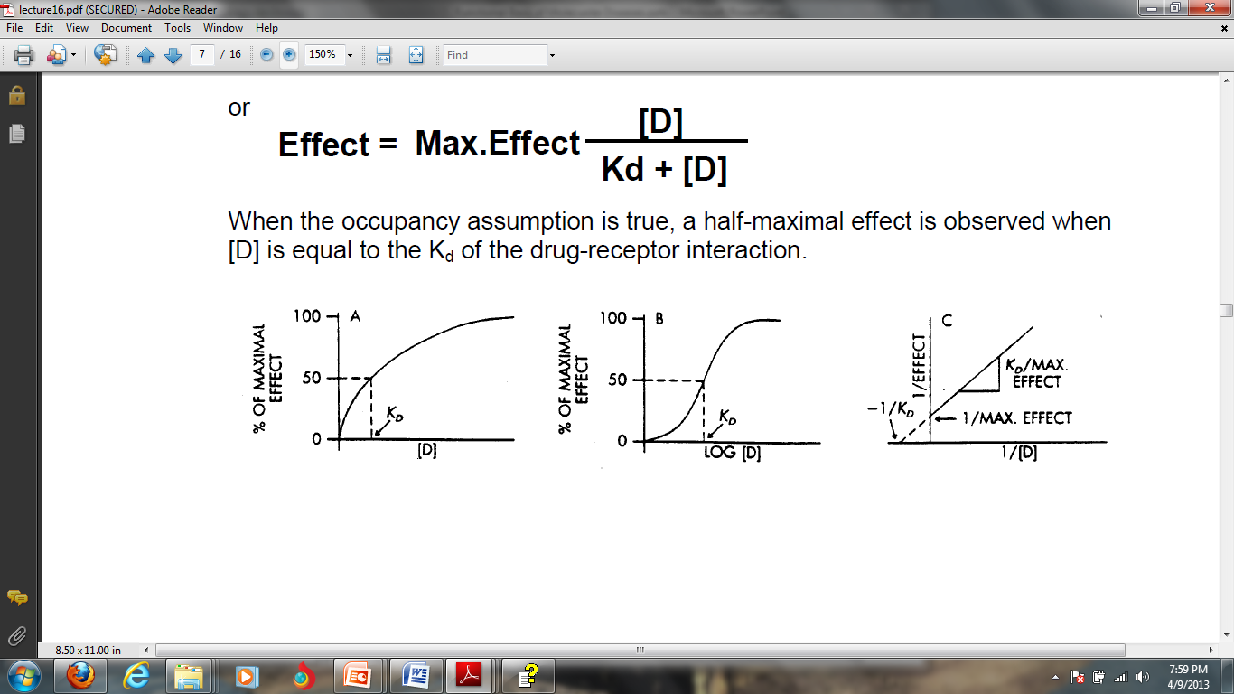

Slide 29
Two-state receptor theory
The previous theory doesn't distinguish between the occupation and activation of the receptor
The two-state model is a simple linear model to describe the interaction between a ligand and its receptor, but also the active receptor (R*).
The model uses an equilibrium dissociation constant to describe the interaction between ligand and receptor.
It proposes that ligand binding results in a change in receptor state from an inactive to an active state based on the receptor's conformation.

Slide 30

Ka: Dissociation equilibrium constant
E: equilibrium constant
A: agonist
R: Receptor

Slide 31
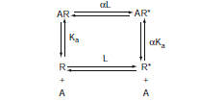
two receptor conformations R and R* controlled by an equilibrium dissociation constant L where
L = [R*]/[R]
Ka = (k1/k2)
α denotes the differential affinity of the agonist for R*
This model explain about the agonist and inverse agonist

Slide 32
Operational model
The basis of the operational model is the experimental finding that the experimentally obtained relationship between agonist-induced response and agonist concentration resembles a model of enzyme function presented in 1913 by Louis Michaelis and Maude L. Menten.

Slide 33
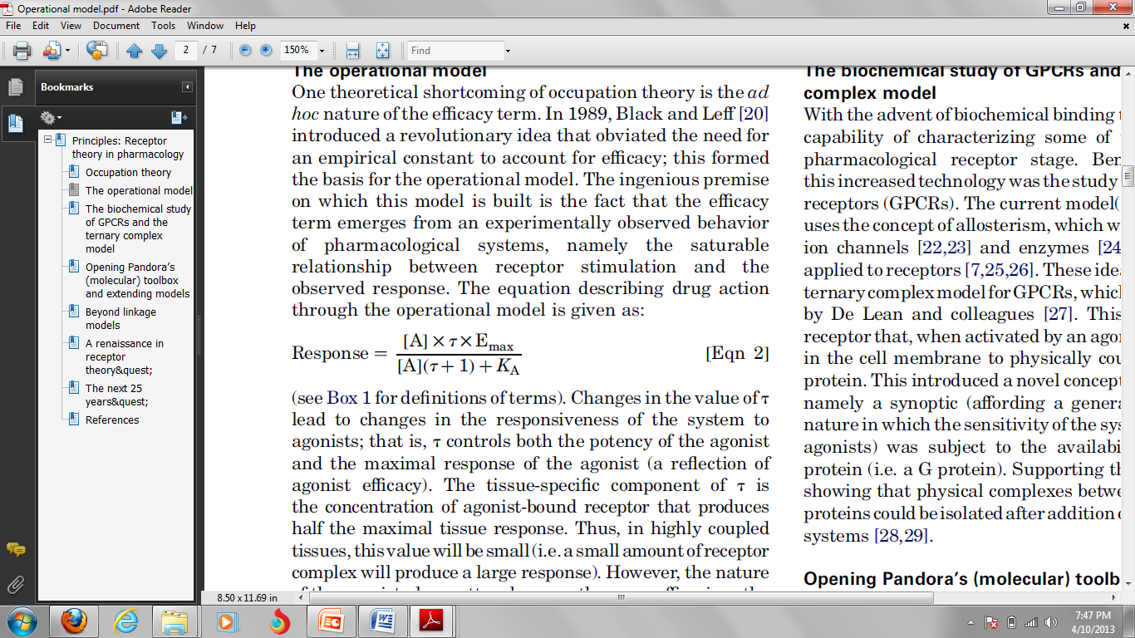
Operational model
The equation describing drug action through the operational model is:
E_{max} is the maximal response that can be obtained from the system
K_{E} the concentration of the AR complex that produces 50% of the maximal response.
[R_{t}] is the receptor density
K_{A} is the equilibrium dissociation constant of the AR complex
τ is the ratio [R_{t}] / K_{E}
Changes in the value of τ lead to changes in the responsiveness of the system to agonist, it controls both the potency of the agonist and the maximal response of the agonist.

Slide 34
An important and versatile parameter in the operational equation is τ;
This constant incorporates the intrinsic efficacy of the agonist: describing the efficiency of the tissue as it converts agonist-derived stimulus into tissue response

Slide 35
Ternary complex model
The ternary complex model was used to describe ligand, receptor, and G-protein interactions.
This model describes a receptor that when activated by an agonist moves laterally in the cell membrane to physically couple to trimeric G protein
It uses equilibrium dissociation constants for the interactions between the receptor and each ligand (K_{a} for ligand A; K_{b} for ligand B), as well as a cooperativity factor (α) that denotes the mutual effect of the two ligands on each other’s affinity for the receptor.

Slide 36
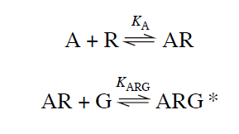
G-protein
ARG*: Ternary complex

Slide 37
Here, the agonist–receptor complex (AR) combines with a G-protein (G) to form a ternary complex
(ARG*), which can initiate further cellular events, such as the activation of adenylate cyclase.
However, this simple scheme (the ternary complex model) was not in keeping with what was already known about the importance of isomerization in receptor activation
it also failed to account for findings that were soon to come from studies of mutated receptors.

Slide 38
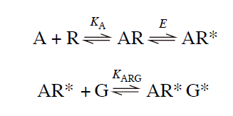

Slide 39
Here, combination of the activated receptor (AR*) with the G-protein causes the latter to enter an active state (G*) which can initiate a tissue response through, for example, adenylate cyclase, phospholipase C, or the opening or closing of ion channels.
In this scheme, what will determine whether a particular agonist can produce a full or only a limited response?
Suppose that a high concentration of the agonist is applied, so that all the receptors are occupied. They will then be distributed among the AR, AR*, and AR*G* conditions, of which AR*G* alone leads to a response.

Slide 40
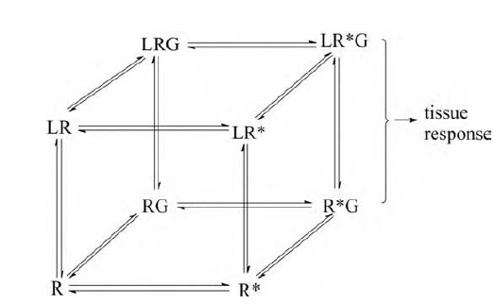
FIGURE : An elaboration of the model reproduced as the front face of the cube.
Each of its four elements (R, R*, LR, and LR*) can combine with a G-protein to form RG, R*G, LRG, and LR*G, respectively. Of these, only R*G and LR*G lead to a tissue response. The top face of the cube shows ligand-bound states of the receptor.

Slide 41
Suppose that L combines only with the inactive, R, form. Then the presence of L, by promoting the formation of LR at the expense of the other species, will reduce the proportion of receptors in the active, R*, state. L is said to be an inverse agonist or negative antagonist and to possess negative efficacy.
If, in contrast, L combines with the R* form alone, it will act as a conventional or positive agonist of very high intrinsic efficacy.

Slide 42
Thank you

