Slide 1
Maternal Health AP Dr Tan Kok Leong Department of Community Medicine

Slide 2
Learning Outcomes
Describe the scope and health care services of maternal health
Describe the principles of making pregnancy safer
Describe the principles of safe motherhood and mother-baby package

Slide 3
Every minute of every day
380 women become pregnant
190 of them do not wish to be pregnant
110 women experience pregnancy related complication
40 women undergo unsafe abortion
1 women dies from pregnancy- related complications
8 babies die from pregnancy and delivery-related complications and lack of newborn care

Slide 4
Maternal Mortality
About 500,000 women die each year from pregnancy-related complications
24%: haemorrhage
20%: indirect causes
15%: sepsis
13%: unsafe abortion
12%: hypertension including eclampsia
8%: obstructed labour
8%: other direct causes

Slide 5
Maternal Mortality _{(cont)}
Every day, nearly 830 women die from preventable causes related to pregnancy and childbirth
By the end of 2015, roughly 303 000 women had died (99% in developing world)
Maternal mortality is higher among women living in rural areas and among poorer communities
Young adolescents face a higher risk of complications and death
Between 1990 and 2015, maternal mortality worldwide dropped by about 44%
Between 2016 and 2030 reduce global maternal mortality ratio to less than 70 per 100 000 live births

Slide 6
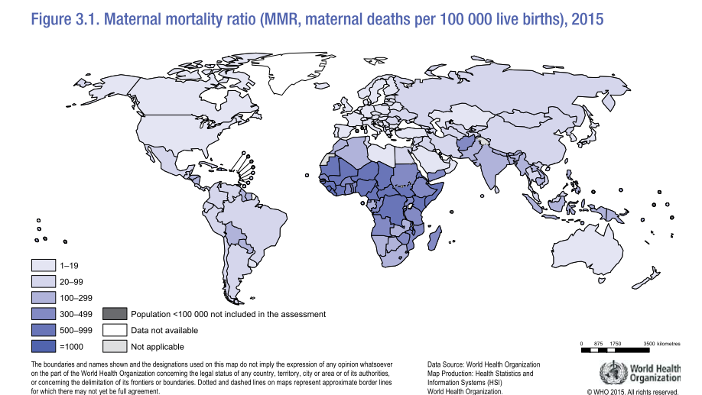

Slide 7
Reducing maternal mortality involves:
Reducing the number of pregnancies
Reducing the number of complications
Reducing case fatality rates among complicated cases

Slide 8
Gender and Women Health
In many societies, women systematically fail to achieve or fail to use some basic human rights according to men
Most of the time, women’s health status and problems are related and affects:
Morbidity
Disability
Mortality
DISCRIMINATION THROUGH THE LIFE OF WOMEN

Slide 9
Neglect
Cannot benefit from the services
Violence
Social pressure
Increase in morbidity
ADOLESENT/ADULT
Unwanted pregnancies, STDs
Sexual harassment/abuse
Turnpike sex
Smoking and substanve abuse
OLDERS
Increase in morbidity /problems on quality of life
CHILDHOOD
Sex selective abortion
Female mutilation
Nutrition problems

Slide 10
Safe Motherhood – ‘Origins’
The United Nations decade for Women 1976-85 raised the focus on the scale of suffering associated with maternity;
Most of the suffering preventable;
In 1987, experts from 30 countries met in Nairobi to draw the world’s attention to the fact that at least 500,000 women were dying every year from complications of pregnancy and childbirth;
The Nairobi meeting launched the Safe Motherhood Initiative whose aim was to reduce by half the number of maternal deaths by end of the century

Slide 11
Safe Motherhood – ‘A definition’
“Safe motherhood” means:
Creating the circumstances within which a woman is enabled to choose whether she will become pregnant, and if she does, ensuring she receives care for prevention and treatment of pregnancy complications, has access to trained birth assistance, has access to emergency obstetric care if she needs it, and care after birth, so that she can avoid death or disability from complications of pregnancy and childbirth
A woman’s ability to have a safe and healthy pregnancy and childbirth
Safe Motherhood is not another vertical programme

Slide 12
Five Pillars of Safe Motherhood
SAFE MOTHERHOOD
Family Planning
Antenatal Care
Clean/ Safe Delivery
Essential Obstetric Care
Responsible Fatherhood
BASIC MATERNITY CARE
PRIMARY HEALTH CARE
EQUITY FOR WOMEN

Slide 13
Five Pillars of Safe Motherhood _{(cont1)}
Antenatal care
Prevent complications
Ensure problem detected early and treated appropriately
Clean and safe delivery
All birth attendants have knowledge, skills and facilities to perform clean and safe delivery
Emergency obstetric care
To ensure that essential care for risk pregnancy and complications that arise during and post delivery

Slide 14
Five Pillars of Safe Motherhood _{(cont2)}
Family planning
Family/ couples have knowledge and service to make decision on timing, number and spacing of childbirth
Responsible fatherhood

Slide 15
Mother-Baby Package
An integrated approach
Family planning
STD management
Maternal and Newborn health/ care
Goal
Contribute to the reduction of
Maternal mortality by half of 1990 levels by 2000 (MDG) and subsequently SDG
Perinatal and neonatal mortality by 30-40% of 1990 levels by 2000 (MDG) and subsequently SDG

Slide 16
Mother-Baby Package _{(cont1)}
How to achieve the goal:
Define national policy and guidelines
Assess needs
Estimate costs
Prepare national plan of action
Identify sources of financial support
Develop detailed implementation plan
Implement planned activities
Monitor and evaluate

Slide 17
Mother-Baby Package _{(cont2)}
Intervention for mother and baby:
Before and during pregnancy
During delivery
After delivery
Mother
Infant
Intervention during delivery:
Clean and safe delivery
Recognition, early detection and management of complications at health centre or hospitals (for example haemorrhage, eclampsia, prolonged/ obstructed labour)

Slide 18
Mother-Baby Package _{(cont3)}
Intervention after delivery: Mother
Recognition, early detection and management of postpartum complications at health centre or hospital (for example haemorrhage, sepsis and eclampsia)
Postpartum care (promotion and support to breastfeeding and management of breast complications)
Information and services for family planning
STD/ HIV prevention and management
Tetanus toxoid immunization
Intervention after delivery: Newborn
Resuscitation
Prevention and management of hypothermia
Early and exclusive breastfeeding
Prevention and management of infections including ophthalmia neonatorum and cord infections

Slide 19
Issues in Management of Maternal Care Services and Safe Motherhood
Do we know where we are?
Are we systematically monitoring our service delivery, analyzing the data and taking appropriate action
Do we know what our priority problems are?
MCH 70% of population, cause of MMR
Budget low
Do we have specific goals and objectives (yearly targets) set for maternal care services?
To reduce MMR by 10% every year
To increase antenatal care or 8 visits per pregnancy
To increase postnatal care from 1 to 2 visits for each pregnancy

Slide 20
Issues in Management of Maternal Care Services and Safe Motherhood _{(cont)}
Are we providing enough resources for MCH?
Health centres for rural areas
Equipment
Supplies (drug, vitamins)
Are we reaching all women of reproductive age?
Access to care (geographical/ financial)
Knowledge of women (are women knowledgeable)
Are we meeting the needs of our clients?
Is the community involved?
Are health workers skillful?
Are they technically competent?

