Slide 1


Descriptive Statistics (Part III)
Measures of Dispersion
By
Dr Lwin Mie Aye
Senior Lecturer (M.B;B.S)
Community Medicine Department

Slide 2
Measures to Describe Frequency distribution
Identify an appropriate methods of presenting data in graphs and tables
Describe the data using appropriate descriptive statistics

Slide 3
Measures to Describe Frequency distribution
There are TWO main types of measures that are used to describe frequency distributions
Measures of central tendency
Measures of variability or dispersion

Slide 4
Measures of Dispersion
Measures of dispersion are descriptive statistics that describe how similar a set of scores are to each other
  The more similar the scores are to each other, the lower the measure of dispersion will be
  The less similar the scores are to each other, the higher the measure of dispersion will be
  In general, the more spread out a distribution is, the larger the measure of dispersion will be
Dispersion measures the extent to which the items vary from some central value

Slide 5
Measures of dispersion/ variability (Cont:)
There are several ways to measure the variability of the data
Variance
Standard deviation
Coefficient of variation
Range
Interquartile range

Slide 6
Variance (S²)
Average of squared deviation from the mean
Where the mean is a measure of the centre of a group of numbers, the variance is the measure of the spread from the centre.
It involves measuring the distance between each of the values and the mean.
The larger the variance value the further the observed values of the data set are dispersed from the mean.
A variance value of zero means all observed values are the same as the mean.
s² is our best estimate of the population variance σ²

Slide 7
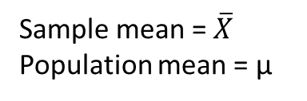
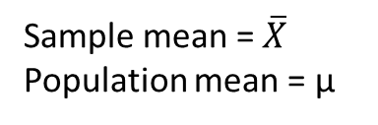
Variance on Distribution Curve
Mean
Squared deviation from the mean is “Variance”
δ²
μ
Sample Variance = S²
Population variance = δ²
Sample mean = $\overline{X}$
Population mean = μ

Slide 8
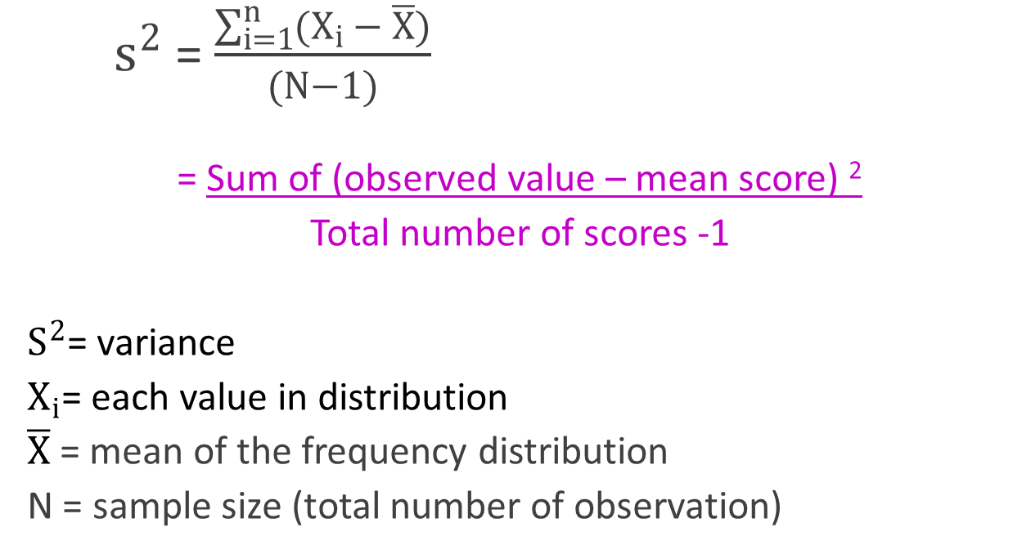
Variance Formula
  $s^{2}$ = $\frac{\sum_{i=1}^{n}{(X_{i }}− \overline{X})}{(N−1)}$
  = Sum of (observed value – mean score) ²
  Total number of scores -1
  $S^{2}$= variance
  $X_{i}$= each value in distribution
  $\overline{X}$ = mean of the frequency distribution
  N = sample size (total number of observation)

Slide 9
Calculation of Variance (S²⁾
To calculate the variance :
  Calculate the mean
  For each value in the distribution subtract the mean and then square the result (the squared difference)
  Squared differences are summed and divided by (N-1)
N-1 is called degree of freedom which is symbolized by “d”. The concept of degree of freedom will be covered in inferential statistics
Variance has no units
Interpretation of variance is not easy original units of measure are squared to arrive at the variance.

Slide 10
Standard Deviation
Sample standard deviation (abbreviated s or SD)
Most commonly used measure to describe variability is standard deviation (SD)
SD is a function of the squared differences of each observation from the mean
SD is the square root of variance.
SD measures the variability in the same units of measurement as the sample.

Slide 11
Describing Variability
Sample variance (s²)
Sample standard deviation (s or SD)
The sample variance is the average of the square of the deviations about the sample mean
Measure of how different the values in a set of numbers are from each other
The sample standard deviation is the square root of s²

Slide 12
Describing Variability
Example: n = 5 systolic blood pressures (mm Hg)

Slide 13
Describing Variability
Example: n = 5 systolic blood
pressures (mm Hg)
X = 99 mm HG
Now:

Slide 14
Describing Variability
Sample Variance
Sample standard deviation (SD)
s = 15.97 (mm Hg)

Slide 15
Calculation of Standard Deviation
The individual steps involved in this calculation are as follows
Step 1: Calculate the mean of the numbers.
Step 2: Find the deviations from the mean.
Step 3: Square each deviation.
Step 4: Sum the squared deviations.
Step 5: Divide the sum in Step 4 by n – 1.
Step 6: Take the square root of the quotient in Step 5.

Slide 16
EXAMPLE
Group 1 data: 1,1,1,2,3,3,5,8,20
  Mean: 4.9 Median: 3
Group 2 data: 1,1,1,3,3,3,5,8,10
  Mean: 3.8 Median: 3
SD: group 1: 6.1 group 2: 3.2
What does this indicate????

Slide 17
Notes on “s”
Often abbreviated SD
“s” measures the spread about the mean
The bigger the “s” is, the more variability there is
“s” can equal 0 only if there is no spread i.e.
  All n observations have the same value
The units of s is the same as the units of the data (for example, mm Hg)

Slide 18
Normally distributed data (Gaussian distribution) & SD
68% of the observations fall within one standard deviation of the mean
95% of the observations fall within two standard deviations of the mean
99.7% of the observations fall within three standard deviations of the mean
When applied to ‘real data’, these estimates are considered approximate.
“Most” of the population will be within about 2 standard deviations of the mean
For a normally (Gaussian) distributed population, “most” is about 95%

Slide 19
Distributions of Blood Pressure
Mean = 125 mmHG
s = 14 mmHG
68%
95%
99.7%
The “68-95-99 rule” applied to the distribution of systolic blood pressure in men.

Slide 20
Coefficient of Variation
Coefficient of variation is a measure of relative variability
Also known as relative standard deviation
For any set of data, the coefficient of variation is given by
for a sample or
for a population
C.V has NO units and is expressed as a percentage.

Slide 21
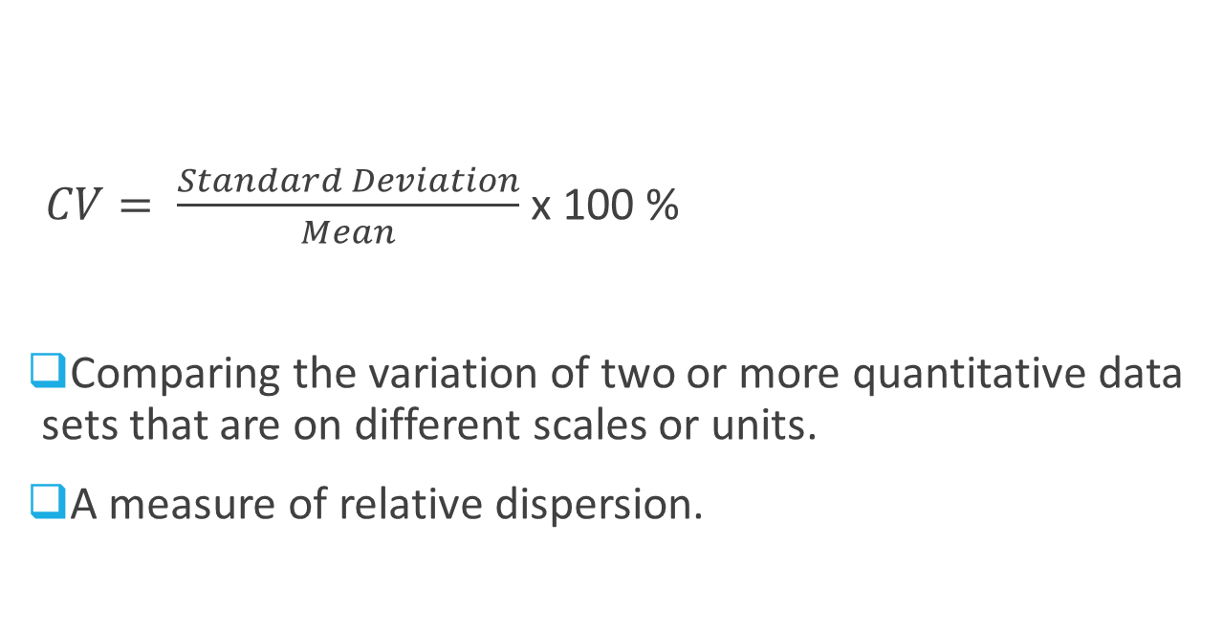
Coefficient of Variation
$CV= \frac{Standard Deviation}{Mean}$ x 100 %
Comparing the variation of two or more quantitative data sets that are on different scales or units.
A measure of relative dispersion.

Slide 22

Example
Example:
Compare variability of weight ( = 140lb, sd = 28 lb) <and>
variability in the height ( = 66 in, sd= 6 in) of 100 students.
CV adjusts the scale so that a sensible comparison can be made.

Slide 23
Example: Comparing Samples
Compare the dispersions in the two samples A and B.
A: 12, 13, 16, 18, 18, 20
B: 125, 131, 144, 158, 168, 193

Slide 24
Example: Comparing Samples
Solution (continued)
Sample B has a larger SD than sample A, but sample A has the larger relative dispersion (coefficient of variation).
Sample A | Sample B

Slide 25
Range &
Interquartile range (IQR)
For any set of data, the range of the set is given by
Difference between the smallest and largest values in frequency distribution
Range = X_{max} - X_{min}
Affected by extremely values

Slide 26
Example: Range of Sets
For any set of data, the range of the set is given by
Range = (greatest value in set) – (least value in set).
The two sets below have the same mean and median (7). Find the range of each set.
Solution
Range of Set A: 13 – 1 = 12.
Range of Set B: 9 – 5 = 4.
Set A | 1 | 2 | 7 | 12 | 13
Set B | 5 | 6 | 7 | 8 | 9

Slide 27
Interquartile Range (IQR)
Inter quartile range (IQR) is another measure of spread but this time looks at the data in terms of quarters or percentiles.
Distribution can also be divided in quarters (quartiles): [25/25/25/25]
The range of data is divided into four equal percentiles or quarters (25%).
Q1
25th percentile
Q3
75th percentile
Min
Max
Q2
Median
50th Percentile

Slide 28
Interquartile Range (IQR)
IQR is the range of the middle 50% of the data. Therefore, because it uses the middle 50%, it is not affected by outliers or extreme values.
Describes the spread of the middle 50% of the data.
(Median Q2: Divides distribution in half. 50/50)
Q1
25th percentile
Q3
75th percentile
IQR
Min
Max
Q2
Median
50th Percentile
Range

Slide 29
Interquartile range
Q1: first quartile = 25th percentile
Q2: median or second quartile = 50th percentile
Q3: third quartile = 75th percentile
Interquartile range (IQR): = Q3 – Q1

Slide 30
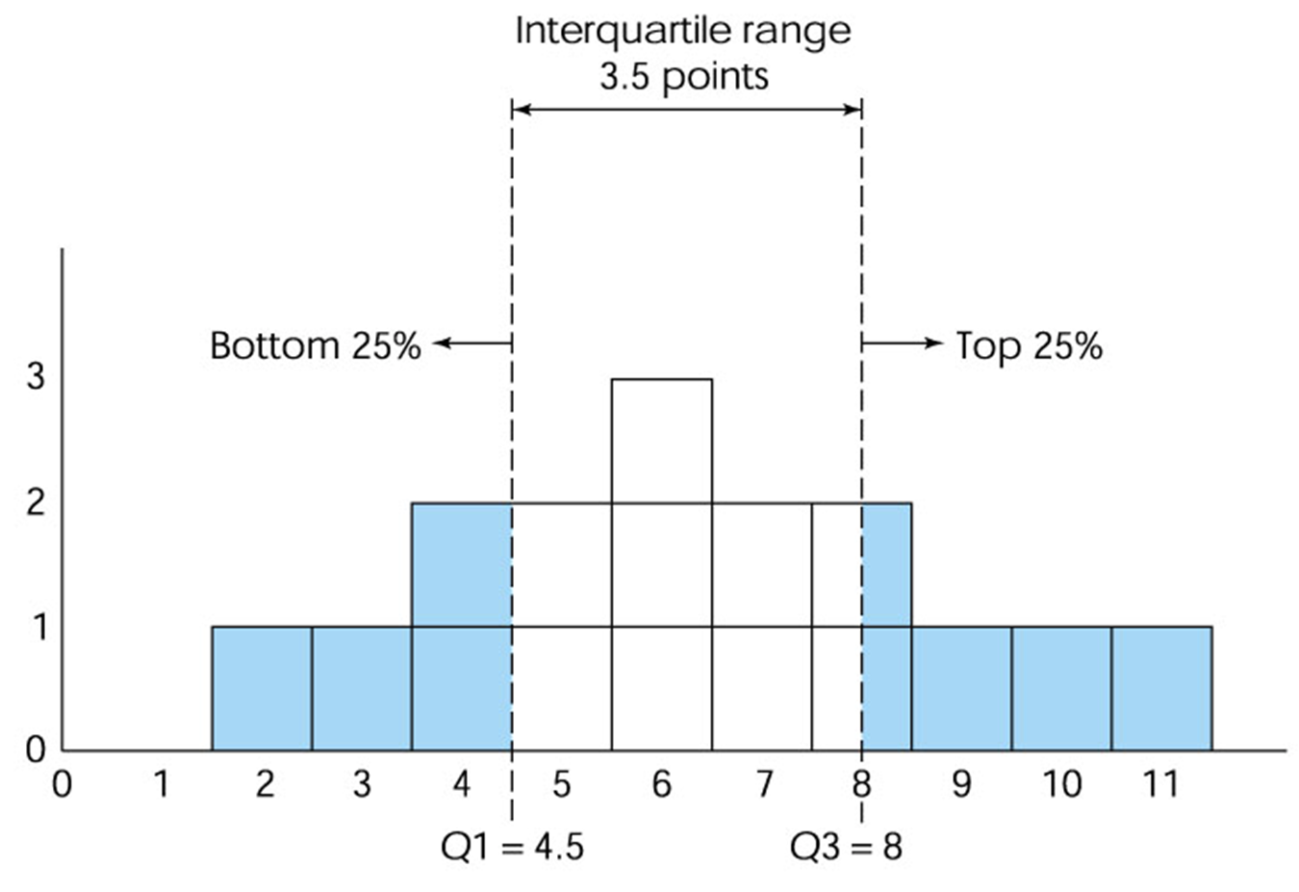

The Interquartile Range

Slide 31
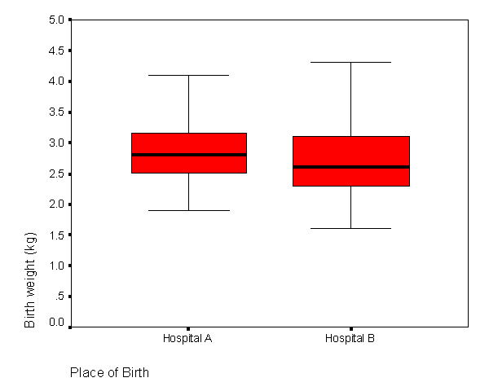





Finding Median and IQR from Box Plot
Infant birth weight and hospital delivery

Slide 32
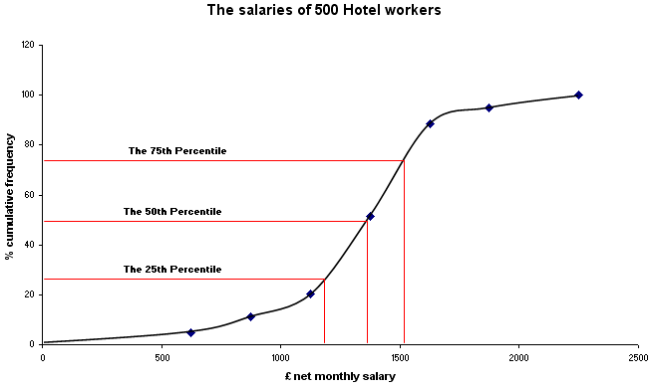
Finding IQR from OGIVE

Slide 33
Thank you.

