Slide 1

Descriptive Statistics (Part II)
Measures of Central Tendency
By
Dr Lwin Mie Aye
Senior Lecturer (M.B;B.S, MSc Public Health)
Community Medicine Department

Slide 2
Learning Outcomes
Identify an appropriate methods of presenting data in graphs and tables
Describe the data using appropriate descriptive statistics

Slide 3
Measures to Describe Frequency distribution
There are TWO main types of measures that are used to describe frequency distributions
Measures of central tendency
Measures of variability or dispersion

Slide 4
Measures of Central Tendency
Most effective way of summarizing the center of metric data
Measures the location and focus on the typical value of a data set
Describes the middle or most commonly occurring values in a series.
Estimates the ‘center’ of a distribution of values.
There are THREE main types of estimates of central tendency.
  Mean
  Median
  Mode

Slide 5
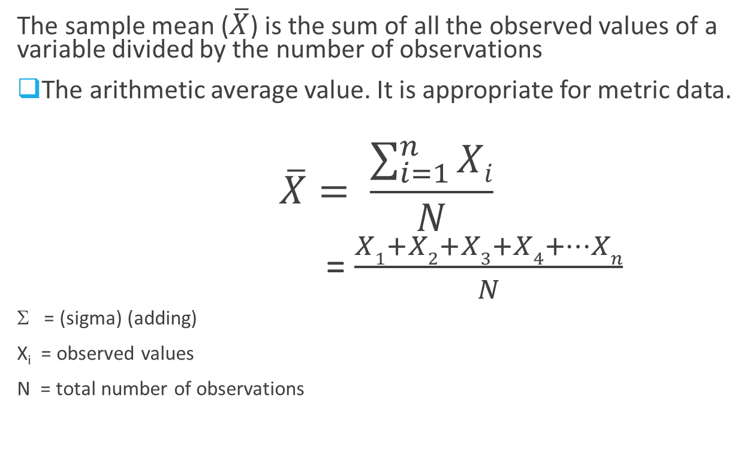
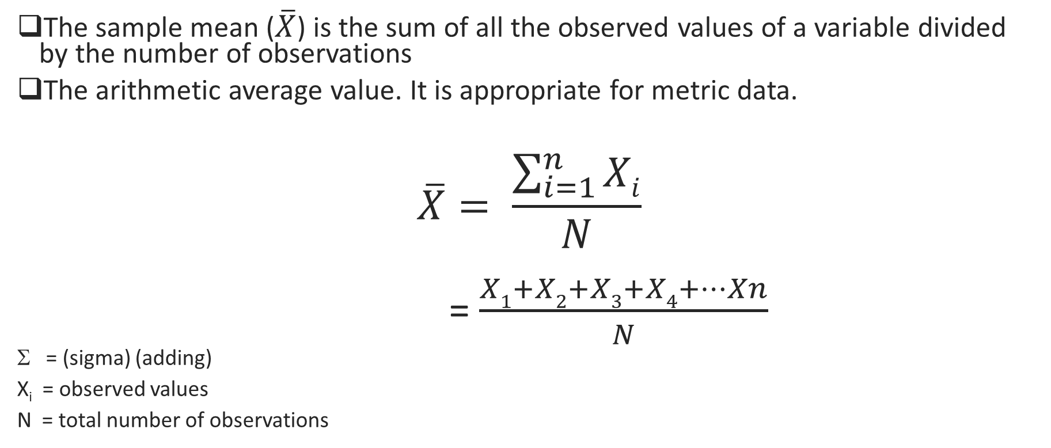
Mean (arithmetic)
The sample mean ($\overline{X}$) is the sum of all the observed values of a variable divided by the number of observations
The arithmetic average value. It is appropriate for metric data.
$$\overline{X}= \frac{\sum_{i=1}^{n}{Xi}}{N}$$
= $\frac{X1+X2+X3+X4+…Xn}{N}$
Σ = (sigma) (adding)
X_{i} = observed values
N = total number of observations

Slide 6
Mean (Example)
1, 3, 5, 7, 7, 8, 9
n = 7
∑xi =1+3+5+7+7+8+9= 40
=
= 5.71
=
6

Slide 7
Median
It is defined as the midpoint of a frequency distribution of ordinal and metric data.
The value halfway through the ordered data set, below and above which there lies an equal number of data values.
Median is the middle value i.e., 50% of the observed values fall above it and 50% fall below it
It is the same as the 50th percentile of a distribution curve (cumulative frequency curve).
Generally, a good descriptive measure of the location which works well for skewed data or data with outliers.
It is less sensitive to extreme values than mean.

Slide 8
Median
Arrange the observations from the smallest to largest (vice versa) (ascending or descending).
Find the middle value.
If the number of observation is odd, the median is the middle value.
Odd number of measurements (n=odd value)
  The median is the value of middle-most observations in ascending order.
    x = [1 2 3 4 5 6 7]
    n = 7
    Median = 4 (4th observation)
8

Slide 9
Median
If the number of observation is even, the median is the average of the two middle values.
  Median = n+1 (th) of ordered observation
  2
Even number of measurements (n=even value)
  The median is the average value of the two middle-most observations in ascending order.
    x = [1 2 3 4 5 6 7 8]
    n = 8
    Median = 4+5/2 = 4.5 (between 4th and 5th observation)

Slide 10
Exercise 1: Median (Odd)
[3 5 7 8 9 11 13]
  Median = 8
[1 11 9 15 5 7 15]
  [1 5 6 9 11 15 15]
  Median = 9
[24 79 54 43 21 16 67 33 39]
  [16 21 24 33 39 43 54 67 79]
  Median = 39

Slide 11
Exercise 2: Median (Even)
[3 5 7 8 10 13 17 19]
  Median = (8+10)/2 = 9
[1 11 9 15 5 7 15 28]
  [1 5 6 9 11 15 15 28]
  Median = (11+15)/2 = 26/2 = 13
[24 79 54 43 21 16 67 33 39 37]
  [16 21 24 33 37 39 43 54 67 79]
  Median = (37+39)/2 = 76/2 = 38

Slide 12
Mode
Is defined as the most frequently occurring value in a data set.
There may be more than one mode (bimodal) on a set of observation if two or more values are equally common.
It may also not exist; this is true if all the observations occur with the same frequency.

Slide 13
Exercise 1: Mode
2,4,5,5,5,7,8,8,9,12
  Mode is 5.
76,73,69,70,68,69,73,67,69,51
  Mode is 69.
55,25,25,79,79,55,19,34,19,34
  There is no Mode.
1,2,5,8,8,8,8,9,9,11,15,16,16,16,16,19,32
  Mode are 8 and 16 (bimodal)

Slide 14
Example
12,17,18,18,18,21,25,26
Mean
    155/8 = 19.38
Median
    18
Mode
    18

Slide 15
Mean can mislead
Group 1 data: 1,1,1,2,3,3,5,8,20
  Mean: 4.9 Median: 3 Mode: 1
Group 2 data: 1,1,1,2,3,3,5,8,10
  Mean: 3.8 Median: 3 Mode: 1
When data sets are small, a single extreme observation will have great influence on mean, little or no influence on median
In such cases, median is usually a more informative measure of centrality

Slide 16
Trimmed mean
Trim (discard) most extreme values
Calculate mean for the remaining values
Not as sensitive to extreme values
  because it ignores them= robust

Slide 17
Calculate the trimmed mean
Sort data by Y
Trim largest and smallest values
Get mean of remaining values
Interpretation:
Ignoring the TWO most extreme values, the average BMI is 18.8
Average BMI if extreme values are included = 20.46

Slide 18
Effect of Extreme Values
<1,3,4,5,5,7,8>
<1,3,4,5,5,5,47>
Mean = 4.71
Median = 5
Mode = 5
Mean = 70/7 = 10
Median = 5
Mode = 5

Slide 19
Skewness
Defined as asymmetry in the distribution of the sample data values. Values on one side of the distribution tend to be further from the ‘middle’ than values on the other side.
Measures to what extend a distribution of values deviates from symmetry around the mean.

Slide 20
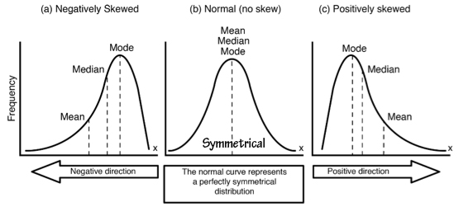
The relationship between three measures depends on the spread of the data
Mean < Median < Mode
Mean = Median = Mode
Mean > Median > Mode

Slide 21
Using Central Tendency
If outlying observations occur in only one direction either a few small values or a few large ones, it is called a skewed distribution.
If the outlying values are small, the distribution is skewed to the left (negatively skewed).
If the outlying values are large, the distribution skewed to the right (positively skewed).
Mean=median (symmetrical)
Mean>median (distribution skewed to right)
Mean<median (distribution skewed to left)

Slide 22
Using central tendency _{(cont)}
 | Continuous data | Discrete data | Ordinal data | Nominal data | Effected by extreme values
Mean | + | + | - | - | +
Median | + | + | + | - | -
Mode | + | + | + | + | Not relevant

Slide 23
Group Data
23

Slide 24
Mean for Grouped Data
The mean of a sample of grouped data organized in a frequency distribution is computed by the following formula
where: f = frequency of class
X_{m} = midpoint of class
n = sample size or total number of observations

Slide 25
Example: Calculate the mean of the grouped frequency distribution.
The grouped frequency distribution table below shows the marks (out of 25) achieved by 50 students in a test.
Marks achieved | 1-5 | 6-10 | 11-15 | 16-20 | 21-25
No. of students | 11 | 12 | 15 | 9 | 3
Notes:
Ask students to write notes in their copies.

Slide 26
Marks achieved | 1-5 | 6-10 | 11-15 | 16-20 | 21-25
No. of students | 11 | 12 | 15 | 9 | 3
11 of the students received between 1-5 marks.
12 of the students received between 6-10 marks.
15 of the students received between 11-15 marks.
9 of the students received between 16-20 marks.
3 of the students received between 21- 25 marks.

Slide 27
Step 1: Estimate the mid-interval value of each class
In order to calculate the mean, we must estimate the mid-interval value of each class.
  1 + 5 = 3
  2
  6 + 10 = 8
  2
  11 + 15 = 13
  2
  16 + 20 = 18
  2
  21 + 25 = 23
  2
Marks achieved | 1-5 | 6-10 | 11-15 | 16-20 | 21-25
No. of students | 11 | 12 | 15 | 9 | 3

Slide 28
Step 2: Calculate f(Xm)
Class | f | Midpoint (Xm) | f (Xm)
1-5 | 11 | 3 | 11*3
6-10 | 12 | 8 | 12*8
11-15 | 15 | 13 | 15*13
16-20 | 9 | 18 | 9*18
21-25 | 3 | 23 | 3*23
 | 50 |  | 555

Slide 29
Step 3:
Mean = 11(3) + 12(8) + 15(13) + 9(18) +3(23)
50
= 555/50
= 11.1

Slide 30
Median for Grouped Data
Where:
L_{m} = lower boundary of the median class
(Median class is the interval where n/2 is found)
cf = cumulative frequency for the class interval preceding
the median class
w = class size(width) of the median class
f = frequency of the median class

Slide 31
Finding the Median Class
To determine the median class for grouped data:
  Construct a cumulative frequency distribution.
  Divide the total number of data values (n) by 2.
  Determine which class will contain this value.
  For example, if n=40, 40/2 = 20, then determine which class will contain the 20th value.

Slide 32
Example
Class Interval | Class boundary | f | Cf
20-24 | 19.5-24.5 | 7 | 7
25-29 | 24.5-29.5 | 9 | 16
30-34 | 29.5-34.5 | 8 | 24
35-39 | 34.5-39.5 | 12 | 36
40-44 | 39.5-44.5 | 4 | 40
median class=40/2=20. Number 20th is in the third class (look at cf)
So the median is in the third class
L_{m} =lower boundary of the median class= 29.5
cf = 16(cumulative frequency for the class interval preceding the median class
w = class size of the median class =5
f = frequency of the median class= 8

Slide 33

Example: continued
= $\left[\frac{\frac{40}{2} −16 }{8}\right]$ $5+$29.5
= $\left[\frac{4}{8}\right]$ $5+$29.5
= 2.5 + 29.5
= 32

Slide 34
Percentiles
Percentile: a measure of relative standing of a value in a data set. The p^{th} percentile is a value such that approximately p percent of the data have values less than that value. E.g., if your SAT results ranks your math test score at the 75th percentile, then about 75% of the test takers got lower scores than you did.

Slide 35
To find the quartiles, first calculate the index for each percentile:
index: i = n (p/100), i denotes the position of the value corresponding to that percentile, e.g., the 4th number.
where p is the percentile and n is the number of data values and i is the position of that percentile.
If the index i is not an integer, round up to the nearest integer, e.g., round 3.25 up to 4.
If the index i is an integer, average the value in position i with the value in the position (i + 1) to get the value for that percentile [ i+ (i + 1)]/2

Slide 36
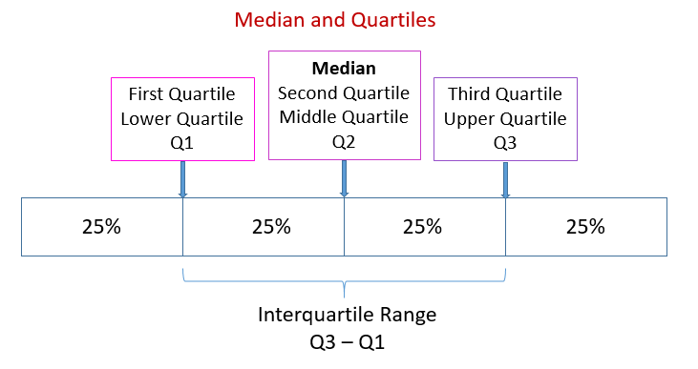
Quartiles
Minimum
Maximum
Quartiles divide the data into quarters (chunks of 25%). So in general, 25% of the data are between the minimum and Q1; 25% are between Q1 and the median; 25% are between the median and Q3; and 25% are between Q3 and the maximum.

Slide 37
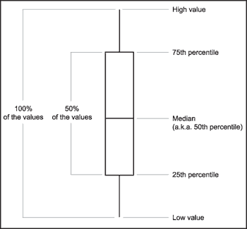
Quartiles
Q3
Q2
Q1

Slide 38
Readings
David B. Medical statistics from scratch: An introduction for Health Professionals. 3rd Edition. Wiley Blackwell. 2014
Forther RN, Hernandex M, Lee ES. Biostatistics: A guide to design, analysis, and discovery. 2nd Editon. Elsevier. 2006

