Slide 1

Descriptive Statistics (Part I)
Data Presentation
By
Dr Lwin Mie Aye
Senior Lecturer (M.B;B.S, MSc Public Health)
Community Medicine Department

Slide 2
Learning Outcomes
Identify an appropriate methods of presenting data in graphs and tables
Describe the data using appropriate descriptive statistics

Slide 3
Presentation of Statistical Data
Collected data must be arranged properly and purposively to bring out important points clearly and strikingly.
Manner to present the data is very important.
  Tables
  Charts
  Graphs
  Pictures
  Maps
  Box and whiskers
  Plots
2

Slide 4
Value Label | Frequency |  | Value Label | Frequency
60 | 14 |  | 78 | 7
61 | 13 |  | 79 | 5
62 | 15 |  | 80 | 2
63 | 13 |  | 81 | 6
64 | 11 |  | 82 | 6
65 | 19 |  | 83 | 1
66 | 11 |  | 84 | 4
67 | 13 |  | 85 | 3
68 | 7 |  | 86 | 3
69 | 9 |  | 87 | 4
70 | 5 |  | 88 | 6
71 | 22 |  | 89 | 1
72 | 4 |  | 90 | 1
73 | 8 |  | 92 | 1
74 | 9 |  | 94 | 1
75 | 5 |  | 98 | 1
76 | 4 |  | 100 | 1
77 | 10 |  | 105 | 1

Slide 5
Frequency Tables (Nominal, Ordinal, Continuous)
One-way Frequency Table
Weight Interval (Kg) | Frequency (n) | Relative Frequency (%)
10 – 19 | 5 | 8.8
20 – 29 | 20 | 35.1
30 – 39 | 10 | 17.5
40 – 49 | 12 | 21.1
50 – 59 | 4 | 7.0
60 – 69 | 4 | 7.0
70 – 79 | 2 | 3.5
Total | 57 | 100
5

Slide 6
Frequency Tables
Two-way Frequency Table
Body Mass Index | Gender |  | Total
 | Male | Female
Underweight | 1 (3.3%) | 0 (0%) | 1 (2.5%)
Normal | 10 (33.3%) | 2 (20.0%) | 12 (30.0%)
Overweight | 14 (46.7%) | 6 (60.0%) | 20 (50%)
Obese | 5 (16.7%) | 2 (20.0 %) | 7 (17.5%)
Total | 30 | 10 | 40
6

Slide 7
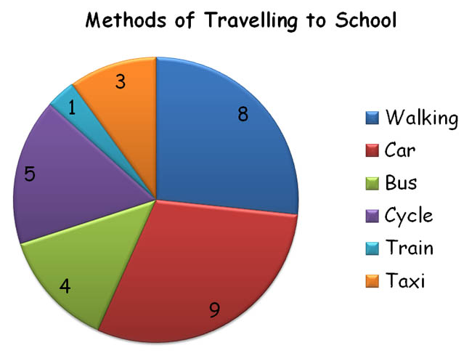
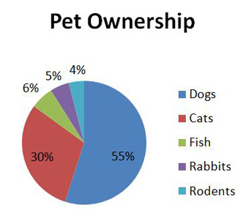
Pie Chart (Categorical data)
A.
B.
7

Slide 8
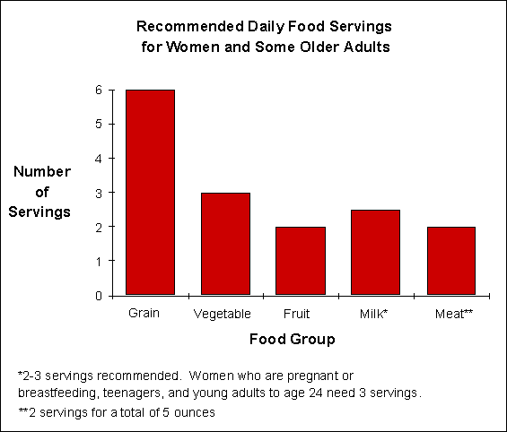
Bar Graph (Categorical data)
8

Slide 9
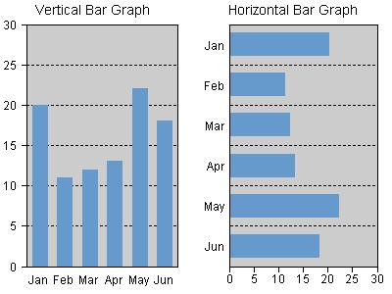
Bar Graph (Vertical & Horizontal)
9

Slide 10
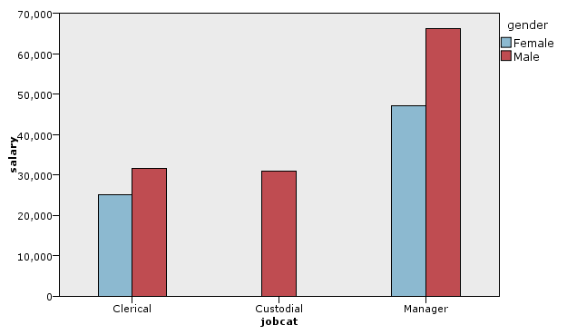
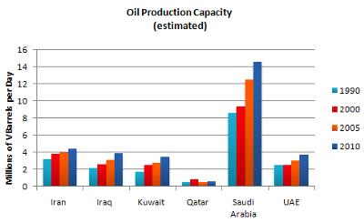
Clustered Bar Charts
Used when there is more than one group to present.

Slide 11
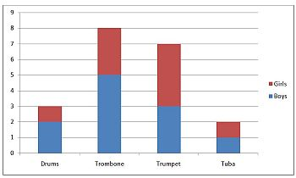
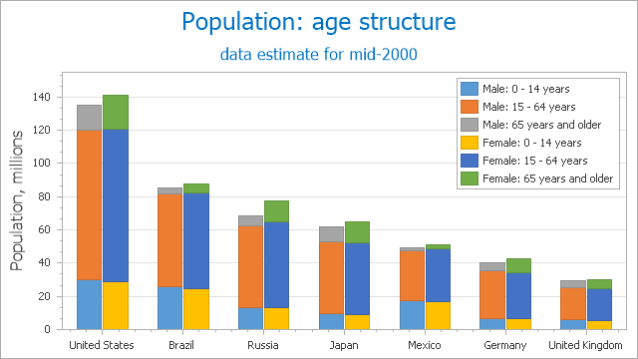
Stacked Bar Charts (Categorical data)
Used to compare the total number of subjects between groups

Slide 12
Histogram
If bars are used with continuous data, the chart is called histograms.
Divide range of data into intervals (bins/groups) of equal width
Count the number of observations in each class
Draw the histogram
Label scales
11

Slide 13
Histogram
Histogram of the Systolic Blood Pressure for 113 men. Each bar spans a width of 5 mmHg on the horizontal axis. The height of each bar represents the number of individuals with SBP in that range.

Slide 14
Pictures of Data: Histograms
Another histogram of the blood pressure of 113 men. In this graph, each bar has a width of 20 mmHg, and there are a total of only 4 bars making it hard to characterize the distribution of blood pressures in the sample.
13

Slide 15
The Histogram and the Probability Density
Histogram of blood pressure measurements, this time for a sample of 5,000 men: notice how the shape of the histogram is more defined that with the previous sample of 113 men.
154

Slide 16
Histogram
 | Weight Interval | Frequency (n) | Relative Frequency (%)
1 | 10 – 19 | 5 | 8.8
2 | 20 – 29 | 20 | 35.1
3 | 30 – 39 | 10 | 17.5
4 | 40 – 49 | 12 | 21.1
5 | 50 – 59 | 4 | 7.0
6 | 60 – 69 | 4 | 7.0
7 | 70 – 79 | 2 | 3.5
 | Total | 57 | 100
10-19 20-29 30-39 40-49 50-59 60-69 70-79
16

Slide 17
Frequency Polygon
10 to 19 20 to 29 30 to 39 40 to 49 50 to 59 60 to 69 70 to 79
17

Slide 18
Shapes of the Distribution
Three common shapes of frequency distributions:
A
B
C
Symmetrical and bell shaped
Positively skewed or skewed to the right
Negatively skewed or skewed to the left
18

Slide 19
Distribution Characteristics
Mode: Peak(s)
Median: The point where it divide the data into equal halves
Mean: Balancing/average point
Mode
Mean
Median
19

Slide 20
Shapes of the Distribution
Three less common shapes of frequency distributions:
A
B
C
Bimodal
Reverse
J-shaped
Uniform
208

Slide 21
The OGIVE (Cumulative Relative Frequency Curve)
Ogive is useful when estimating the cumulative relative frequency on the vertical axis Y for any value on the horizontal axis X (the group value)
Can estimate median and interquartile range from the Ogive curve

Slide 22
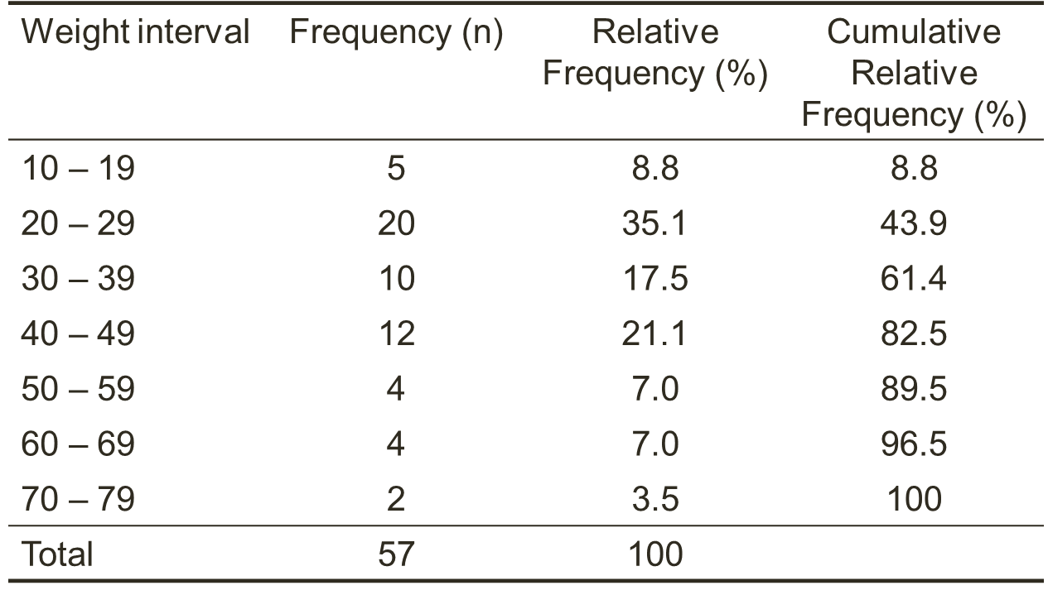
Example: The OGIVE

Slide 23
OGIVE
Cumulative relative frequency %
Body weigh (Kg)
24

Slide 24
Boxplots and Whiskers
It is a graphical summary of the three quartiles values, the minimum and maximum values and any outliers.
Usually plotted with value on vertical axis
Represent one variables at a time
A number of box plots can be set alongside each other
Lines sticking out from the bottom and top of the box (whiskers)

Slide 25
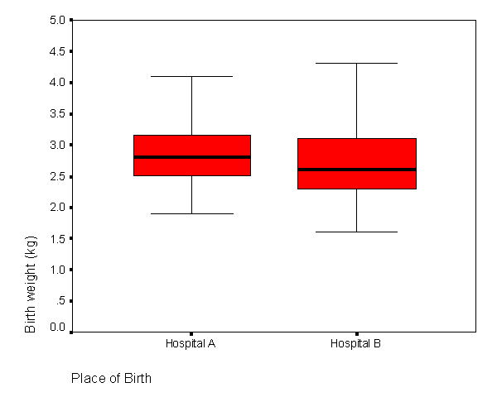





Example: Boxplot
Infant birth weight and hospital delivery
25

Slide 26
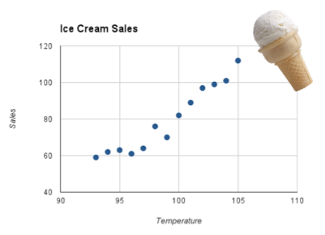
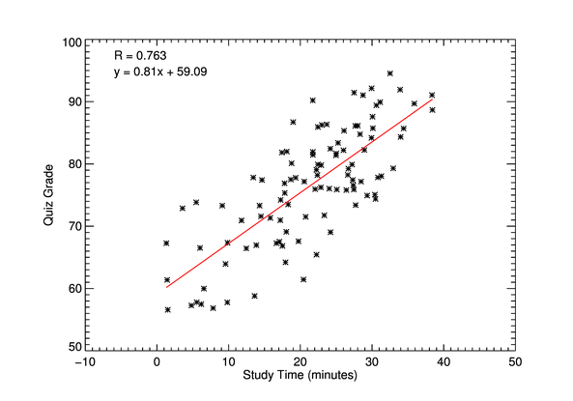
Scatter Plot
Describe the relation between two quantitative variables.
To test the association between two continuous variables, it’s strength of association and direction of association
A.
B.

Slide 27
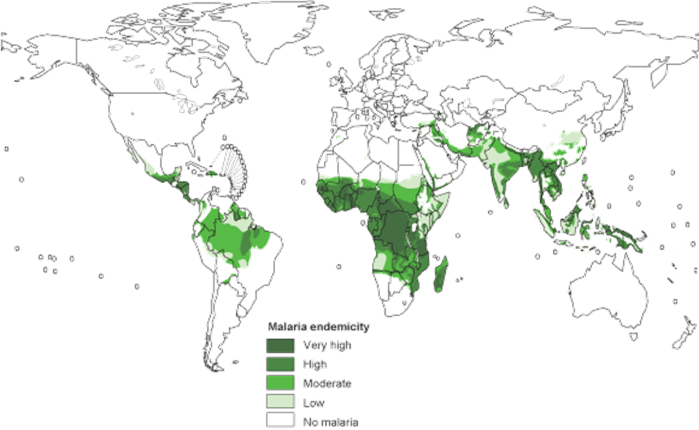
Heat Map
Global distribution of malaria transmission risk, 2003
28

Slide 28
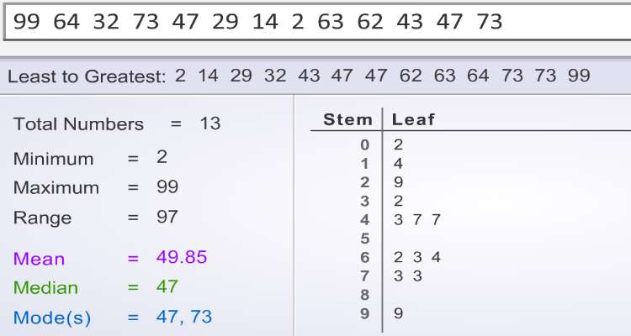
Stem and Leaf
Steam and leaf plot constructs the distribution of a variable with numbers themselves

Slide 29
Search questions
What are the differences between hisogram and bar chart ?
What is the total area under a histogram?
In histogram , which is better: to have many bars or few bars? Why?
What is the recommended number of bars?
29

Slide 30
Readings
David B. Medical statistics from scratch: An introduction for Health Professionals. 3rd Edition. Wiley Blackwell. 2014
Forther RN, Hernandex M, Lee ES. Biostatistics: A guide to design, analysis, and discovery. 2nd Editon. Elsevier. 2006

