Slide 1
INTRODUCTION TO TYPES OF BIOMEDICAL DATA By Dr. Lwin Mie Aye Senior Lecturer (M.B:B.S, MScPH) Community Medicine Department

Slide 2
Learning Outcomes
Describe the basic concepts and terminology of biostatistics
Define the terminology of biostatistics
Explain the different type of variables, type of data and measurement scales used in research

Slide 3
Definition
Biostatistics is defined as the application of statistical principles in medicine, public health, or biology
Principles based in applied mathematics
Includes tools and techniques for data collection, summarizing, analyzing and interpreting those results
Make inferences and draw conclusions

Slide 4
Applications
Collection of data
E.g. Vital statistics (e.g. mortality rates) to inform and monitor the health status of the population
Analysis of data
E.g. Accidents records to find out the times during the year when the highest number of accidents occurred and decide when the safety instruction is the highest
Clinical trials
E.g. To determine whether or not a new antihypertensive medication performs better than the standard treatment
Surveys
E.g. To estimate the proportion of low-income women of child birth
Studies
E.g. To investigate whether or not exposure to EMF is a risk factor for leukemia

Slide 5
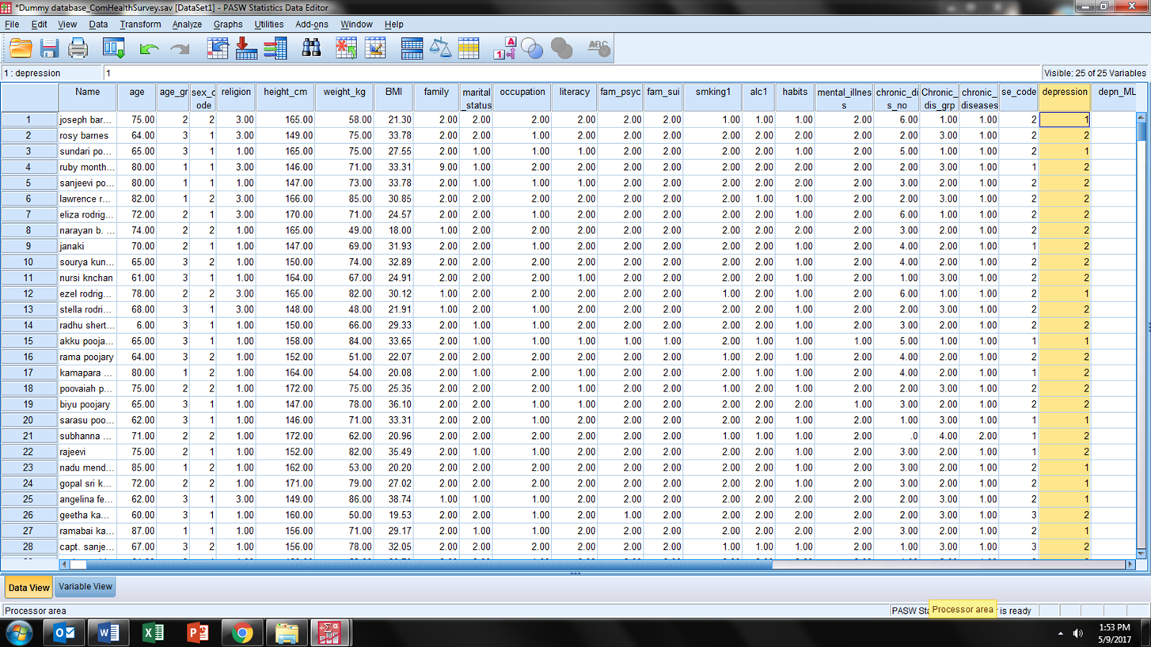
How are we going to handle this raw data?

Slide 6
Statistical Process
Collection of Data
Presentation of Data
Data Analysis
Interpretation

Slide 7
Types of Statistics
Statistical
Methods
Descriptive
Statistics
Inferential
Statistics

Slide 8
Descriptive Statistics
It is a set of observation that describe the characteristics of a sample
Does not make any conclusions using statistical tests
For informational purpose only
Summarization and display of data numerically or graphically
E.g. Mean, median, mode, standard deviation, etc.
E.g. Bar charts, histograms, boxplots, stem and leaf
Summarizing data collected in the sample
identify patterns
leads to hypothesis generating

Slide 9
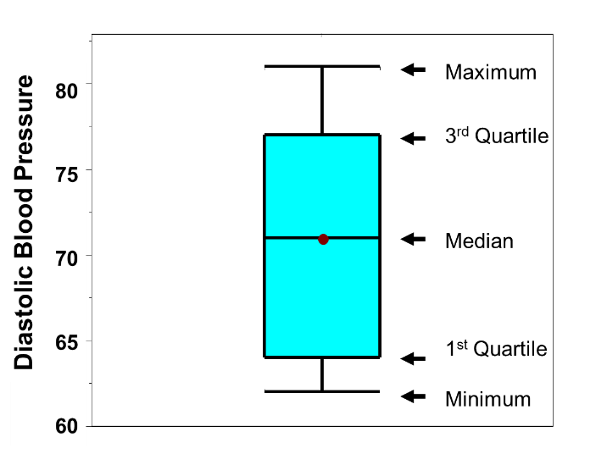
E.g. Graphical display of Descriptive Data
Frequency of age group for 40 patients in DIG40
Age group | Number of patients | Percentage %
Under 40 | 3 | 7.5
40-49 | 6 | 15.0
50-59 | 8 | 20.0
60-69 | 11 | 27.5
70-79 | 12 | 30.0
Total | 40 | 100.0

Slide 10
Example, the manager of a fast-food restaurant tracks the wait times for customers during the lunch hour for a week and summarizes the data.
Numeric descriptive statistics:
Graphs to visualize the wait time

Slide 11
Inferential Statistics
Uses data from a sample to make comparisons and draw conclusions about a larger group that the sample represents
Inferential Statistics
distinguish true differences from random variation
allows hypothesis testing
Estimating population values from sample values
Inferential statistical methods
A procedure for making inferences or generalizations about a larger population from a sample of that population.

Slide 12
Inferential Statistics (Sample to Population)
Population
Generalise conclusions from the sample to the population
Select a samples from the population
Sample

Slide 13
Samples to Populations
Finite Population
or
Infinite Population
Why do we need samples?
answer
Not possible to obtain data from all the members
Finite Population
Infinite Population
Random samples
Sample STATISTICS ( ,s)
Population PARAMETERS (μ,δ)

Slide 14
Statistic and Parameter
Population
Sample
(select)
Population
Sample
(describes)
(calculate)
(estimate)
Parameter
Statistic
true proportion
true mean
sample proportion
sample mean

Slide 15
Inferential Statistics
Two ways to generalize from samples to populations
Estimation of parameters (Confidence Interval, CI)
Hypothesis testing (Test of significance, p value)
Purpose
Make decisions about population characteristics

Slide 16
Population Parameter vs Sample Statistic
Population Parameter
Sample Statistic
Is a number describing the population.
Example: μ,σ
It is a fixed number.
Usually we do not know their values.
Is a number describing the sample data.
Example: , s
The value varies from sample to sample (sampling variation).
Use observed result to get information about the population parameter.

Slide 17
Population and samples
Symbols | Population parameter | Sample statistic
Mean
Standard Deviation
Variance
Proportion | p | P
Product-moment correlation | r | ρ
Rank-order correlation | r_{s} | ρ_{s}
Size | N | n

Slide 18
Statistical Basic Terms
Population | A collection or set of individual , objects or events whose properties are to be analyzed. Not only individuals , but it could also be any thing. All women between ages 30–40 All patients with a particular disease
Sample | A subset of a population selected by the collector. The population of interest could be: The sample is a small number of individuals from the population
Parameters | A numerical value summarizing all the data of a population. E.g., mean μ
Statistics | A numerical value summarizing the sample data. E.g., mean
Variable | A characteristic measured on individuals drawn from a population under study. age, gender, height, weight, etc.
Data | Measurements of one or more variables made on a collection of individuals Data (singular): The value of the variable of one element of the individuals. E.g., age = 22 Data (plural): A set of values from the elements of the individuals. E.g., age = 22, 23, 25, 21,…..

Slide 19
Data
Key component of a study
It is important as different statistical methods are used based on type of data
One cannot have a good study without good data.

Slide 20
Types of Data
Scales of measurement
Quantitative (Numerical)
Qualitative (Categorical)

Slide 21
Types of Data 1. Quantitative (Numerical)
Continuous (E.g., Age, height, blood pressure values)
Discrete (E.g., Numbers of brothers/sisters)
Continuous | Discrete
Continuous values on proper numeric line or scale Measured unit E.g, Age, Height, Blood pressure, Time, Body temperature | It is integer values on proper numeric line or scale Counted units E.g, Number of siblings, Number of children in the family
Notes:
The variable ‘number of brothers/sisters’ takes integral values only; numbers such as 2.6 or 4.5 cannot occur. It is Discrete.
A continuous variable (age) , on the other hand, can take any value.
Examples of continuous variables are ‘birth weight’, ‘age’, ‘time’ and ‘body temperature’,
Examples of discrete variables are ‘number of children per family’, ‘number of hospital admissions

Slide 22
Types of Data 2. Qualitative (Categorical)
Binary (dichotomous) :
Categorical:
Ordinal
Binary | Nominal | Ordinal
used to classify participants as possessing or not possessing a particular characteristics or attribute Disease present or absent Male or Female Treatment or no treatment | Values in arbitrary categories No units E.g, Race: Malay or Chinese or Indian, Blood groups, Education: primary or secondary or graduate | Values in ordered categories. It has intrinsic value No units E.g, BMI: Underweight, normal, overweight, obese, Scores: Grade A, B or C, Age group: Young, middle, elderly

Slide 23
Types of Data
Quantitative (Numerical)
Qualitative (Categorical)
Continuous
Discrete
Binary
Nominal
Ordinal
Same property can be measured in different scale.
Example: Age

Slide 24
Variables
Variables are the characteristics of the units measured or observed.

Slide 25
Type of variables
Dependent Variable (Outcome)
Independent Variable
Example: In a study of hypertension among 500 school children, investigator measures systolic (SBP) and diastolic blood pressure (DBP) for each pupil. Pupil’s age, height and weight are recorded in addition to the SBP and DBP readings.
- How many variables are there? - What are dependent variables? - What are independent variables?

Slide 26
Has the variable got units?
No
Yes
Can the data be put in meaningful order?
Do the data come from measuring or counting?
No
Yes
Counting
Measuring
Categorical nominal
Categorical ordinal
Discrete metric
Continuous metric

Slide 27
Variable | Breast Cancer Group (n=106) % | Control Group (n=226) %
Age | 61.6 (10.9) | 51.0 (8.5)
Ethicity Malay Chinese Indian Others | 15 (14) 16 (15) 42 (40) 32 (31) | 31 (14) 31 (13.7) 84 (37) 80 (35)
Social Class - I II III IV | 10 (10) 38 (36) 28 (26) 11 (10) | 20 (9) 82 (36) 72 (32) 21 (9)
No. of children - 0 1 2 >= 3 | 15 (14) 16 (15) 42 (40) 32 (31) | 31 (14) 31 (13.7) 84 (37) 80 (35)
Menopausal state (%) Premenopausal Perimenopausal Postmenopausal | 14 (13) 9 (9) 83 (78) | 66 (29) 43 (19) 117 (52)
Body mass index (kg/m2) | 26 (5.5) | 24.8 (4.2)

Slide 28
Readings
Forthofer RN, Lee ES, Hernandez M. Biostatistics: A guide to design, analysis, and discovery. 2nd edition. Oxford; 2007.
Kirkwood B, Sterne J. Essentials of Medical Statistics. 2nd ed. New York: Blackwell; 2001. Chapter 4
Daniel W. Basic Concepts and Methodology for the Health Sciences. 9th ed. John Weiley & Sons, Inc. Chapter 2

Slide 29
Thank you.

