Slide 1
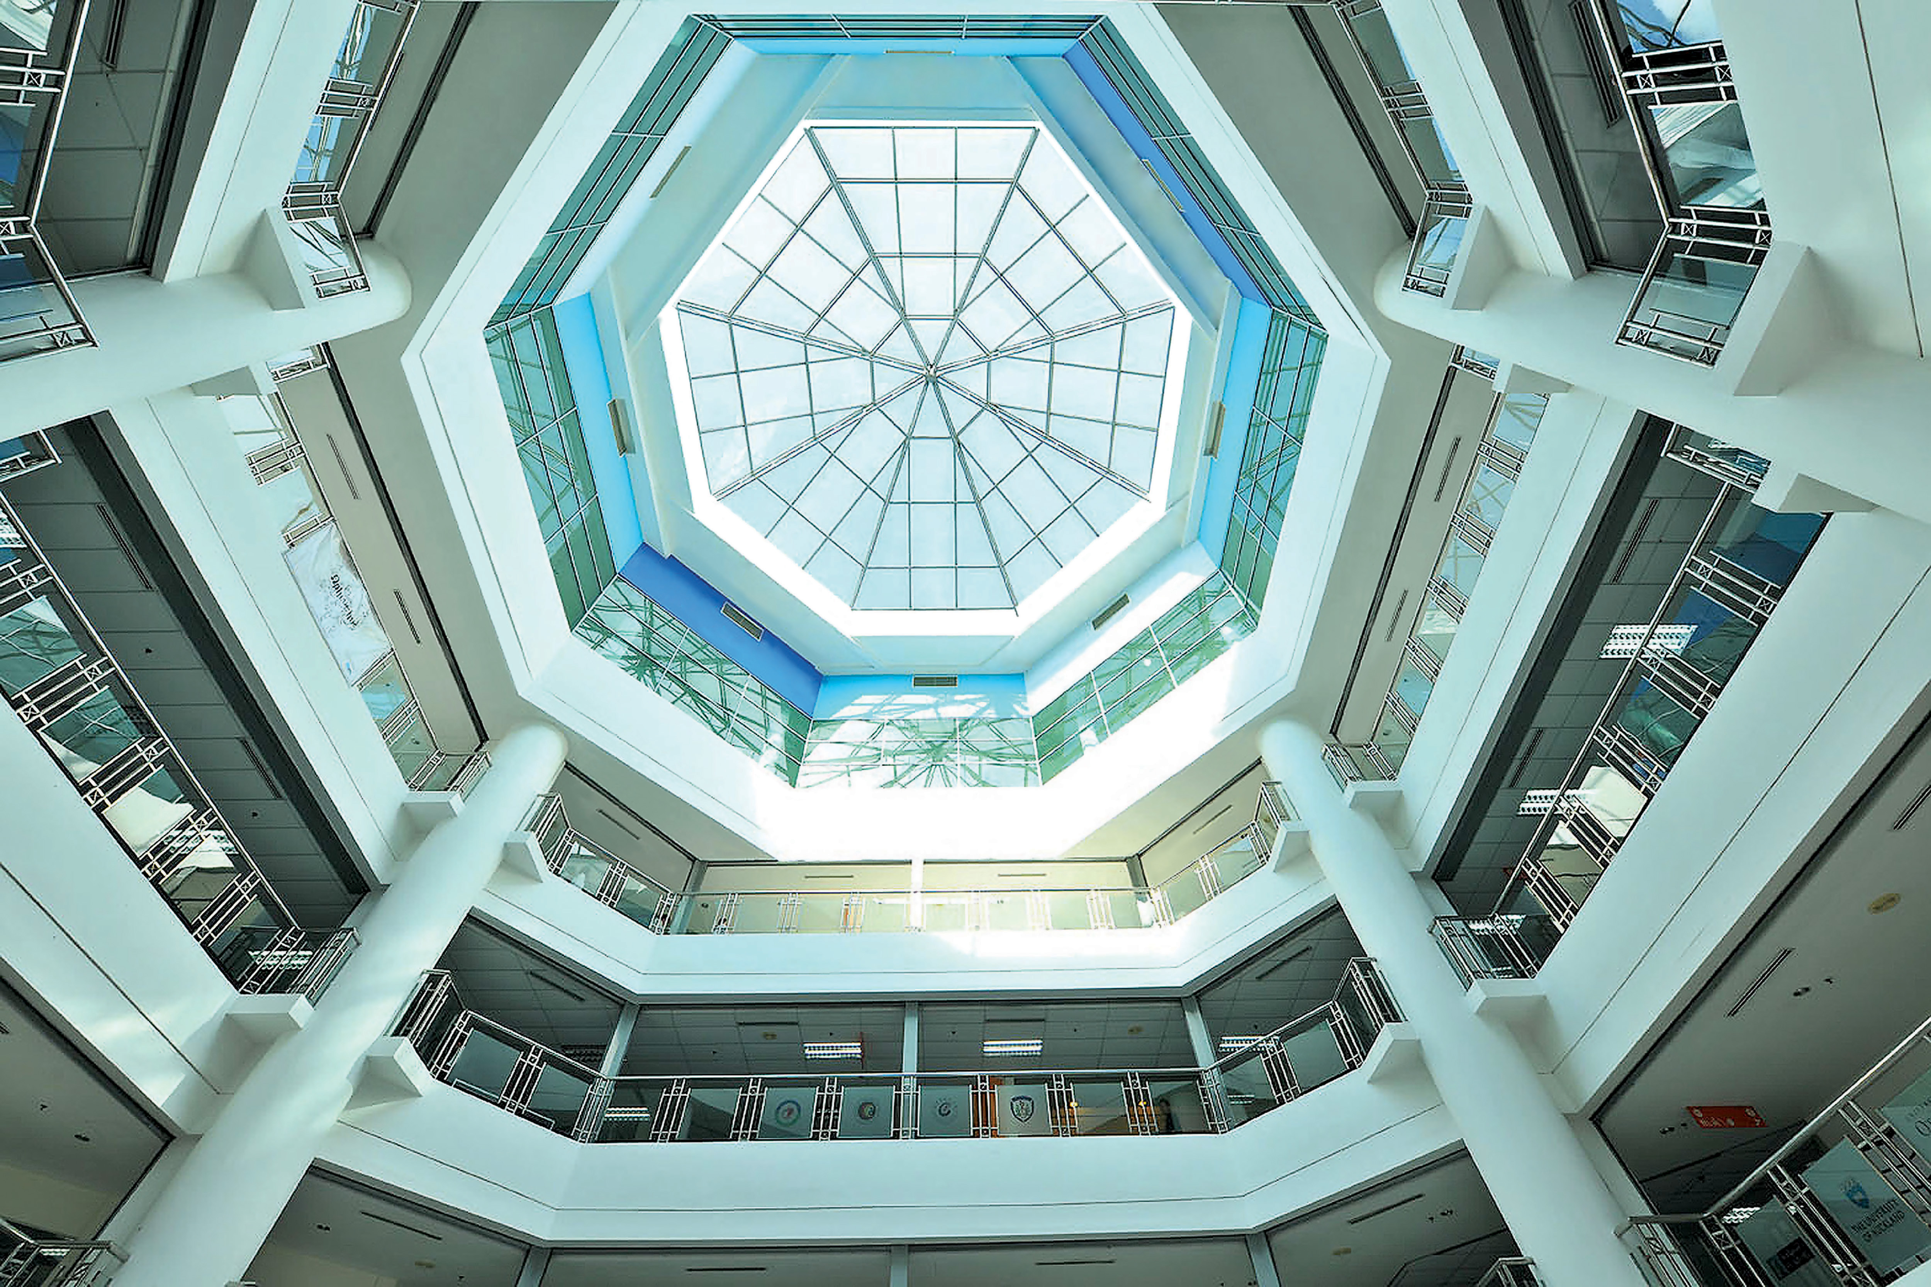

Student access imu network,computer
ITS Department

Slide 2
Password
a) Minimum password length: 6 characters
b) Choose a password that is easy to remember
c) Try not to use ‘easy-to-guess’ passwords (ie; your birthday, name, phone number….)
d) Good password uses combination of alphabets and numbers

Slide 3
Directories
There will be 2 visible network directories after you log in:
a) H:\ drive
- This is your own home directory which you have FULL access.
b) I:\ drive
- This is the Callab folder where lecturers will place their lecture notes, presentation…etc
You will have READ access only.

Slide 4
Keeping your account safe and private
a) Log off or Restart(recommended) the PC after using.
b) Ensure that your password is not known to anybody else. Change your
password if you suspect somebody else knows it.
c) Contact Helpdesk Department if you have forgotten your password.
d) Scan files before moving them to your Home Directory
(esp. from diskettes, thumb drive).

Slide 5
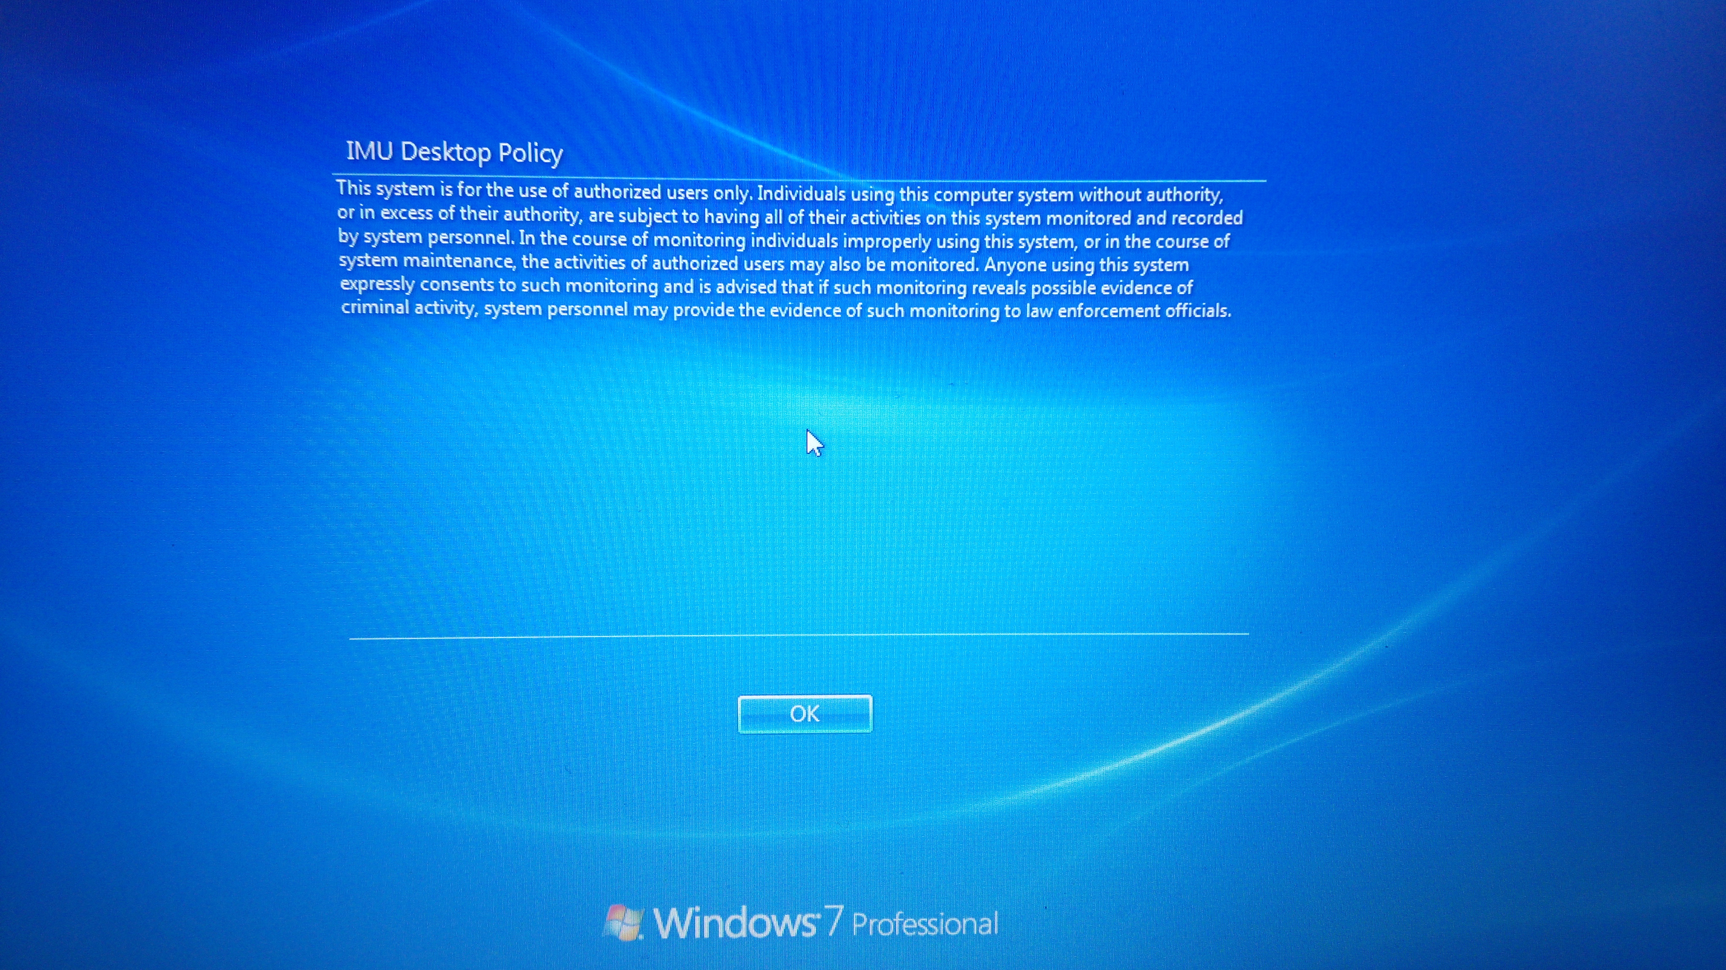
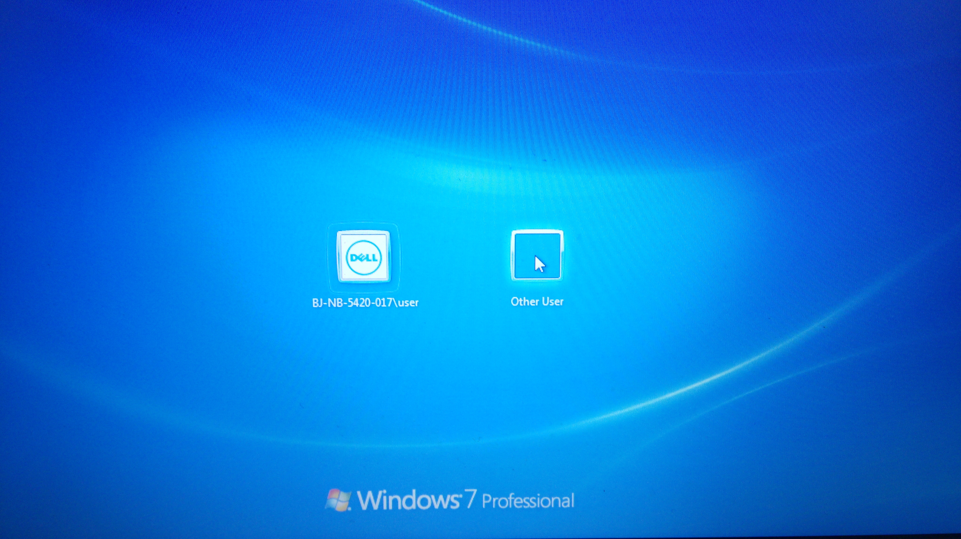
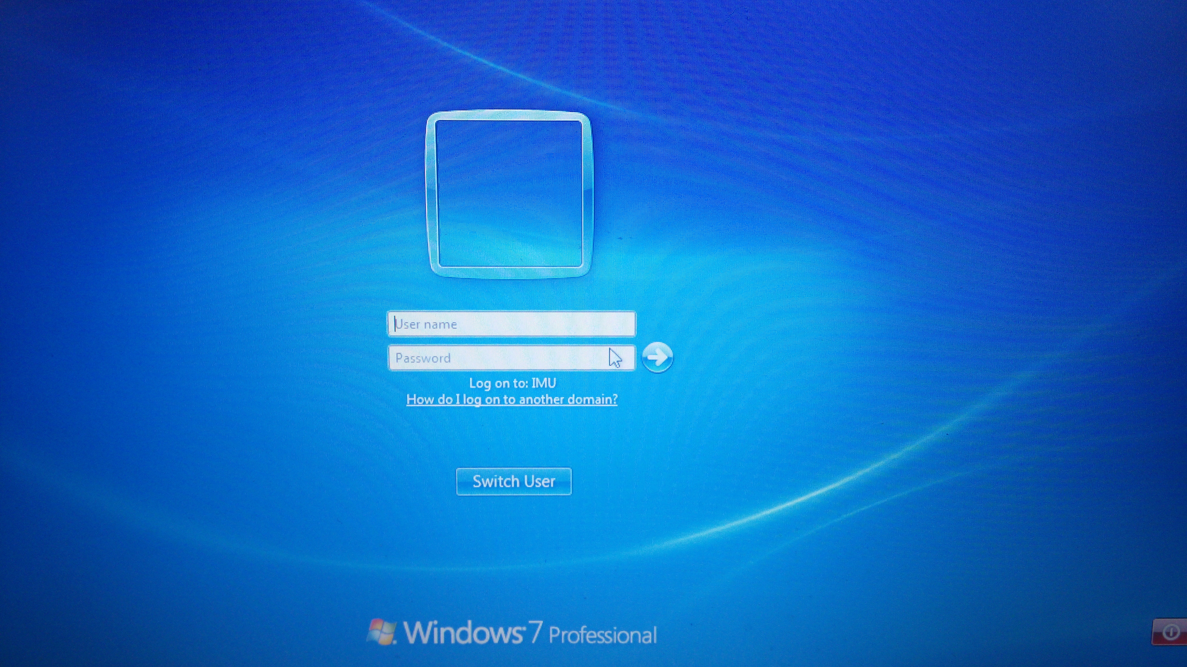
Login Computer – First time
Choose other user
Enter your Student ID for User name:- (Example: 000000123456)
Default password = password
Login ID ( student ID )

Slide 6
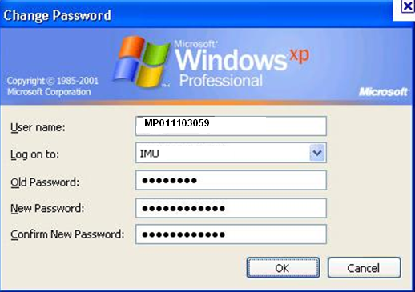
Change password
Enter default password
2. Enter your password
3. Retype your password
4. Click OK

Slide 7
Network Drive
(H:) Drive is your Home Directory
(I:) Student Drive

Slide 8
Q & A

