Slide 1

DYNAMICS OF POPULATION
Department of Community Medicine
International Medical University

Slide 2
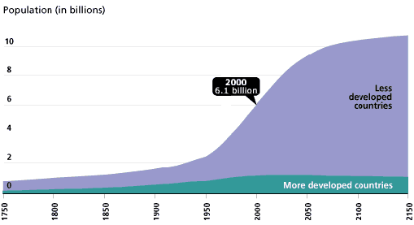

Slide 3
DEFINITION OF DEMOGRAPHY
Scientific study of human population primarily with respect to:
Size
Structure
Development and
Composition and geographic distribution of population and changes over time

Slide 4
DYNAMICS OF POPULATION
Economic, Social and Demographic characteristics of the population influence health status of individuals
Population size changes according to fertility, mortality and migration
Population is DYNAMIC and NOT STATIC

Slide 5
Factors affecting population growth
Socioeconomic status
Fertility rates
Immigration and emigration
Contraceptive prevalence rates (CPR)
Quality in health care
Availability of health care

Slide 6
Fertility

Slide 7
Fertility denotes the actual reproductive performance. (opposite of sterile)
Fecundity denotes the ability to reproduce offspring's. The ability of the women to conceive and carry the foetus to term. (opposite of childless)

Slide 8
MEASURES OF FERTILITY
Crude Birth Rate (CBR)
General Fertility Rate (GFR)
Age-Specific Fertility Rate (ASFR)
Total Fertility Rate (TFR)

Slide 9
CRUDE BIRTH RATE
CBR = Total no. of births in year x 1000
Total mid-year population
e.g. 500,000 x 1000 = 20 per 1000 population
25,000,000
Commonly used measure of fertility
Expressed as ‘births per 1000 population’
Crude measure because it refers to total population but only women of reproductive age can bear children.

Slide 10
GENERAL FERTILITY RATE
GFR = Total no. of births in year X 1000
Total mid-year pop. of women aged 15-49
      e.g. General Fertility Rate (GFR)= 500,000 x 1000 = 20.8/1000 24,000,000
More precise than CBR
Need to be adjusted to reflect proportion of women in reproductive age
Does not reflect the distribution of fertility among child bearing women

Slide 11
AGE-SPECIFIC FERTILITY RATE
ASFR = Birth in year to women aged X x 1000
Women aged X at mid-year
ASFR not a single number
Calculated for each age group
Comparison complex between countries
Rapid rise after 15 years to a peak in early to mid twenties and declines to low levels after 40 years

Slide 12
Age Specific Fertility Rate (ASFR) Bangladesh, 1974
Age group | Women | Births | ASFR(1000)
15-19 | 3,777,000 | 756,900 | 200.4
20-24 | 3,101,000 | 1,046,000 | 337.3
25-29 | 2,636,000 | 819,500 | 310.9
30-34 | 2,161,000 | 565,100 | 261.5
35-39 | 1,793,000 | 353,200 | 197.0
40-44 | 1,481,000 | 141,600 | 95.4
45-49 | 1,222,000 | 16500 | 13.5
 | 16,171,000 | 3,698,800 | 1416

Slide 13
TOTAL FERTILITY RATE
Average number of children per woman that would be borne to a group of women experiencing the given age-specific fertility rate if they survived to 50 years
TFR = Sums of ASFR X 5
1000
Measure of fertility that is most widely used
Expressed as per woman
One index number
Independent of age structure of the women in the reproductive age group

Slide 14
TFR for Bangladesh
TFR= Sum of ASFR x 5
      1000
      (200+337.3+310.9+261.5+197+95.4 + 13.5) x 5
      1000
      =1416x 5
      1000
      =7.08
      Average number of children a woman would have in her life time on condition that the given age-specific fertility rates remain the same during her life time

Slide 15
Mortality

Slide 16
MORTALITY
Crude Death Rate
Age-Specific Mortality Rate
Expectation of Life at Birth

Slide 17
Crude Death Rate (CDR)
CDR = Total no. of deaths in year x 1000
Total mid-year population
Commonly used measure of mortality
Expressed as ‘deaths per 1000 population’
Crude measure

Slide 18
MIGRATION
Movements of population
External migration refers to movements across national boundaries
Internal migration refers to movements within a country (rural to urban)
Net migration = Immigration – Emigration

Slide 19
RATES OF POPULATION GROWTH
Population change= Fertility – mortality +nett migration
Rate of population growth=CBR- CDR+CNMR
CNMR=Crude nett migration rate or (Immigration –migration)
We sometimes assume nett migration is zero

Slide 20
Rate of natural increase (RNI)
RNI=CBR-CDR
e.g. 33.7- 3.17= 30.5
Population growth rate(%)
(CBR-CDR)/10
(assuming net migration is 0)
e.g. (33.7-3.17) /10 =3% per year

Slide 21
REPRODUCTION RATES
Another way to look at population is replacement basis
Replacement is the number of children each generation must produce in order to replace itself
At replacement level, each couple has on the average, 2 children to replace themselves
Consider only female births

Slide 22
GROSS REPRODUCTION RATE
(GRR)
Number of female babies that would be born per woman in a group of women subjected to current fertility but not to mortality rates
GRR = TFR X % of births that are female
7.08 x 0.55 = 3.9
3.5 x 0.55= 1.95

Slide 23
NETT REPRODUCTION RATE
Number of female babies who will live to reproductive age that the woman bears, given current fertility and mortality.
This is adjusted as some of the babies die before their reproductive age
NRR = GRR X Probability of surviving to average child-bearing age
e. g. NRR = 3.9 x 0.5 = 1.95 (growing pop)
NRR = 1.95 x 0.5 = 0.975 (declining)

Slide 24
The NRR is the number of female babies who will live to reproductive age that the average women bears, given current fertility and mortality
NRR >1 The population is intrinsically growing
NRR < 1 The population is declining
NRR=1 the population is constant

Slide 25
THE DOUBLING TIME
The doubling time is the number of years required for their population to double in size if they grow continuously at their current rates
Doubling time= Log 2
Population growth rate (3%)
=0.693 = 23 years
0.03

Slide 26
Doubling time
Pop Growth rate (%) Doubling time (yrs)
1 69
2.5 28
2 35
3 23
4 17

Slide 27
Population pyramid

Slide 28
Population Pyramid
It is the graphical representation of the population in the country
Basically it is histogram for the males and the females category
In developed countries the structure is more barrel shaped and in developing countries it is more pyramid shape with a widening at the bottom of the pyramid

Slide 29
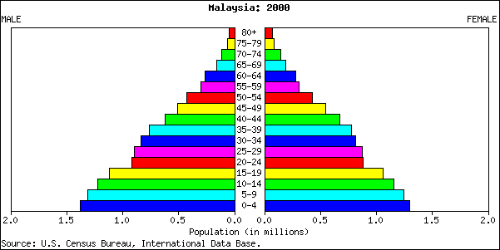

Slide 30
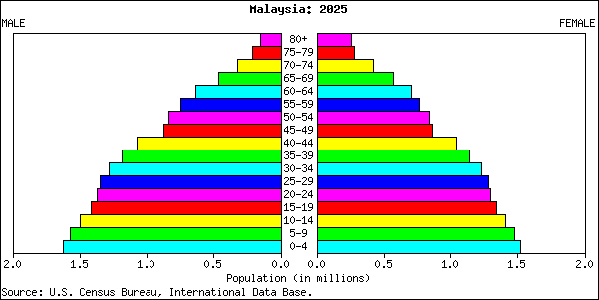

Slide 31
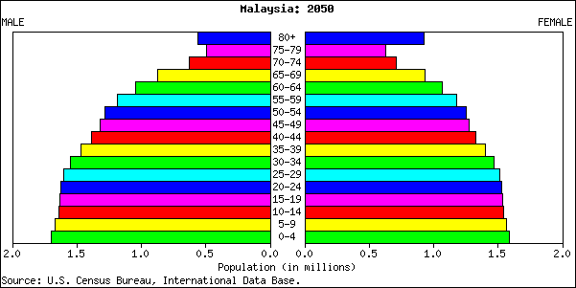

Slide 32
Measures of age- sex structure
Population pyramid
Median –half above and half below
Mean -sum of ages divided by population
Dependency ratio
Sex ratio

Slide 33
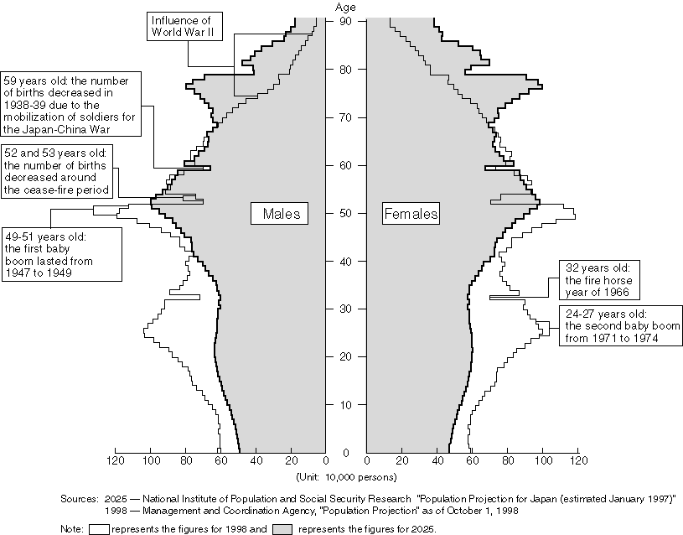

Slide 34
Dependency ratio

Slide 35
Dependency ratio
Total dependency ratio refers to the ratio of number of dependents (population 0-14 and population aged 65 and over) to the total population aged 15-64. The total dependency ratio is calculated as follows
Pop aged 0-14 + pop aged >65 x 100
Pop aged 15-64

Slide 36
Aged dependency ratio
The aged dependency ratio refers to the ratio of the number of the aged population (pop aged 65 and over) to the total population aged 15-64
The aged dependency ratio is calculated as follows
Pop aged >65 x100
Pop aged 15-64

Slide 37
Child dependency ratio
The child dependency ratio refers to the ratio of the number of the children population (pop aged 0-14) to the total population aged 15-64
The aged dependency ratio is calculated as follows
Pop aged 0-14 x100
Pop aged 15-64

Slide 38
Factors that affect disease patterns

Slide 39
FACTORS THAT INFLUENCE DISEASES PATTERNS
Demographic transition
Epidemiologic transition
Changing risks pattern
Epidemiological polarization

Slide 40
DEMOGRAPHIC TRANSITION
Demographic Transition Theory
Population’s fertility and mortality will both decline from high to low level as a result of economic and social development
Decline in mortality usually precedes the decline in fertility, resulting in high population growth during the transition period

Slide 41
DEMOGRAPHIC TRANSITION
Education
Income
Public health
Urbanization
Industrialization
Mortality decline
Fertility decline

Slide 42
Demographic transition developed world
40
Birth rate
30
Pop
per
1000
Transition phase
20
Death rate
13-16
10
75-150 years
8-9
1850
1950
1988

Slide 43
Demographic transition developed world
Decline in death rates occurred over long period of time (150 years)
Birth rate decline followed closely by mortality
Growth rates were generally low
Base population small and land and resources plentiful
Majority of the countries have completed demographic transition

Slide 44
Demographic transition developing world
Birth rate
40
28-44
Per 1000
Pop.
30
Death rate
20
8-15
10
15-25 years
1945
1970
1988

Slide 45
Demographic transition-developing countries
Decline in death rates occurred in short period of time
Birth rate decline followed slowly (not matching) by fall in mortality
Growth rates were generally high
Base population generally large and land resources limited
Majority of the countries are in transition phase

Slide 46

1.Pre industrial stage
2 Transition stage
3 Industrial stage
4. Post industrial stage

Slide 47
EPIDEMIOLOGIC TRANSITION and HEALTH TRANSITION
Changes in population,
age, structure
Chronic and
degenerative
Disease emerge
Fertility
decline

Slide 48
CHANGING PATTERNS OF RISK
Risk of developing certain diseases – higher
  STDs
  AIDs
  Obesity
Industrial accidents
Substance abuse
Diet
Lifestyle

Slide 49
Thank you……

